Slide 1
PROCESS IMPROVEMENT & AUTOMATING MONEY EXCHANGE A. Marisa Martin May 17, 2018

Slide 2
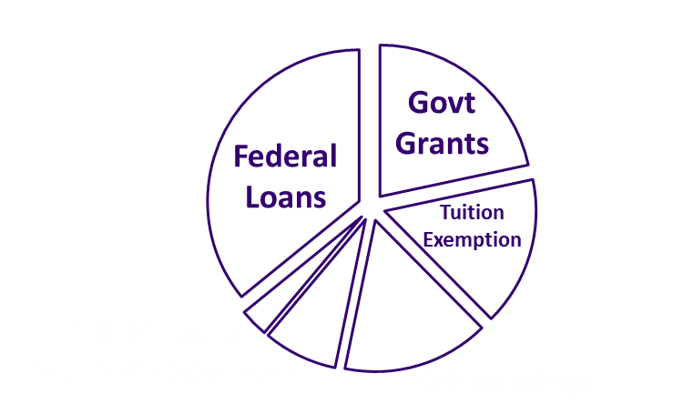
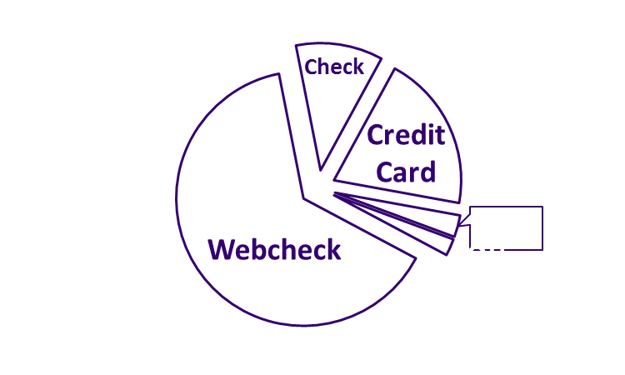
WHOM AND HOW WE SERVE
2017 Academic Year
Served over 55,000 enrolled students
Billed $984 million in tuition and fees
Processed $509 million in payments
Processed $85 million in 3rd party scholarships/sponsored students
Disbursed $835 million in financial aid and scholarships
Since 1990, our staff has been reduced by 54%. We support more than 2500 students per FTE - with 90% satisfaction with In-person services and 79% satisfaction for online services
Notes:
ACTION NEEDED TO SUSTAIN: PROCESS IMPROVEMENT AND AUTOMATION OF PROCESSES

Slide 3
AUTOMATION AND PROCESS IMPROVEMENT
Select process improvement methodology that works for your team
LEAN process improvement at UW since 2012 (everyone has the tools to improve their work)
Review each process individually
Identify time-consuming, cumbersome, or inefficient processes
(hint: ask the people doing the work)
Examine processes to pinpoint waste
Map processes to uncover opportunities to streamline or automate
Gather data – create measures, explore patterns, ask questions
Evaluate findings and research options/feasibility – can we take the steps we need to improve this process?
Seek approvals and organize a project team to institute change
Measure outcomes
Notes:
LEAN: a process improvement methodology that focuses on workplace culture as the genesis of change. The methodology utilizes tools meant to equip employees with the ability to effect change through innovation supported and empowered by an organization aligned with purposeful goals to promote growth.
LEAN improves the work by giving the tools to improve to everyone in an organization, not just a top-down process development model.

Slide 4
AUTOMATION AND PROCESS IMPROVEMENT
If you’ve done your homework they should all be successful!
Recent examples of successful improvements (LEAN) | Impact
Petty Cash Reimbursements | Eliminated process in favor of online options
Cashiering automation | Established an electronic database for cashier till management
Title IV loan process | Improved systems – reduced errors, improved file transfers from COD, improved frequency of returned fund reporting to COD
Over-award automation | Created a communication system that made process paperless
Departmental Deposit processing | Installed a self-service depository for dept. personnel – reducing SFS and UW work per deposit

Slide 5
GOALS FOR 2018

Slide 6
PAYMENT METHODS
YEAR | WEBCHECK | ONLINE (CREDIT CARD/WIRES) | TOTAL
2012 | 67.95% | 4.85% | 72.80%
2013 | 67.31% | 6.36% | 73.67%
2014 | 66.96% | 9.60% | 76.56%
2015 | 68.30% | 10.51% | 78.81%
2016 | 68.87% | 12.51% | 81.38%
2017 | 63.12% | 21.89% | 85.01%
2018 Goals | N/A | N/A | 88.00%

Slide 7
DIRECT DEPOSIT
YEAR | DIRECT DEPOSITS | PAPER CHECKS
2012 | 85.60% | 14.40%
2013 | 85.44% | 14.56%
2014 | 84.21% | 15.79%
2015 | 83.00% | 17.00%
2016 | 84.62% | 15.38%
2017 | 85.70% | 14.30%
2018 Goal | 90.00% | 10.00%

Slide 8
ADOPTION OF AUTOMATION
Goals for 2018
Increase direct deposit refunds from 85.7% to 90% by December 2018
Increase percent of online payments from 85% to 88% by December 2018
Question: how have we gotten this far – how can we move the needle?

Slide 9
HOW HAVE WE GOTTEN THIS FAR?
Outreach - More than 100 orientation sessions to students and parents each summer between two UW campuses
Point of Sale - Cashiers and line monitors encourage students to use online payment methods and answer questions
Department Cooperation - Partnered with First Year Programs at UW to include our messaging in their programs for newly-admitted students
Customer Conversations - Addressing customer inquiries by phone or email is an opportunity to promote the value of direct deposit and/or online payment
Management Support - Allow team to try out different ideas and learn from failures and successes
Notes:
More than 100 orientation sessions to students and parents each summer across two UW campuses

Slide 10
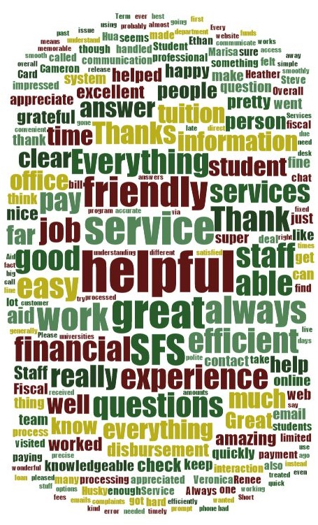
DOES THE NEEDLE NEED MOVING?
Annual customer satisfaction survey
90% satisfaction with in-person/phone services
79% satisfaction with our online services

Slide 11
CHALLENGES
Student Success
Staff Reduction
Enrollment Growth
Fraud
Returned Items

Slide 12
CHALLENGES
Student Success - MOST IMPORTANT: benefit to the students – faster, more efficient, safer disbursements and payments
Staff Reduction - (0.5 FTE (Current FTE is 21.5), Student Assistants from 5 to 3)
Enrollment Growth - 72% increase since 1990/28% since 2007
Fraud - Persistent threat
Returned Items - lost checks, long delivery times, old addresses (10.98 % canceled checks)
Notes:
The costs of all of the above

Slide 13
THE PLAN
Magic
One word:
Increase outreach – find partnerships in new places to increase number of students contacted
Registrar’s Office
Intercollegiate Athletics
Admissions
Study Abroad
UW Medical
UW Graduate School
Gates School of Law
Foster School of Business
International Student Services
Office of Minority Affairs and Diversity
UW Bothell Campus
UW Tacoma Campus

Slide 14
THE PLAN
Magic
One word:
Increase outreach – find partnerships in new places to increase number of students contacted
Expand communications – reach students in new and novel ways, improve existing messaging and reach out to groups of students we had not targeted in the past

Slide 15
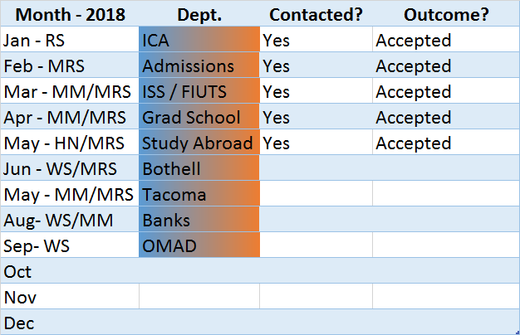
SAMPLE MEASURE
Dept. Communication -Monthly Outreach to Dept. Personnel as of 5-1-18

Slide 16
WHO IS INVOLVED?
Every staff member
Customer Service and Receivables, but also includes “behind-the-scenes” groups – Accounting, Computing
Every person is tasked with bringing ideas to the table
Every person is heard – participation in planning and execution is required
Bi-monthly meetings to create and discuss ideas across units

Slide 17
YOUR HELP, IDEA SHARING AND QUESTIONS
Let’s talk about your ideas for increasing Direct Deposit and Automated Payments
Is this an important process for your school?
Questions?

Slide 18
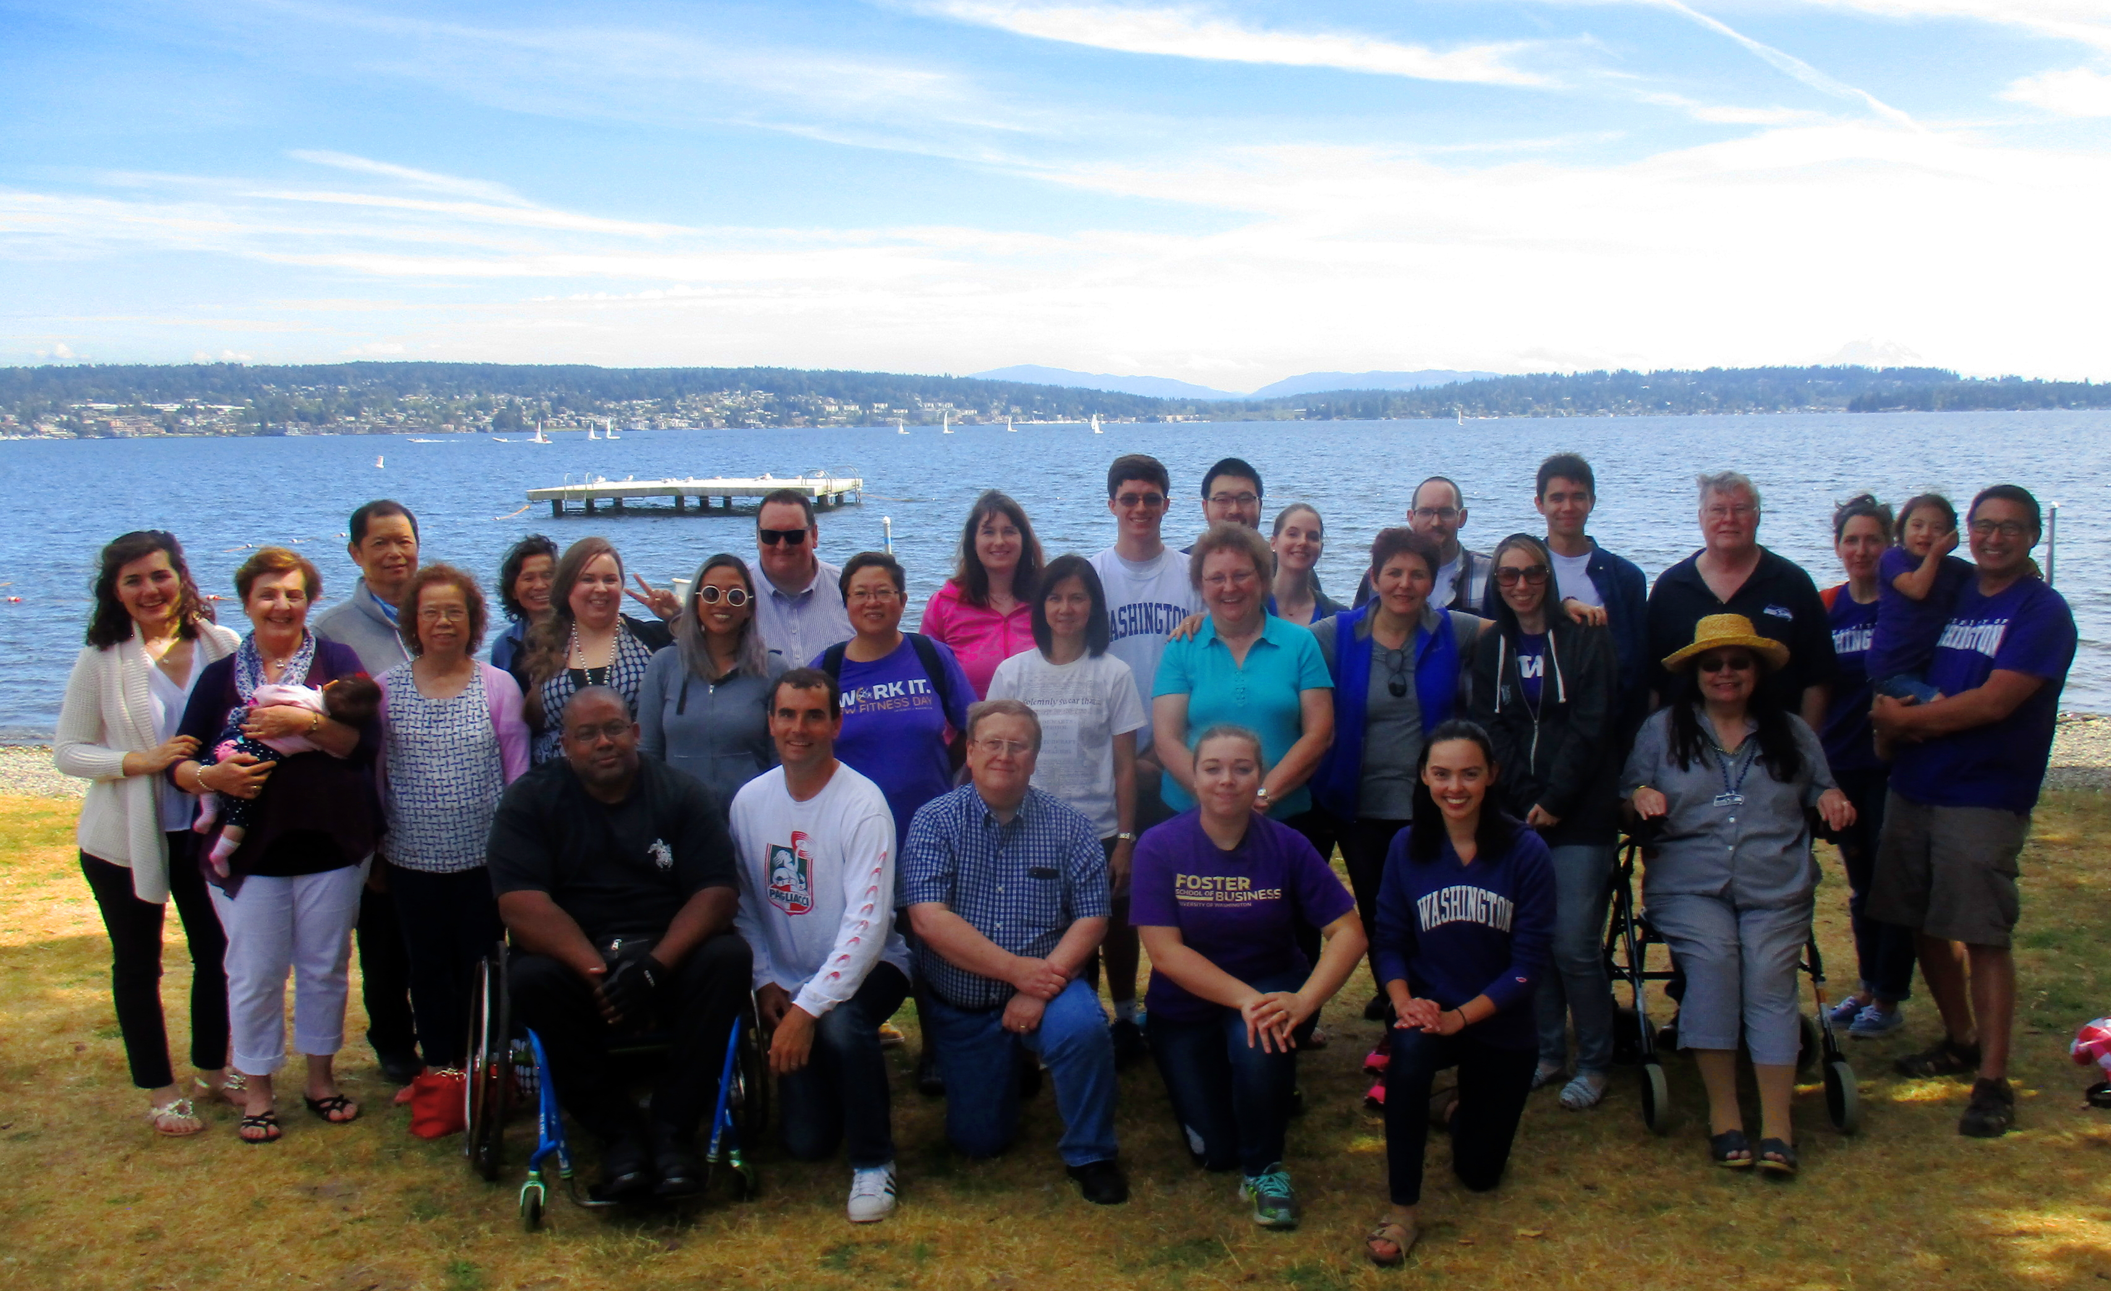
GREETINGS FROM SEATTLE!

