Slide 1
Credit Scores In Today’s Consumer World
Pattyl Aposhian MBA, CIE
Vice President Marketing and Development Caltech Employees Federal Credit Union

Slide 2
Students Know ROFL & EOD But Do They Know FICO?
Notes:
ski11z = skills
n00b = noob, newbie

Slide 3
Numbers for Thought
$834 billion in credit card debt in 2018. Compare that to $733 billion in 2015.
$96 billion in retail credit card debt.
Average balances grow at 3%.
Generation Z (our college student population) balances grew at 12%.
Notes:
No mortgage. No auto loans. No small business loans. Just plastic.

Slide 4
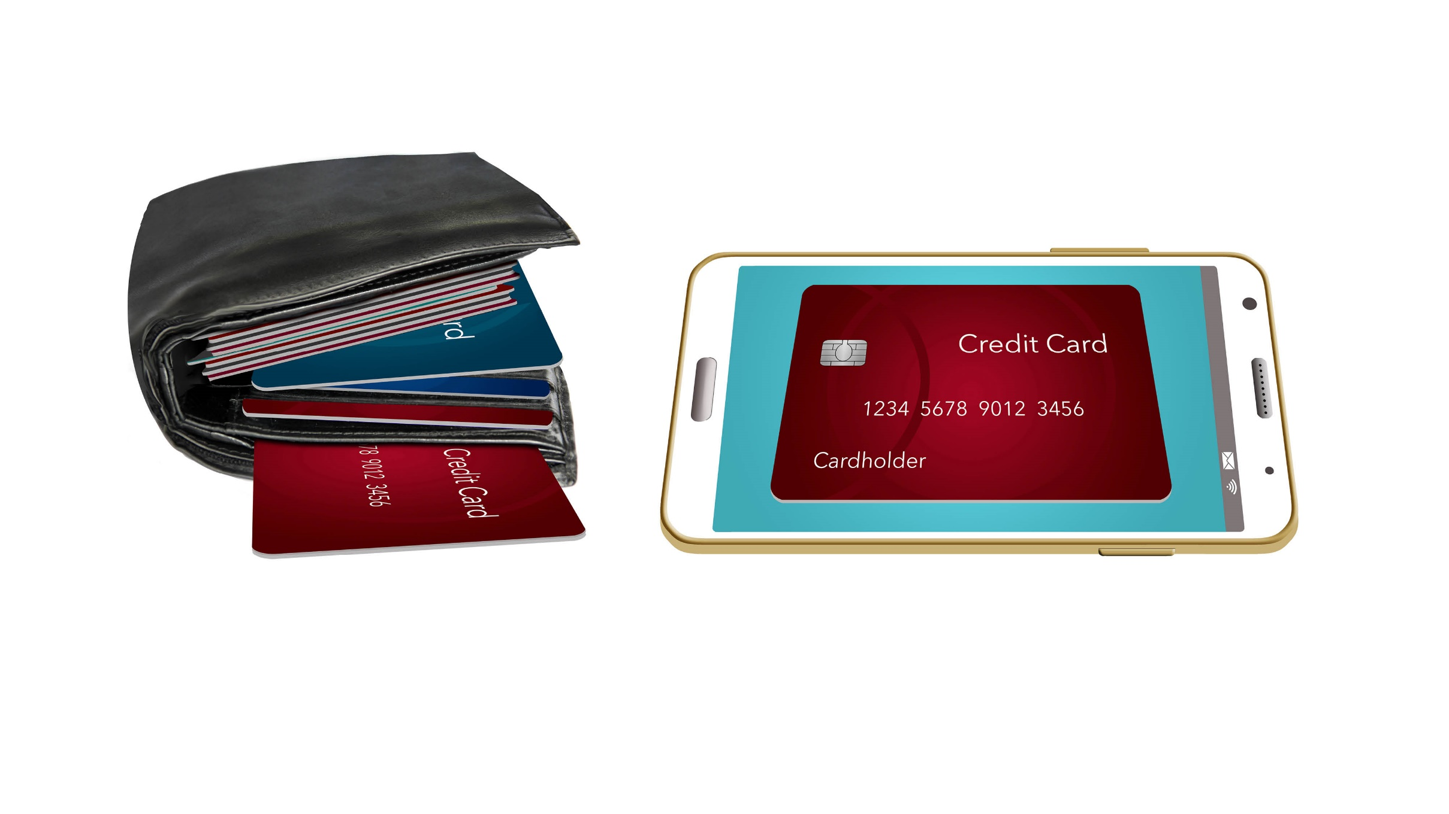
What’s In Your Wallet? Or Apple Pay?
The average credit card interest rate in the U.S. for a consumer with good credit is 15% and poor credit is 23%.

Slide 5
FICO Ranges/Scores in 2018
• Excellent Credit: 800 & above
• Good Credit: 740 – 799
• Fair Credit: 670 – 739
• Poor Credit: 580 – 669
• Bad Credit: below 580
Source: Credit Karma

Slide 6
FICO Ranges/Scores in 2014
• Excellent Credit: 750-850
• Good Credit: 700-749
• Fair Credit: 640-699
• Poor Credit: 570-639
• Bad Credit: below 570

Slide 7
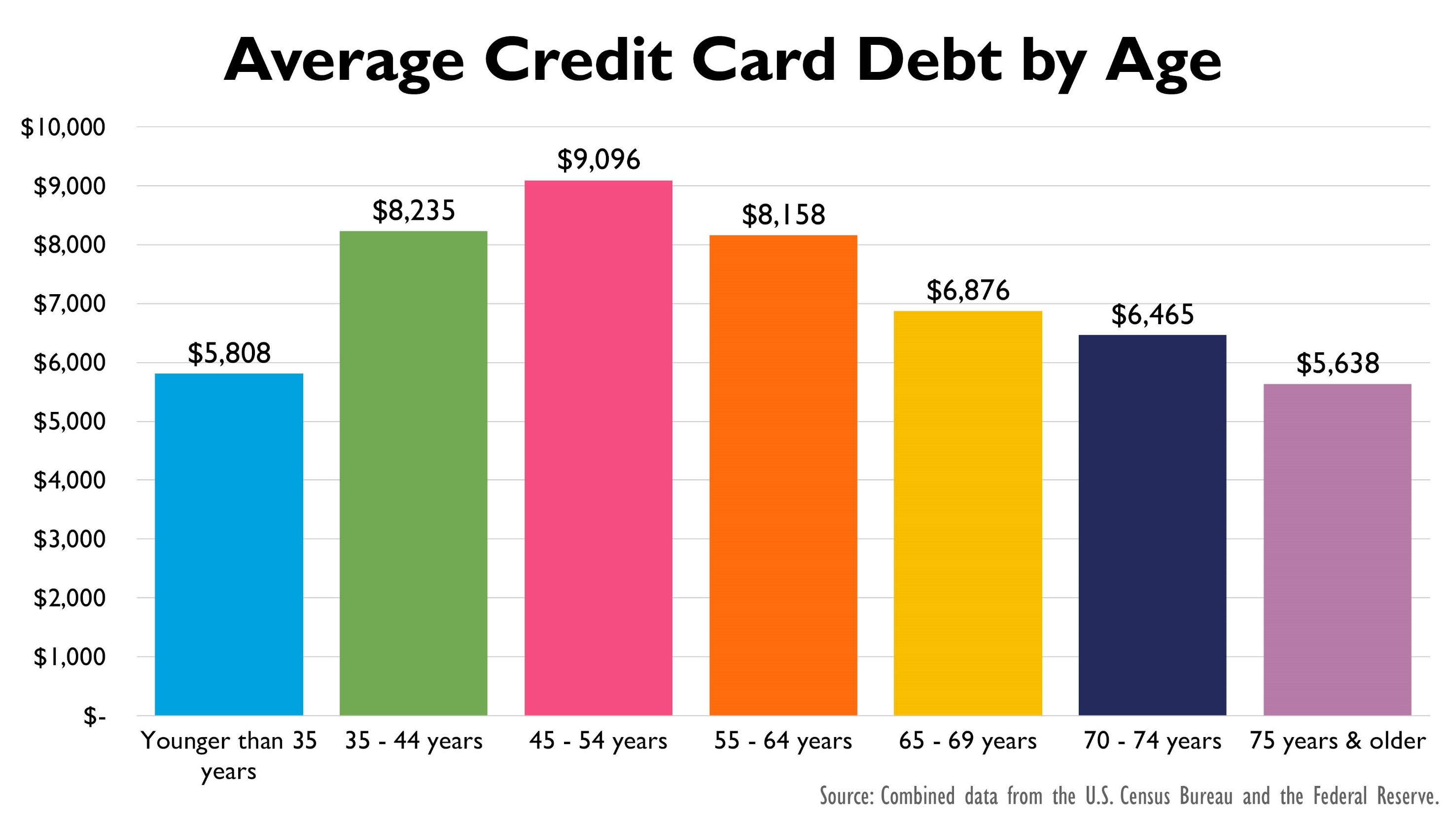

Slide 8
n00b = noob, Newbie
Who are these “n00b” spending machines?
Carrying a credit card with a double digit interest rate.
Making minimum payments on debt of appx. $8,000.
Gen Z — Average new auto payment of $530 and used auto payment of $381.
Notes:
$1.27 trillion in auto loans with year over year Gen Z average increasing by 8%

Slide 9
Credit CARD Act of 2009
Set some serious parameters for lenders
Disclosure mandates
The law restricts credit cards to anyone under the age of 21. There are two important exceptions. An adult younger than 21 can get a credit card if:
A parent or other adult co-signs on the accounts and takes responsibility for paying the bills.
If the young adult can show proof of income or other means of repaying the card loans.

Slide 10
Stay Far Away From Students
Bans card issuers from offering pizza, t-shirts, hats and other freebies in exchange for signing up for a credit card on or near campus.
How close is near? Fed clarified: 1,000 feet — a distance of almost three football fields.

Slide 11
Behind the Scenes
Credit Card companies were analyzing spending patterns using MCC (Merchant Category Code) acting accordingly:
Pawnshops — 5933
Wholesale Clubs — 5300
Bail and Bail Payments — 4900
Buying used clothing or retread tires may be an indication of financial distress and a preamble to missed credit card payments or defaults.
“WHERE A PERSON SHOPS, IN MY OPINION, HAS LITTLE BEARING ON WHETHER THEY CAN PAY BACK A CREDIT CARD BALANCE.”
– U.S. Congresswoman Maxine Waters

Slide 12
It Started With Good Intentions
Marketing | Additional products/Add-on discounts. Airline ticket leads to car rental discount offers.
Fraud Detection | Unusual purchasing habits, out-of-area purchases.
Law Enforcement | Subpoena records for last known location for crime victim or suspect; Homeland Security for terrorist activity.
Risk Management | Pass credit limits or exhibit unusual spending habits may be at greater risk.
Instead, REDLINING where low income cardholders (minorities and students) were seeing decreased credit limits and increased interest rates.
Notes:
A rare glimpse into the details of behavioral modeling was revealed in a federal lawsuit filed by the Federal Trade Commission in June 2008 against subprime credit card marketer CompuCredit Corp. According to the lawsuit, CompuCredit used an undisclosed behavioral scoring model to track customer purchases. The company lowered credit limits on cardholders who shopped at certain establishments or used certain services, including pawnshops, massage parlors, tire retread shops, marriage counselors and bars and nightclubs.

Slide 13
10 Years Later…
Hindered students’ efforts to establish credit in their own names until 21.
Asking parents to co-sign or add them as authorized users — major step backward in their quest for financial independence.
Enters a new player — a non-traditional industry disruptor.
Notes:
Perk cards often have fees or higher interest rates. American Airlines card is a great example.
Fee of $350 for the executive card.
Fee of $75 for the regular card.
Executive card gets you travel privileges such as Concierge Services, Lounge and luggage but what about if you do not travel? Why pay a higher interest rate

Slide 15
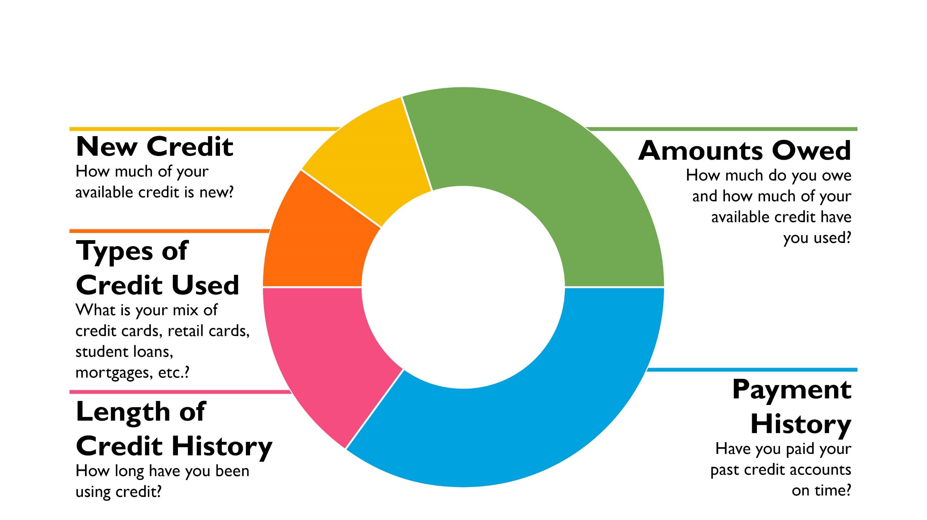
What Makes Up A FICO Score?
Notes:
The formula that determines your FICO score is a well-guarded secret. It’s but we do know that the FICO score is made up of five categories of information:
Payment history (35% of score): Do you pay your bills on time, every month?
Amounts owed (30%): How much do you owe on your credit accounts, particularly relative to your credit limits or original loan balances?
Length of credit history (15%): This considers various time-related factors, such as the age of your individual accounts, the age of your oldest account, and the average age of all of your accounts.
New credit (10%): Newly opened credit accounts, as well as your recent applications for credit, are included in this category.
Credit mix (10%): Lenders want to see that you can be responsible with different types of credit, so having several different types of accounts (credit card, mortgage, auto loan, and so on) can boost your score.
FICO scores range from 300-850, with higher scores being better, and most consumers have FICO scores in the 500-800 range.

Slide 16
850 Perfect FICO
Yes! They do exist. 1.2% of all FICO scores stand at 850.
Credit scores are constantly changing. Even those who reach 850 don’t always stay there.
Perfect FICO scores carry debt. More trade lines, credit products, multiple credit cards.
Less Debt. $3,025 debt compared to the $6,445 national average.
Income is not a factor.
Notes:
FICO- Fair Isaac Corporation- credit scoring systems for lenders and other business.
VantageScore was developed by all three credit reporting companies– Experian, Equifax and Trans Union
Yes, having more money makes it easier to pay, over 38% of perfect FICO Scores were held by people with an annual income of $75% or less.

Slide 17
Reality
Millennials (23-38) have an average FICO Score of 665 — national average is 701 and average total debt balance over $8,000.
Generation Z (18-22) increased their average total debt amount by 26% since last year. They carry an average total debt balance of over $10,000.
Student loan balances increased for both Millennials and Generation Z.

Slide 19
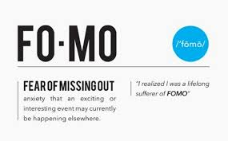
Who’s to Blame?
Notes:
We all have those friends (or random social media acquaintances) who are always jet-setting on a fabulous vacation, eating at the hottest restaurants, wearing the latest fashions and are all-around living a #blessed life.
How do they do it? Maybe they have a killer salary, maybe they're great at scoring a deal — or maybe they're going into debt.
It turns out, nearly 40% of Millennials have spent money they didn't have and gone into debt to keep up with their peers, according to a recent Credit Karma survey.
Expenses range from experiences, like travel, parties and nightlife, music and sporting events and weddings, as well as food and alcohol, clothes, electronics, jewelry and cars.
And even if they're not in serious trouble yet, 36% of respondents doubt they can keep up with their friends' spending for another year without going into debt.
So why can't they just say no? For fear of missing out, aka FOMO, aka the latest version of "keeping up with the Joneses." Not only can it be just plain hard to turn down an invite for a week-long island getaway with all your friends (especially when winter just won't let go), but people are also worried about how their friends will view them if they don't participate.

Slide 21
Welcome to the World of Frictionless Payments
Uber
Disney MagicBands
Starbucks Mobile Order
Amazon Go convenience stores
One-click ordering (eBay, Amazon, Nordstrom, Best Buy)
In-App purchases
Notes:
More convenience
Less time
Less cognitive strain
More flexibility
Fewer abandoned carts
Increased check out efficiency
Repeat purchases

Slide 22
21…21…21…Can’t Drink — But Can They Have Credit?
Option 1: With a job, even a part time job, apply for a low-limit credit card. Spend with it occasionally. Never carry a balance. Pay on time.
Option 2: Apply for a secured credit card. Require a deposit or link to a savings account that’s usually equal to your credit limit. Same rules as above apply.
Option 3: Become a co-signer. Open an account as a joint owner. Both are responsible to repay the balance. Activity is reported to credit bureaus to help build credit history.
Option 4: Become an authorized user. Authorized user can make purchases with the card, but they are not on the hook for payments. Still reported, but FICO credit scoring model gives less weight to authorized user activity because they are not ultimately responsible for paying.

Slide 23
Credit Card Musts
Pay bills on time. Every account should be set on AutoPay — even if it’s the minimum balance.
Do not spend close to your credit limit every month.
Change Spending Habits. Deactivate Instagram for a few months, stick to a lean budget, review monthly payments.
Apply for a 2nd or 3rd credit card only when you need it. Match your lifestyle to your credit card.
Notes:
Americans with graduate degrees carry 61% more total debt than the national average. Their credit scores, however, don’t appear to be suffering as a result of their high balances.
Consumers with graduate degrees have an average FICO Score of 741– which is 40 points higher than the national average of 667.
Consumers with graduate degrees and student loan debt have a score that’s 63 points higher than the national average.
*Experian Consumer Credit date from 4th Quarter 2018
What do this mean?
Having debt does not reduce your score. Having student loan payments does not reduce your score.
Credit scoring algorisms calculate all of the above into the scoring structure.

Slide 24
Match Your Card to Your Lifestyle
TYPE OF CARD | COST | INCENTIVES
REWARD CARD (American Airlines, 76 Gasoline, Marriott) | Medium-High | Perks in the form of rewards and points
CASH BACK CARD (Bank or Retailer) | Medium-High | Percent of spent $$$ back in the form of cash credit
STORE CARD (Target, Macys, GAP) | High | One time discount, email marketing with additional discounts
BANK CARD (CEFCU) | Low | No incentive
Notes:
These cards come with high interest rates or an annual fee, which can negate your rewards if you typically carry a balance.
If you pay off your balance — Get the points, don’t worry about the rate
Are you using your perks? Added perks you may not use or need. (Concierge service, travel insurance)
Is there a fee? Black out dates? Expiration?
10% day-of incentives
The credit card often has a high interest rate
The credit card often has a very tiny minimum payment.
In general, in-store credit cards are not worth the risk.

Slide 25
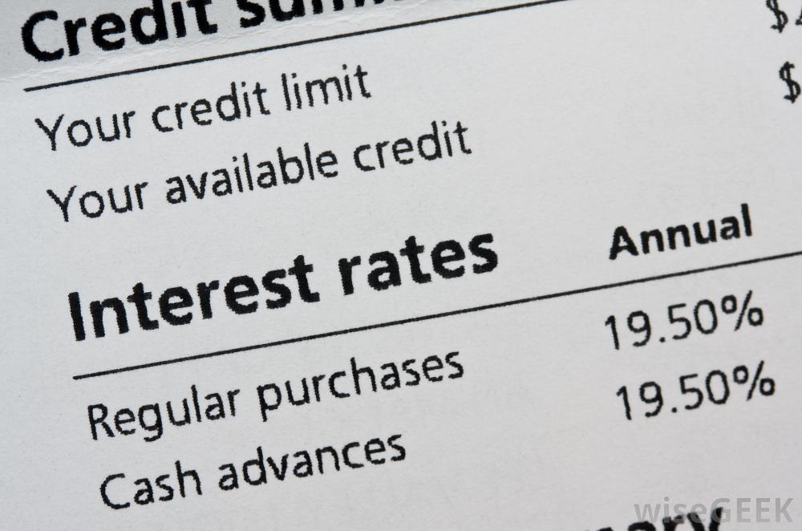
APR (Annual Percentage Rate)
You may have several different finance rates on one card — one for balance transfers, one for cash advances, etc.
The lower the rate, the less the cardholder will pay in interest.
Credit card companies can change the APR, even if the rate is “fixed,” which is one reason to check your statement monthly. Look for change-in-terms notices.
Beware of penalty rates.
Notes:
Banks only have to provide a 15-day heads-up before they apply a rate increase, and that's only if the borrower didn't trigger the penalty rate.

Slide 26
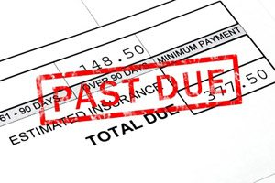
Late Payments
Although it may be fewer than 30 days late, a late payment on a credit card can be reported as late to the credit bureaus and impact your credit score.
Late payment fees range from $20.00 to $45.00 and up.
Late payments can also impact your interest rate in the form of a penalty fee.

Slide 27
Put Down the Credit Card Application!
Missing payments or carrying too much debt can hurt your credit score. But did you know that it’s a mistake to fill out too many credit card applications?
There are 2 kinds of inquiries: hard and soft.
Soft inquiry: NO adverse effect on your credit score.
Hard inquiries: Result of actions YOU take.
Notes:
Every time your credit is reviewed, whether by a bank, credit card company or an employer, it is marked on your credit report as an "inquiry." Too many inquiries can affect your credit score.
If you fill out a credit card application or apply for a car loan or home equity loan, an inquiry is recorded. A hard inquiry can make up as much as 10% of your credit score. Even if you've never missed a payment in your life and keep your debt low, a long list of hard inquiries can be enough to ruin even a great score.

Slide 28
Best Practices
Stick to 2 to 3 cards (VISA, Mastercard, American Express, Discover).
If you carry a balance, keep it under 30% of the available balance.
Monitor your statements for unusual activity and accuracy.
Pay on time.
Never be afraid to ask.
Pull your credit annually.
BEWARE OF SCAMS. HIGHLY SOPHISTICATED. NO RECOURSE.

Slide 29
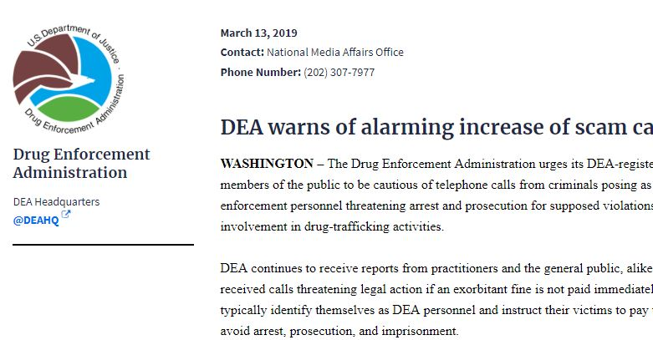
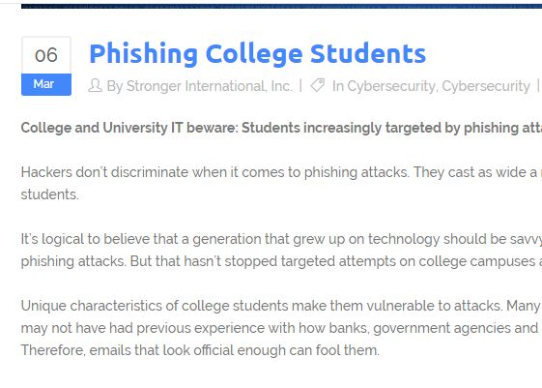

Slide 30
AS IF SCAMMING THE MOST VULNERABLE WASN’T BAD ENOUGH…

Slide 31
The Rise of FinTech
Financial tech companies have emerged in recent years and adapted online lending, banking, payment processing and credit.
FinTech providers are working with several types of credit channels to help make lending “easier” for consumers.
Using alternative data reports.
Relative to the numbers, millennials open more loans with FinTechs than any other age group.

Slide 33
What’s Alternative Data?
80% of lenders rely on a credit report (FICO, Vantage Score) to make a credit decision.
20% use alternative credit data to further evaluate a consumer for a more rounded view of their credit and payment history.
This is in the form of cell phone bills, rent and utility payment history and short term loans.
As well, other trending data and attributes such as social media.

Slide 34
The Good, The Bad, The Ugly
The Good: For many, a history of rent and utility payments is great. It helps build the entire picture for someone who does not have too much credit history. 2019 Launch–Experian Boost helps consumers with limited credit build their profile to include rent, mobile phone history, etc.
The Bad: Trending also incorporates what we include with social media. Photos of back to back weekends at Coachella coupled with hundreds of photos of extra curricular activities.
The Ugly: Peer-to-Peer lending with no rules, no regulations, no boundaries.

Slide 35
Peer-to-Peer Lending
Upstart
Uses alternative data such as education, employment history and whether applicants know their own credit score to underwrite and price loans.
After five years of training its algorithms, it now approves 47% of loans without human intervention and with some of the lowest default rates in the industry.

Slide 36
Affirm
Makes instant 3, 6 and 12 month loans for purchases from 1,500 online merchants.
A handful of sellers subsidize 0% rates, but most loans carry annual interest rates of 10% to 30%.
More than 1 million loans issued. Partners include Wayfair and Expedia.
Notes:
Affirm says its machine learning technology allows it to lend to consumers who might not qualify for credit cards and that repayment helps them build credit histories.
Cofounder & CEO: Max Levchin, 42, a cofounder of PayPal and former chairman of Yelp

Slide 37
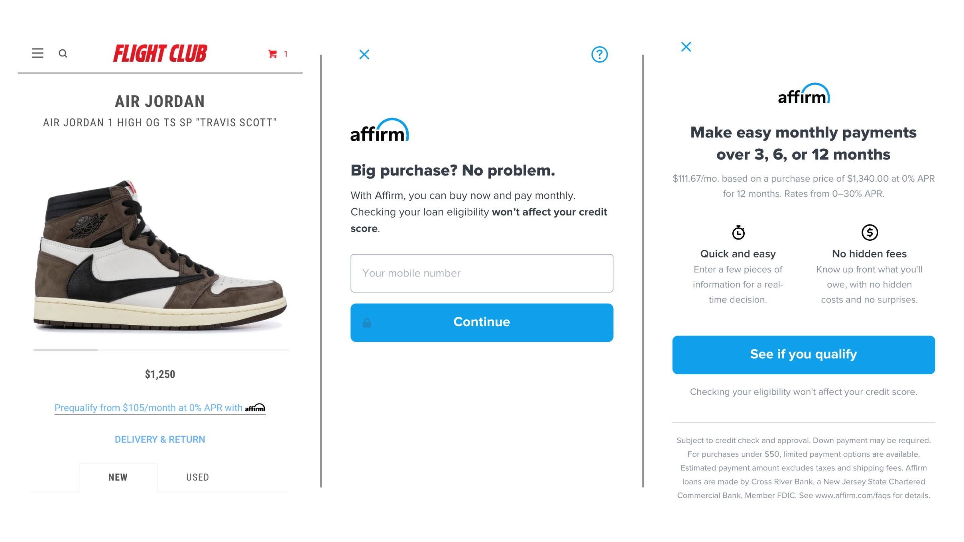
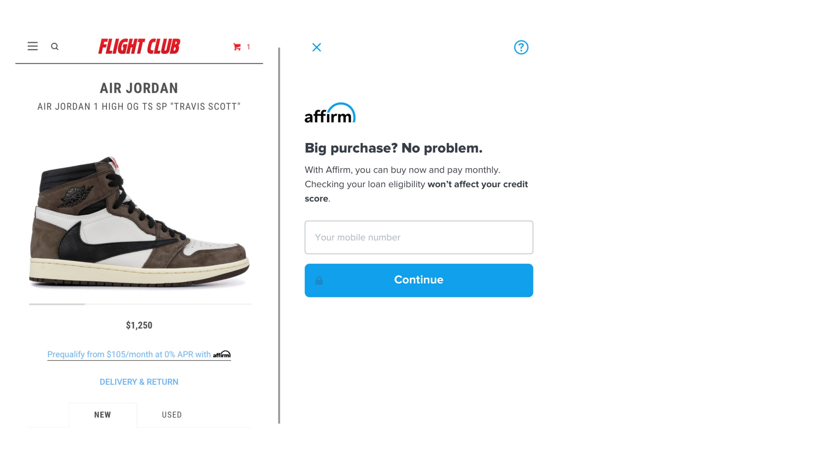

Slide 38
Kabbage
Lending platform offers nearly instantaneous small business loans. Uses creative alternative data to underwrite loans — such as the number of UPS packages a business sends and receives over time.
Over $4 billion in originations to 130,000 small businesses.

Slide 39
Pattyl Aposhian MBA, CIE
Vice President Marketing and Development Caltech Employees Federal Credit Union
paposhian@cefcu.org

