Slide 1
Payment Security PCI DSS v4.0 How Does It Impact Campuses?
David Neild
Lead Security Consultant, Education, UK
PCI QSA, ISO27001 LI, IA

Slide 2
About Me
Consultancy Team, Education, UK
Primary contact QSA Company
PCI Qualified Security Assessor
20 years' experience in the education sector
University of Leeds, UK
Background in Information Security, Cyber Security and Payment Security
David Neild
Lead Security Consultant

Slide 3
Agenda
About Flywire
What is Payment Card Fraud?
What is PCI DSS?
Where and why does PCI DSS apply?
What is new to PCI DSS v4.0?
What are the challenges?
What are the opportunities?
Key takeaways

Slide 4
About Flywire

Slide 5
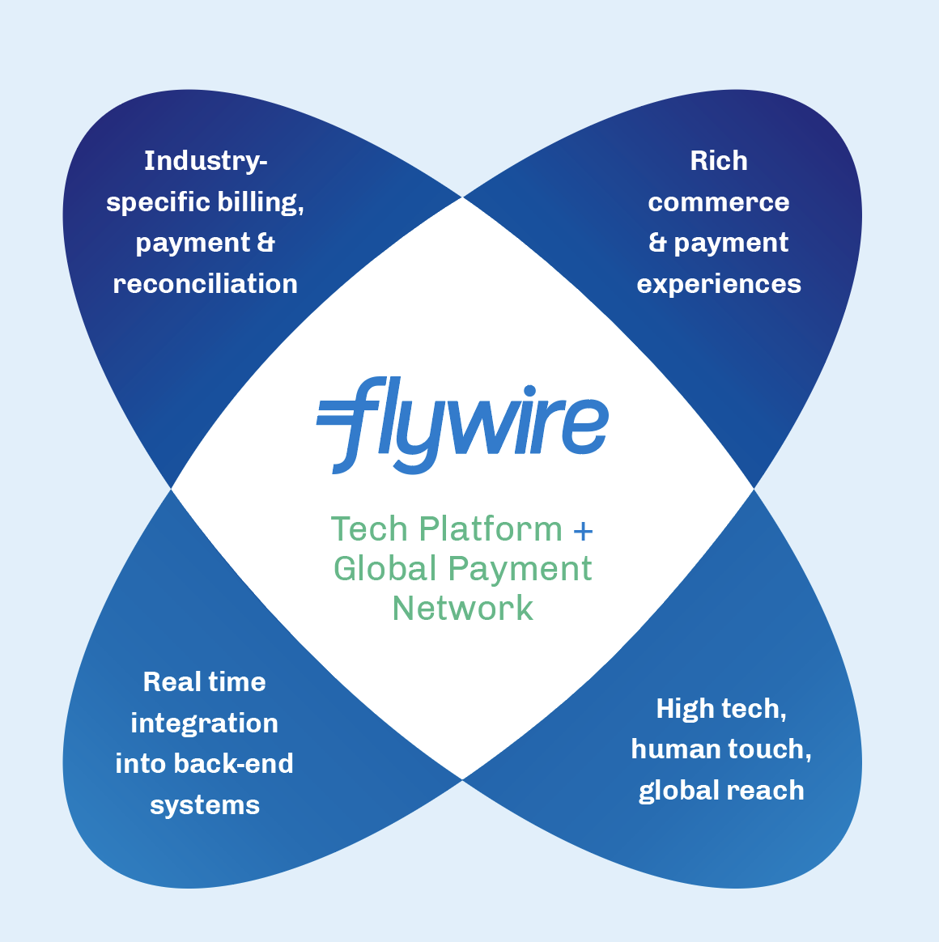
Software drives value
in payments
Next Gen Platform + Global Payment Network
Notes:
Our Software drives values in payments Our mission is to deliver the most important and complex payments
Where we help our clients get paid… …and their customers pay with ease from anywhere in the world

Slide 6
$18.1B
Total Payment Volume FY 2023
1,200+
Global Flymates
3,800+
Clients Worldwide
12
Global Offices
240+
Countries & Territories
10+
Years to Build Payment Network
140+
Currencies Supported
20,000+
Education Agents in Network
As of Feb 29, 2024

Slide 7
Flywire’s industry leadership on display
David King, CTO of Flywire is appointed to 2023-2025 PCI Security Standards Council Board of Advisors!
The Board of Advisors is committed to helping organisations better secure their payments data globally
Flywire joins industry titans like Bank of America, Apple, JP Morgan Chase, HDFC Bank and dozens more
Flywire has a stronger voice, insight and influence on one of the most important standards governing secure payment processing
David King
Chief Technology Officer

Slide 8
What is Payment Card Fraud?
\

Slide 9
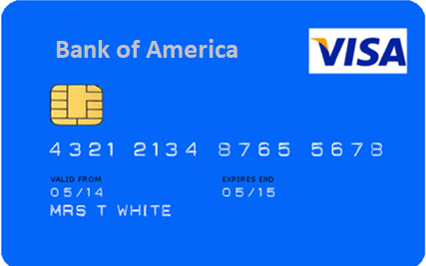
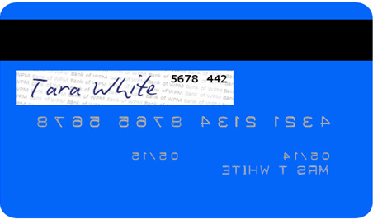
What is Payment Card Fraud?
Scammers want Account Data
Cardholder Data
Sensitive Authentication Data

Slide 10
What is Payment Card Fraud?
1
Data Breaches
2
Fraud
Over 1.06 billion credit cards are used in the US
Over 2.8 billion worldwide
E-commerce: > 85% payment card breaches
Accommodation and food services: 41% attacks targeted payment card data
2021: Costco, device skimming
2018: British Airways, e-commerce, 400k customers
2013: Target, e-commerce 40 million customers
Stolen data worth $10 to $100 per payment card
2024: $35.8 billion global card fraud forecast
62% of businesses say reducing payment fraud is an urgent concern
34% merchants experience charge back fraud
42% of all e-commerce fraud is in the US
44% of credit card users reported having two or more fraudulent charges in 2022
Notes:
Global Payments 2024 Commerce and Payment Trends Report
Verizon DBIR2023 Data Breach Investigations Report
https://dataprot.net/statistics/credit-card-fraud-statistics/
https://www.merchantsavvy.co.uk/payment-fraud-statistics/

Slide 11
What is PCI DSS?

Slide 12
What is PCI DSS?
Payment Card Industry Data Security Standard (PCI DSS)
“A standard designed with the aim of protecting the customer’s credit card data when it’s stored, processed, or transmitted.”
Global Standard
Applies to any entity anywhere in the world that accepts card payments
Minimum Requirements
A baseline of technical and operational requirements for protecting cardholder data
Up to 232 individual requirements

Slide 13
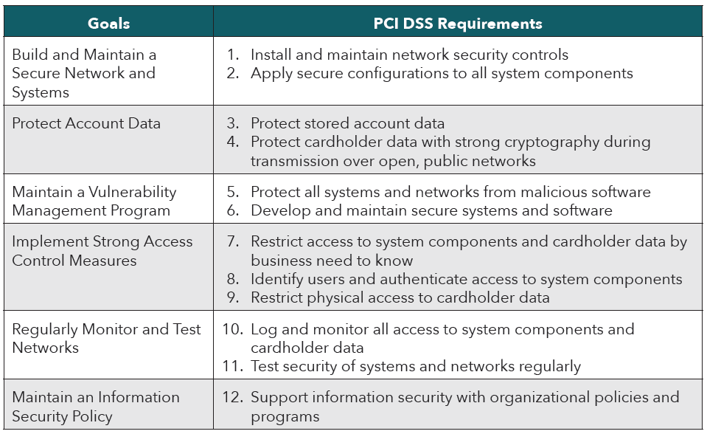
The 12 Principle Requirements

Slide 14
PCI DSS v4.0 Timeline
Official Release: PCI DSS v4.0 with validation documents
ISA/QSA training and supporting documents
31 March 2024
PCI DSS v3.2.1 retired
v4.0 active
31 March 2025
Future-dated new requirements become effective
Q1 | Q2 | Q3 | Q4
Q1 | Q2 | Q3 | Q4
Q1 | Q2 | Q3 | Q4
Q1 | Q2
2022
2023
2024
2025
Transition period from PCI DSS v3.2.1 to v4.0
Transition period from PCI DSS v3.2.1 to v4.0
Implementation of future-dated new requirements
Notes:
First version 2005.

Slide 15
Where and why does PCI DSS apply?

Slide 16
Where and why does PCI DSS apply?
1
Where?
2
Why?
Any location a merchant accepts card payments
Tuition
Accommodation
Catering
Commercial
Donations
Payment Brands
Acquiring Banks
Your school is the “merchant”
Contractual agreement
Some states have incorporated PCI DSS into law

Slide 17
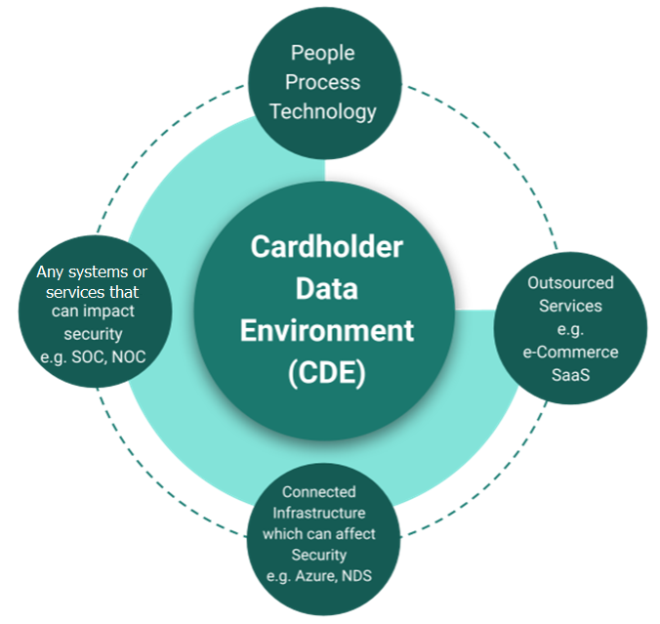
Scope
Annual requirement
Includes People, processes, technology
Wherever cardholder data stored, processed, or transmitted
Campus IT systems can be scope
Lack of network isolation
Physical devices
3rd parties
Telephone payments
Cardholder data on paper

Slide 18
Validation of requirements
Level | Merchant criteria | Validation Requirements
1 | 6M + transactions | Annual Report on Compliance by a Qualified Security Assessor (QSA)
2 | 1M to 6M transactions | Annual Self-Assessment Questionnaire (SAQ)
3 | 20k to 1M transactions | Annual Self-Assessment Questionnaire (SAQ)
4 | Less than 2k transactions | Annual Self-Assessment Questionnaire (SAQ) Compliance validation requirements set by acquirer
Confirm with your acquiring Bank

Slide 19
What is new to PCI DSS v4.0?

Slide 20
Goals for PCI DSS v4.0
Continue to meet the security needs of the payments industry
Promote security as a continuous process
Increase flexibility for different methodologies
Enhance validation methods and procedures
https://docs-prv.pcisecuritystandards.org/PCI%20DSS/Supporting%20Document/PCI-DSS-v4-0-At-A-Glance.pdf

Slide 21
PCI DSS v4.0 Requirements
The twelve principal requirements remain “the same”
1
2
Numbering of individual requirements has changed
Existing requirements have been updated, clarified, moved or removed
3
64 new or evolving requirements
53 merchants
11 service providers only
4
13 new requirements effective immediately
5
51 new requirements effective 31/03/2025 (“”future dated”)
6
Notes:
Change these

Slide 22
What is new to PCI DSS v4.0?
Third-Party Service Providers
Encrypt Removable
Electronic Media
E-commerce
Increased passwords complexity
Automated Log Reviews
User Account Reviews
Targeted Risk Analysis
Annual Scoping
#
Multi Factor Authentication
for all CDE access
Encryption
Phishing
Protection
Accountability & responsibility
CISO
Application and Systems Accounts
Anti-malware

Slide 23
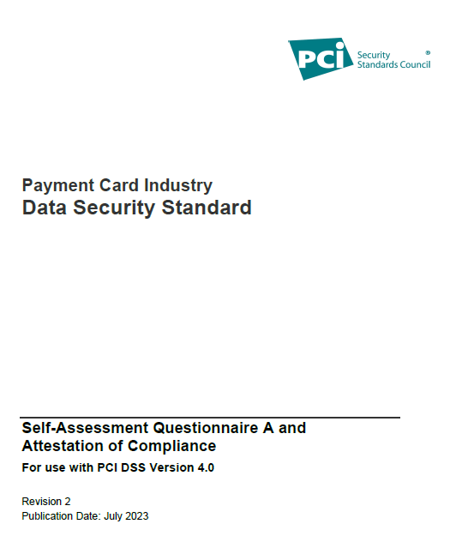
What is new to PCI DSS v4.0?
E-commerce (Self-Assessment Questionnaire A)
6.3.1 Security vulnerabilities are identified and managed
6.4.3 All payment page scripts that are loaded and executed in the consumer’s browser are managed (FD)
11.3.2 External Approved Scanning Vendors (ASV) vulnerability scans are performed
11.6.1 A change- and tamper-detection mechanism is deployed (FD)

Slide 24
What is new to PCI DSS v4.0?
People and process
x.1.1 Roles and responsibilities for performing activities in requirement X documented, assigned, and understood
12.1.4 Responsibility for information security is formally assigned to a Chief Information Security Officer or other information security knowledgeable member of executive management
12.3.1 Perform a targeted risk analysis for any PCI DSS requirement that provides flexibility for how frequently it is performed (FD)
12.3.4 Hardware and software technologies are reviewed at least once every 12 months (FD)
12.5.2 PCI DSS scope is documented and confirmed at least once every 12 months
12.10.7 Incident response procedures are in place and initiated upon detection of PAN (FD)

Slide 25
What is new to PCI DSS v4.0?
People (Training)
12.6.2 security awareness program is reviewed at least once every 12 months (FD)
12.6.3.1 Security awareness training includes awareness of threats that could impact the security of the CDE, to include phishing and related attacks and social engineering (FD)
12.6.3.2 Security awareness training includes awareness about acceptable use of end-user technologies. (FD)

Slide 26
What are the challenges?

Slide 27
What are the challenges?
Leadership support and responsibility
1
2
Building a Payment Security team
Ensuing accurate scoping of environment
3
4
Procurement of new payment channels
Security as a continuous process
5
Ensure compliance is a state and not a point in time
6
Notes:
Change these

Slide 28
Scope - Getting the Balance Right
Complexity
Large scope
De-centralised governance and procurement
Electronic storage of account
Campus IT systems in scope
E-commerce applications on campus
Many third-parties
Legacy payment applications
Inefficient payment channels
Implement more PCI requirements
Increased compliance activity
Increased resource required
Simplicity
Simplified scope
Centralised Governance and procurement
No electronic storage of account
Campus IT systems not in scope
E-commerce applications in the cloud
Consolidated third-parties
Use of secure technologies (P2PE)
Standardised payment channels
Implement fewer PCI requirements
Reduced compliance activity
Reduction in resource required

Slide 29
What are the opportunities?

Slide 30
What are the opportunities?
1
De-scoping
2
Payment Security
Do not store account data digitally or on paper
Ensure all e-commerce is fully outsourced to compliant 3rd parties
Ensure all physical devices are P2PE accredited
Ensure all telephone payments are via compliant solution
Ensure any payment channels on the campus network are isolated
Outsource payment functions to compliant 3rd parties
Use a management system
Align with other standards (ISO27001, NIST)
Understand processing with all third-parties
Ensure all third-parties demonstrate compliance
Continual improvement
Align with institutional drivers and digital transformation
Align with mature Information Security Programme

Slide 31
What are the opportunities?
Payment Security is a business opportunity
Changes to payment acceptance can
improve security
Demonstrable compliance PCI DSS
Reduce your scope to mitigate risk
Maintain reputation and credibility
Transform, improve and embed business processes
Reduce the risk of a data breach and fines
Ensure consistency in payment acceptance across the institution
Reduce the risk of operational downtime
Improve customer and stakeholder confidence

Slide 32
Key takeaways

Slide 33
Key Takeaways
Payment Card Fraud affects us all
1
PCI DSS v4.0 is here!
2
PCI DSS is a contractual obligation
3
Descoping will help achieve compliance
4
Use PCI DSS compliant third-parties
5
We are here to help, contact your relationship manager
6

Slide 34
Thank you Resources and blog: https://www.flywire.com/resources David Neild Lead Security Consultant, Education, UK david.neild@flywire.com https://www.linkedin.com/in/dave-neild-6bb5563/

