Slide 1
Smart Orientations - How To Manage and Grow Your Financial Literacy Programs
Marisa Martin – Associate Director of Student Fiscal Services – University of Washington
Jared Church – Associate Director of the Student Financial Solutions at UCSD

Slide 2
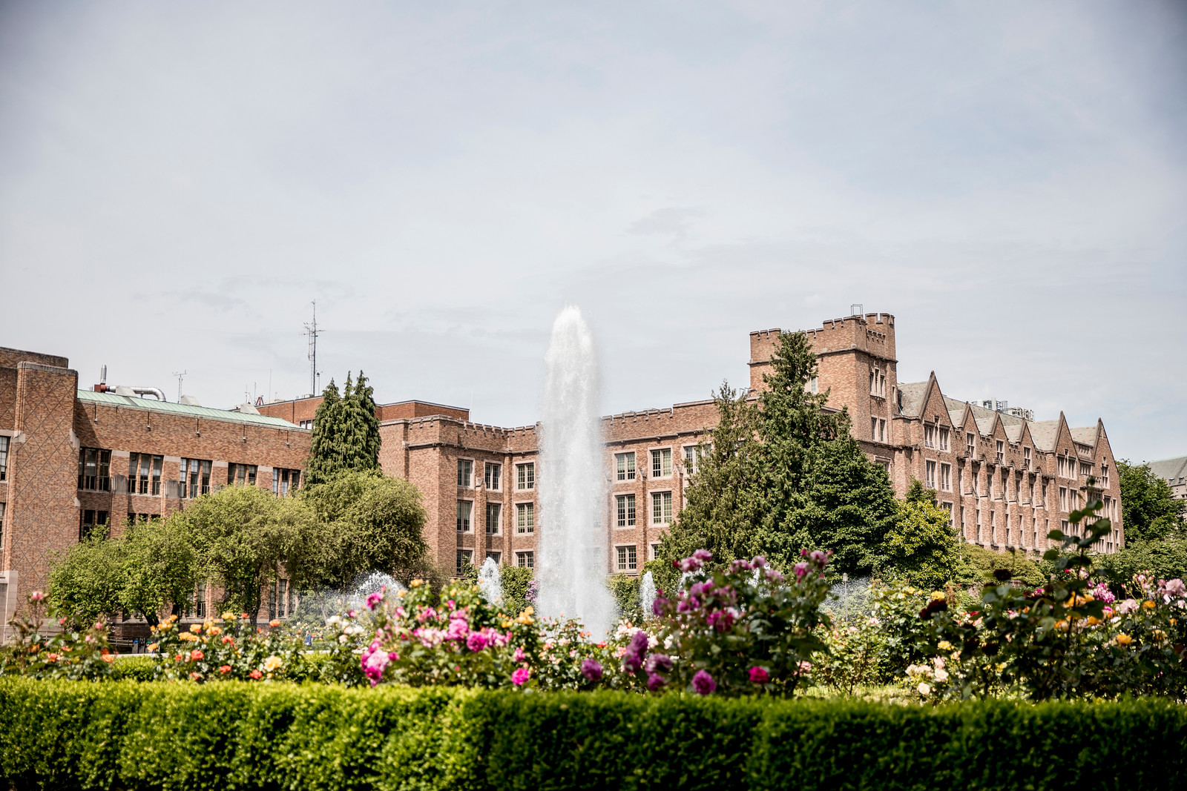

Slide 3
Learning Objectives
Set The Plan in Motion
Identify if there is a need to improve your Financial Literacy Program
Culture of process improvement – How does it help?
Includes all team members
Collaborates with internal and external customers
Creating and growing a Financial Literacy Program
What actions did we take
What were our results
What we Learned
What next??

Slide 4
Creating and growing a Financial Literacy Program
Financial Literacy was identified as one area where UW Student Fiscal Services could improve. Why? We needed to meet the demands of a growing student population and a decrease in staffing. We also knew that by talking to students and parents we could communicate tips and steps to take to make their financial road easier to travel through adopting automation and understanding our processes

Slide 5
How does process improvement help?
We used LEAN methodology to evaluate the process from beginning to end:
Examined the current orientations to pinpoint wasted opportunities
Gathered ideas from the team, business partners, outside vendors and our customers
Gathered data – created measures, explored patterns, asked questions, identified unique and engaging delivery methods
Evaluated findings and researched options/feasibility – could we take the steps we need to improve this process?

Slide 6
A Culture that encourages all Team Members to contribute
Work as a team to identify common goals for the department and designate team member roles
Set expectations – at UW Student Fiscal Services it is to come up with two ideas per person
Be open and evaluate any idea presented, be positive and encouraging
Have a strong reward and recognition goal based system that is fun and gives the team exciting incentives when goals are met

Slide 7
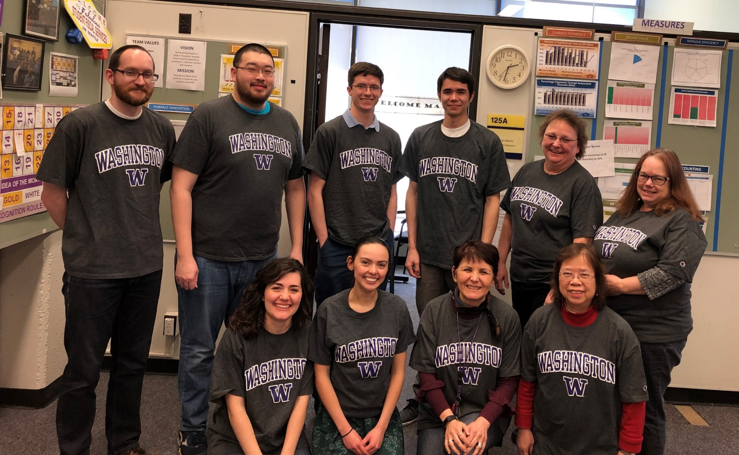

Slide 8
Collaborates with internal and external customers
Include business partners (internal and external customers) – asked for their feedback and ideas
How can they help you attain the goals, while finding value to their business?
Remember that all collaboration should add value, not only in processes, but also in creating and developing relationships

Slide 9
What actions did we take?
We approached our First Year Programs team to identify any presentations we could add to our speaking engagements. A gap was identified in lack of financial training for transfer students and the need to grow the number of freshman presentations
We reached out to various business partners, including the Minority Affairs Dept., Graduate School, Study Abroad, Admissions, International Student Services, Foster School of Business, to determine if there were opportunities for our department to provide financial literacy training to students that they served
We worked with First Year Programs and an external business partner, FIUTS, to identify if there was value on adding more orientations for international students/parents, and also orientations in diverse languages

Slide 10
More Actions….
The meetings with all our business partners resulted in the re-writing of many of our presentations to better fit what students needed to know
We added online orientations for students who could not attend in person
We added Cantonese/Mandarin orientations to assist the incoming Chinese students with better understanding of finances and banking in the United States
From feedback from students that attended orientation, we reconfigured and expanded the presenting team such that our student workers presented to incoming freshmen and the more seasoned staff presented to parents and transfer students. We also changed our presentations to have more pizzazz!

Slide 11
Results – reflection of the culture
Outreach - More than 120 orientation sessions to students and parents each year between two UW campuses. Added online, Chinese language, and transfer student presentations.
Department Cooperation - Partnered with First Year Programs at UW to include our messaging in their programs for newly-admitted students
Customer Conversations – View customer interactions as an opportunity to promote financial literacy
Example: share the value of direct deposit and/or online payment
Management Support - Allow team to try out different ideas and learn from failures and successes

Slide 12
Results - change in the numbers
We increase the students/parents we reached by 35%
We increase presentations from 93 to over 120 per year
By speaking to students/parents, we were better prepared to answer and anticipate types of questions resulting on a phone wait time of less than 45 seconds (around 19,000 calls in 2018) and replying to over 18,000 emails in 2018 within 24 hours of their arrival
We increased our Aid- Direct Deposit adoption to 88.9% and our automated payments for students paying tuition to 89.8% as of fall 2018

Slide 13
Results

Slide 14
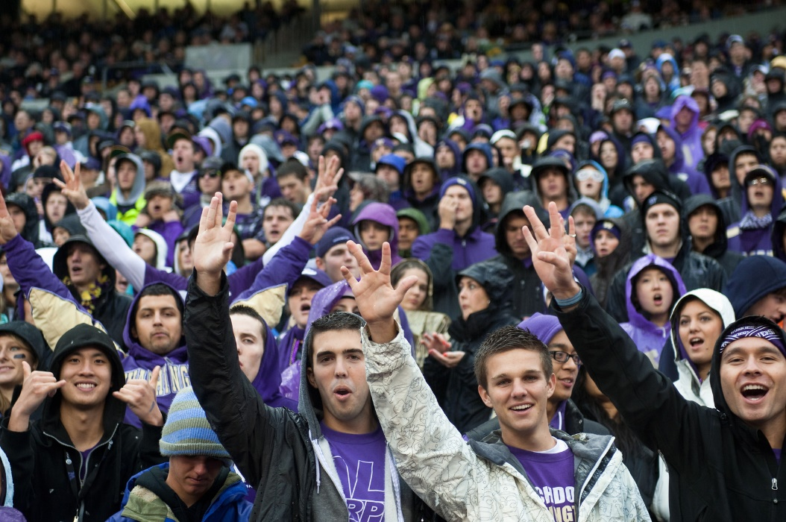
Feedback from our customers
The feedback from First Year Programs was that according to parents and students we reached, our presentations were 5 out of 5 in terms of topics, information, interest, timing, and fun!

Slide 15
What we learned
By creating a collaborative process that is inclusive of the entire team, there can be a focus towards a shared goal where everyone benefits from the improvements and feels they have added value. By engaging teams from the beginning, they can contribute ideas for improvement, take on tasks, be part of the solutions, and partake in the celebration of the success. This results in a positive experience that evolves into a culture of participation and inclusion.

Slide 16
One more Win!
Last summer we decided to reduce the amount of cash we accepted to $500 per student
Safety for our students – were we on the right track?
Verified with university police
Checked with auditors
Confirmed with business partners and two other campuses
Everyone supported this initiative to the fullest!

Slide 17
What we did and results
Once again, as a team, we came up with ideas:
Visited banks in the area to let them know of the change so they were aware of the change
Distributed and posted brochures all over campus in areas of high student traffic
Orientations!!!!!
Results
Reduced our cash intake by 63% by Autumn quarter!!!

Slide 18
What next?
As 2019 started, Student Fiscal Services continues to look for additional methods to reach our students and parents in order to inform them and train them in our processes and systems
The challenge to meet an overgrowing population of students with the same number of staff encourages our team to continue process improvement and focus on automating processes
In the end, however, having strong team engagement and participation is the key. Keeping things fun is key to the success!

Slide 19
university
billing
central cashier
Student & entity billing
Payment plans
Delinquent account management
Payments
Change orders
Deposits
Petty cash reimbursement
loan
administration
student accounts &
client services
Counseling
Cohort default management
Loan collections
Customer service
Refunds
3rd Party/VA sponsorships
Scholarships, Emergency loans
campus
cards
13 Full-Time Employees – SFS
7 Full-Time Employees – Cashier
10-15 Student Employees
Identification
Access management
Cashless transactions

Slide 20
values.
mission.
vision.
To support the financial needs of students, parents, and organizations through an integrated services approach.
To enrich our students’ lives with programs and solutions that educate, empower, and encourage life-long financial health.
People First
Purposeful Interactions
Building Pathways
Progressive Change

Slide 21
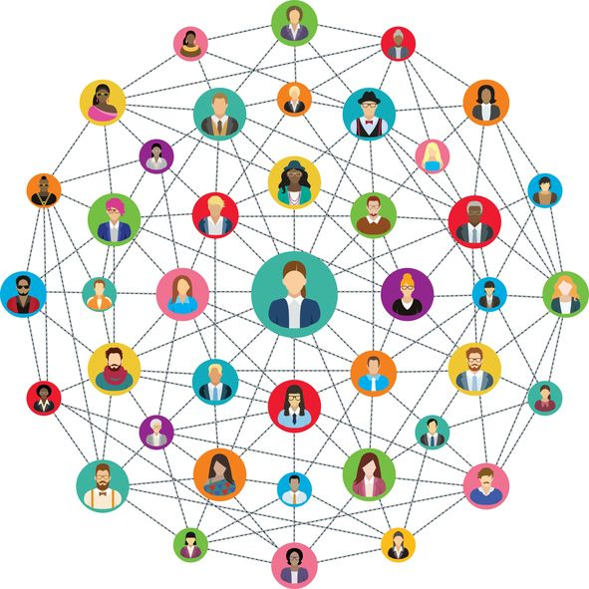
SFS
SOME CURRENT FACTS AND STATS.
AND THE IMPACT WE’RE MAKING.
$578M
Payments collected from students
$425M
$1.1B
Checks & cash processed
Population Serving
Charges assessed on student accounts
100,000+
75%
Cases answered by
student employees
7
current students, parents, faculty, staff, alumni, borrowers, affiliates
Student employees hired as Career or TES in last 10 years!
?
20,000+
Walk-ins, emails, phone calls
6.31%
Cohort Default Rate
Notes:
36K current Students
17K parents est
21K Former Students (20929 outstanding students with loans)
31K Faculty/Staff
$16.9 million fy 17 scholarship awards
$118 million in student refunds
$1.6 million unpaid balance

Slide 22
SFS STRATEGIC GOALS 2018-2021
1
2
3
4
Deliver integrated and innovative solutions
Address the changing needs of our students and process partners using technology
Be the expert
Elevate SFS reputation and capabilities
Strengthen relationships and engagement
Cultivate external relationships and collaboration
Empower and prepare team
Increase recognition by our peers and clients as being knowledgeable, supportive, resourceful and flexible
Broaden student impact
Promote knowledge sharing and succession planning
Encourage creativity and innovation

Slide 23
Goal 1: Address Changing Needs through technology
How We Educate
How We Want to Educate
Website(s)
Audit showed SFS alone had 30+ pages of content
Emails
Laborious, Inconsistent, Outdated
Orientations
18 Sessions; 2 weeks/year
Physical attendance required
Use technology to extend our reach
Website
Streamlined content; Knowledge Base Articles
Smart Orientations

Slide 24
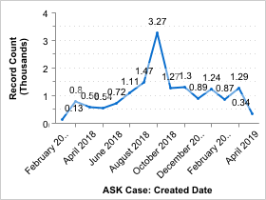
Where to begin
Volume
Question Types

Slide 25
WHERE TO BEGIN
Annual Student Satisfaction Survey Results: Net Promoter Score
4.0 to 3.61 – Online Content Accessibility
3.82 to 3.65 – Useful Info on Website
Salesforce Transaction Survey Responses
1445 Current FY – Possible Score 1-5
246 Scored 2 or Less – 17% of total
659 Related to Billing – 45% of total

Slide 26
WHAT WE FOUND
Basic Questions
Fall Quarter 18: 80% could be answered proactively
Orientations Ineffective
Infrequent: 18 sessions over 2 weeks per year
Required Physical Attendance
Small, Isolated Population

Slide 27
BABY STEPS
Staff Turnover
Consolidate responsibilities and create specialized roles
Communications Team
Focused on analyzing data and developing practical solutions
Web Updates
New platform with streamlined content
Maintenance Schedule
Virtual Options
Resources: Campus Partnerships

Slide 28
Virtual Options
Tour
Who is SFS?
5-10 Min. Video
Office Functions
Webinars – Multiple Languages
Incoming Students
Modify current presentation
Continuing Students
Graduating Students
How To Videos
I earned a scholarship, now what?
How do I pay my bill?
Endless options…
Tools: Zoom, Articulate, iMovie, PowerPoint

Slide 29
Where are we now?
Web Updates
Virtual Options
Project assigned to specialized role
Transitioning to new web platform
Using audit results to identify duplicated and redundant content
Content owners responsible for streamlining information
Will be finished before Fall ‘19
Project assigned to specialized role
Virtual Tour
Outline complete
Script Written
Need to shoot and edit
Will be finished by July ’19
Incoming webinar
Outline complete
Updating old presentation
Will be ready by July ‘19

Slide 30
Thank you

