Slide 1
Third-Party Billing Strategies and Solutions

Slide 2
Third-Party Billing Strategies and Solutions
May 15, 2019
Robyn Bongartz, Wichita State University
Leena Abonasser, UC San Diego
Carol Imper, Santa Clara University

Slide 3
Third-Party Billing Strategies and Solutions
Session Description
Introductions
Each School Shares
Questions

Slide 4
Third-Party Billing Strategies and Solutions
Cry
Hope
Pray
Beg
Threaten

Slide 5
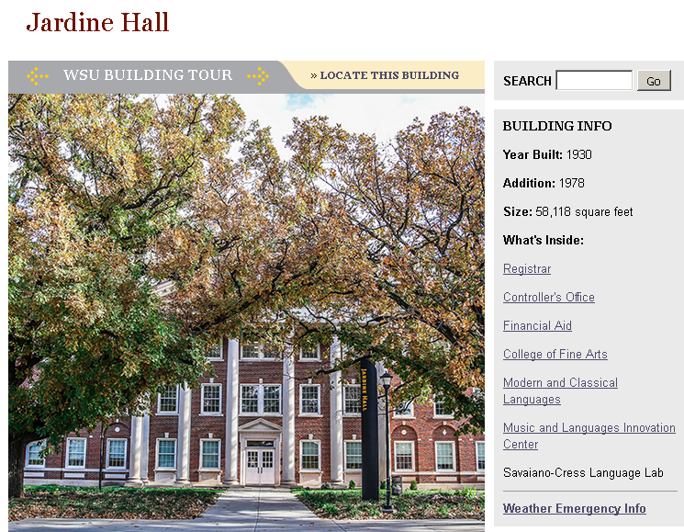
Wichita State University
Who is Wichita State?
15,000 students
Research institution
Combine traditional learning with applied learning
Innovation campus
Banner ERP
TouchNet client since 2004
60 Sponsors for Student Payments
Spring 2019 - $3,661,867.30 (Student)

Slide 6
Third-Party Billing Strategies and Solutions
WSU’s Form – For Company (information)

Slide 7
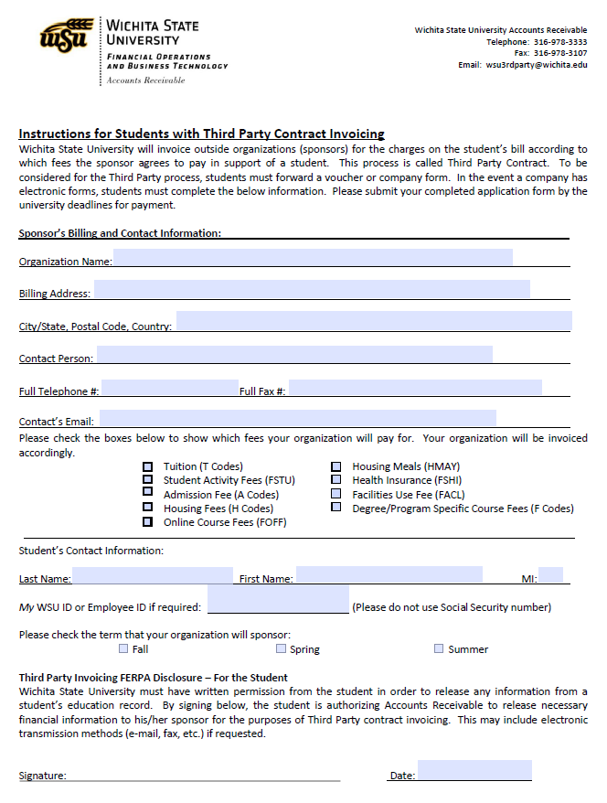
Third-Party Billing Strategies and Solutions
WSU’s Form – For Student (information)

Slide 8
Third-Party Billing Strategies and Solutions
WSU’s Form – For Student (FERPA)

Slide 9
Third-Party Billing Strategies and Solutions
WSU’s Challenges
Time-consuming manual billing and payment process for Third Party transactions
Excessive paper handling
Periodic statements cumbersome to manage
Excessive communication with sponsors required to resolve billing questions
Limited IT resources for specific billing requests

Slide 10
Third-Party Billing Strategies and Solutions
Benefits to WSU
Application of Payment (TGRAPPL)
Automation of Third Party bills and payments for most small companies
Payments online – multiple payment methods available
Statements & payment history – viewable 24/7 – real time
Account details & user profiles easily managed
Paperless! Saves time, money & hassle
Information sharing with internal departments

Slide 11
Third-Party Billing Strategies and Solutions
Benefits to Sponsors/Students
Security of student’s personal information – restricted to certain individuals
Real time knowledge on student’s bill and class schedule
Payments online – multiple payment methods available
Statements & payment history – viewable 24/7 – real time
Account details & user profiles easily managed
Paperless! Saves time, money & hassle

Slide 12
Third-Party Billing Strategies and Solutions
Veteran Friendly
Chapter 33 is treated like other military Tuition Assistance
https://www.nacubo.org/News/2018/12/NACUBO-Updates-Guide-to-1098T-Reporting

Slide 13
Third-Party Billing Strategies and Solutions
Veteran Friendly (1098-T)

Slide 14
Third-Party Billing Strategies and Solutions
Departments

Slide 15
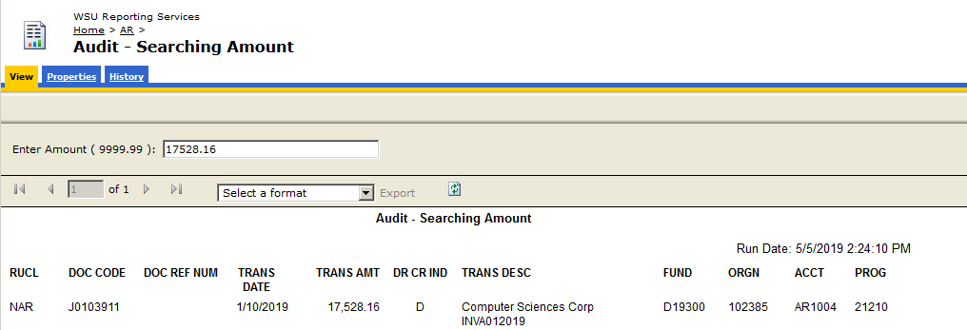
Third-Party Billing Strategies and Solutions
Departments

Slide 16
Third-Party Billing Strategies and Solutions
Departments

Slide 17
Total Enrollment: 35,502 Undergraduate: 27,812 Sponsored: ~230
Government-140 Students
Department of Rehabilitation
Department of Defense- Army, Navy, Air Force
VA Vocational Rehabilitation
International-50 Students
Saudi Arabia
United Arab Emirates
Malaysia
Thai Embassy
University-35 Students
Stanford
Vanderbilt
Johns Hopkins
UC San Diego
Spring 2019: 60-65 Sponsors
Billing: $4 million
Includes VA 33 & Graduates
Notes:
Current UCSD Stats

Slide 18
Third-Party Billing Process
Sponsor provides Financial Guarantee
Duration of coverage
Items eligible for coverage
Direct contact information
Student completes Direct Billing Authorization
Contract created in AR
Waiver applied for all terms covered by sponsorship
Sponsor invoiced directly after add/drop date
Payment received and posted to Third Party AR account
UC San Diego
Notes:
Timeline:
-Office receives notice of sponsorship from either student or entity
-Student completes and returns billing authorization
-SFS-Update master list
-Contract created in AR
- Specific by fee type, certain transactions, specific amounts
-Fee “waiver” is applied to eligible charges on student AR account, fees are moved over to sponsor/entity AR account from which we bill
-Invoicing done after add/drop date
-Accounts for lab fee changes, part-time status, summer fee changes
-Payment received via check and wire
-Posted by Cashier’s Office, reconciled by SFS to later identify remaining outstanding charges

Slide 19
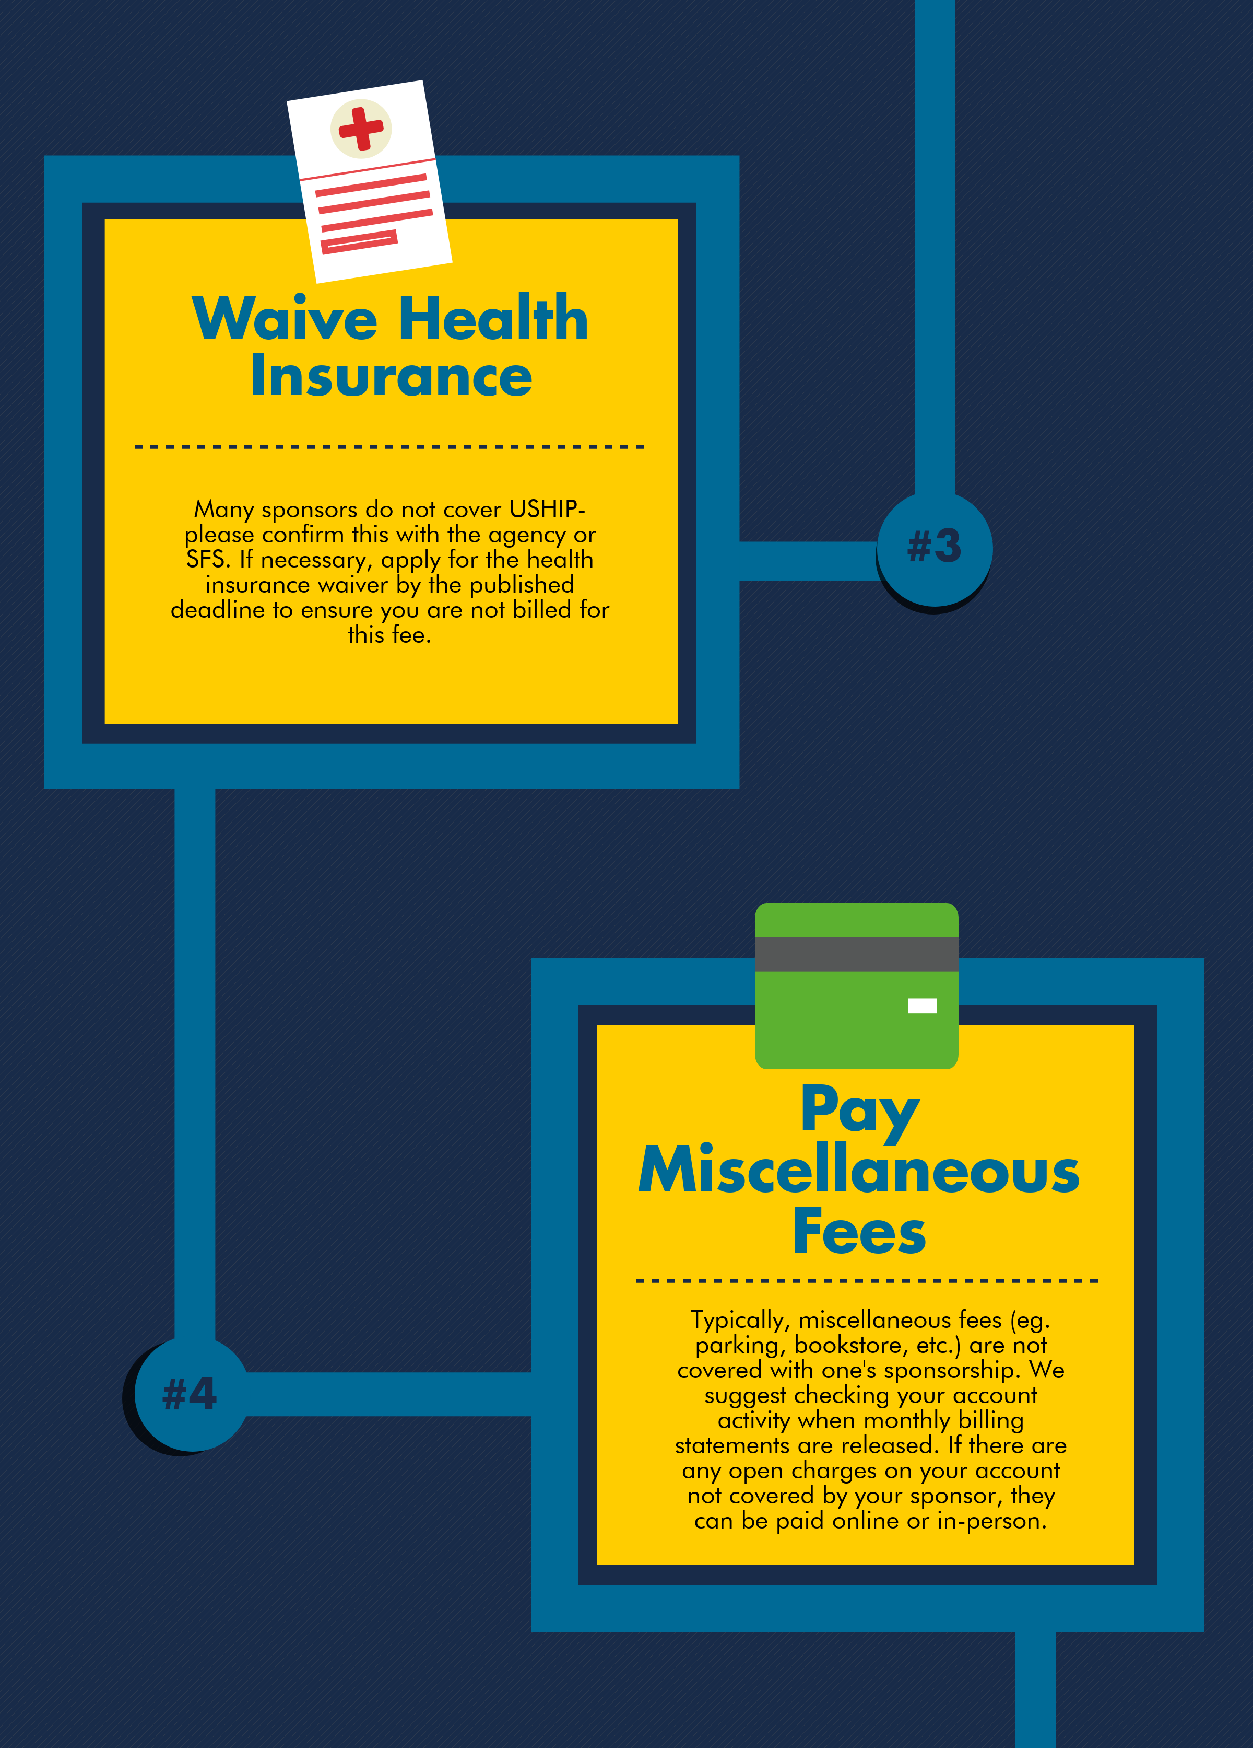
Notes:
Infographic created for new SFS website-Quick/easy reference for students to understand general 3rd party process

Slide 20
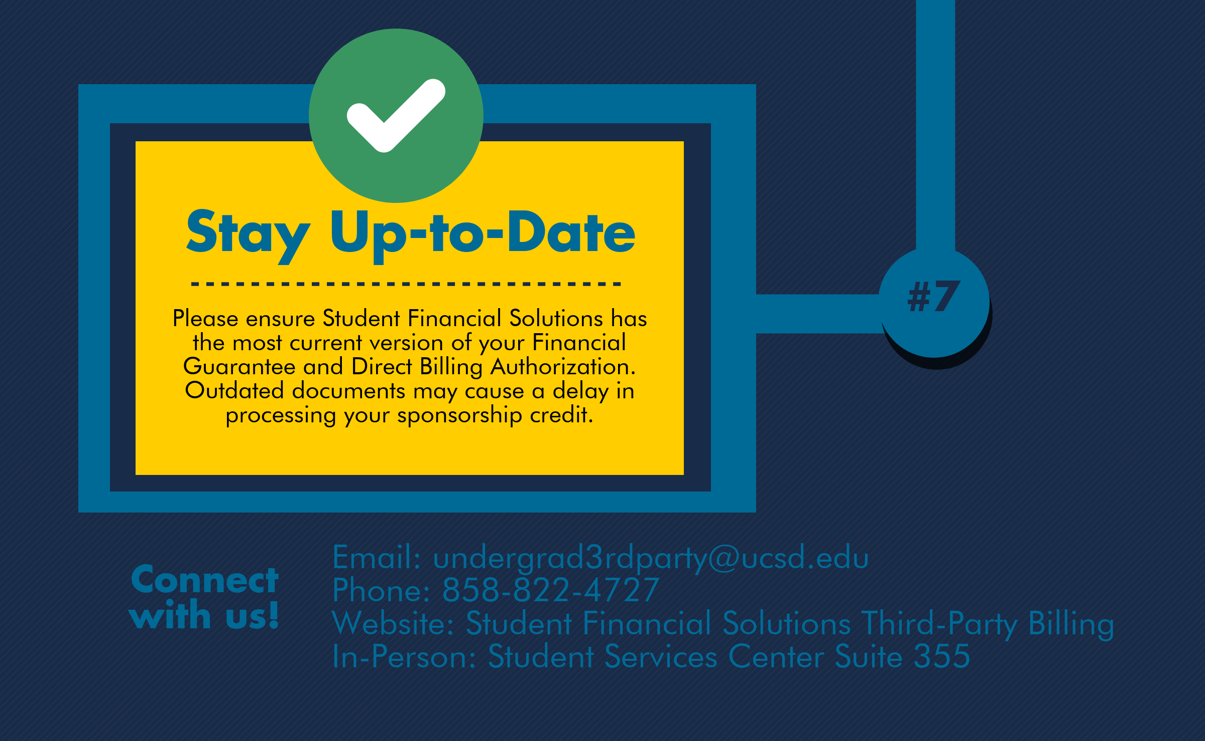

Slide 21
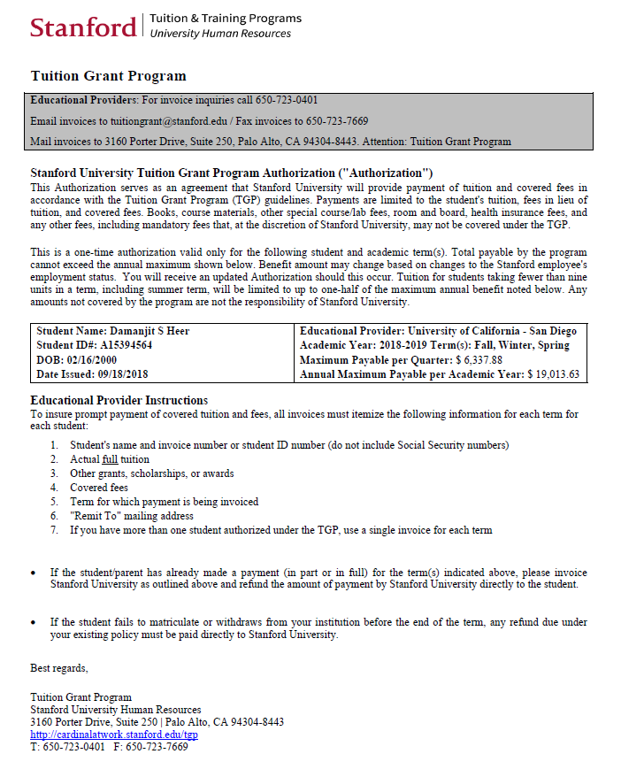
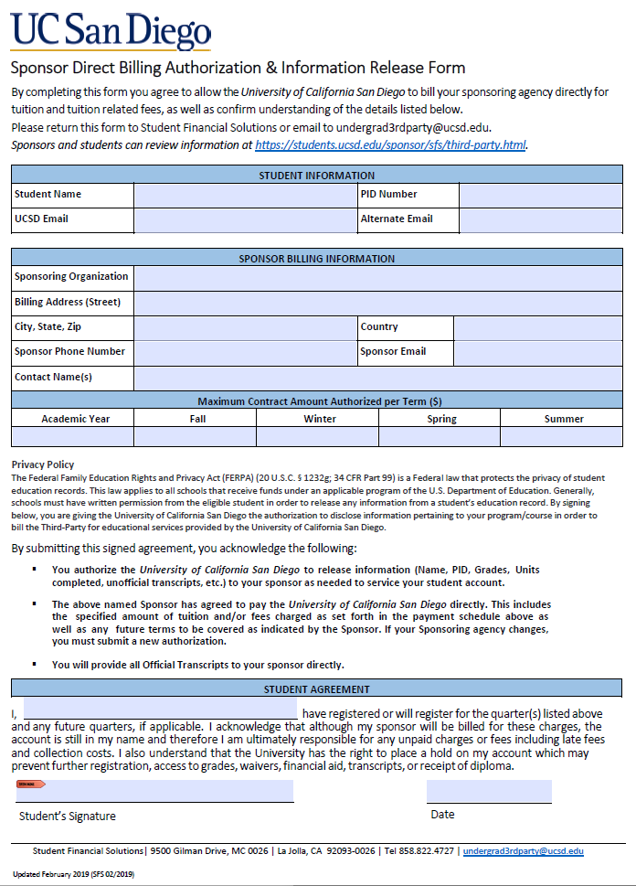
Notes:
Left- Example of financial guarantee/sponsorship letter
-Student info, duration/term of coverage, maximum amount, items eligible/ineligible for coverage, contact info
Right- Student Direct Billing Authorization
-Student must complete. Serves as FERPA release. Student also acknowledges responsibility of payment if sponsor does not cover fees

Slide 22
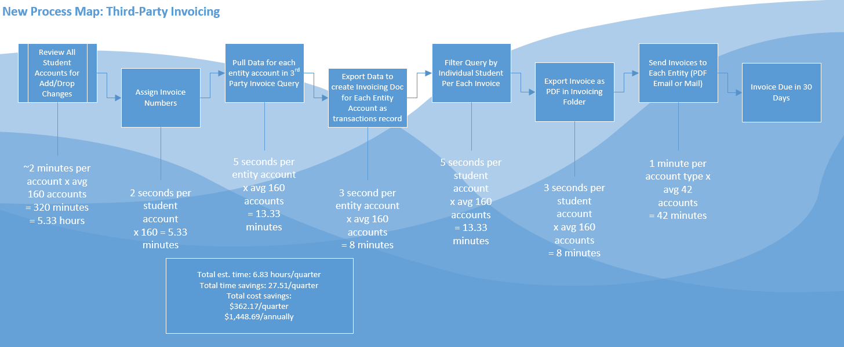
Notes:
Prior invoicing process- Manual PDF invoice creation
New-Use of Access Database. Queries are run pulling information from AR data warehouse and info is exported in 2 separate documents:
-Invoicing document- Excel spreadsheet that is used for reconciliation once payments are received. Internal use
-Invoice- PDF with AR transactions, student info, invoice #, payment instructions

Slide 23
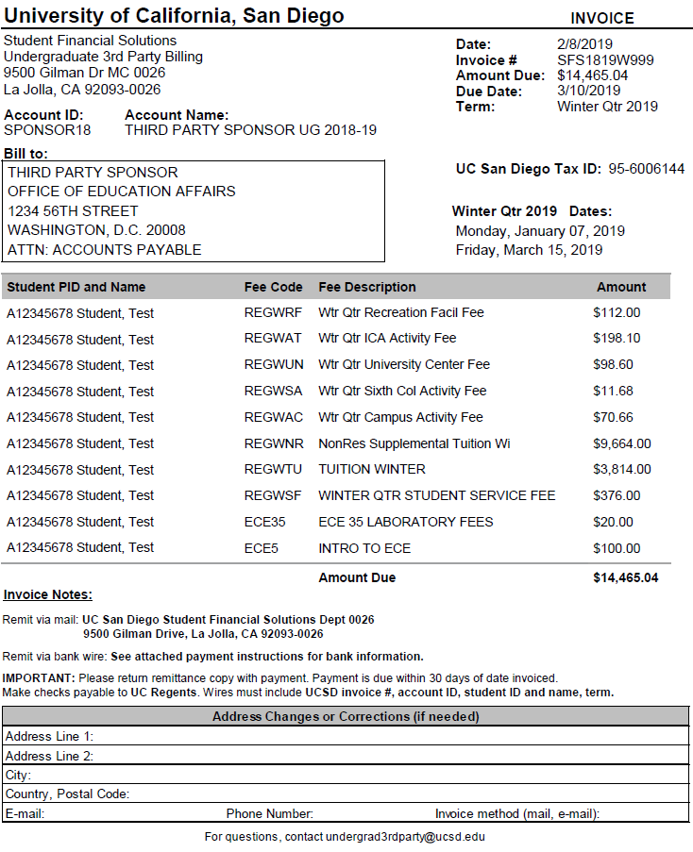
Invoice Example
UC San Diego

Slide 24
Third-Party Tips & Tricks
Student awareness
Charges ineligible for coverage
Account holds
Process partner involvement
Financial Aid, Registrar, International Students & Programs Office, Graduate Division
Revoked sponsorship
Collections
Online Reference
https://students.ucsd.edu/sponsor/sfs/third-party.html
Notes:
Student awareness
-Ineligible charges- bookstore, market, etc. Should be aware to avoid late fees, write-off
-Account holds- for those with past due balances of non-sponsored fees, account holds are placed. This prevents future contracts from being applied, so students know they will need to pay or next term’s fees will remain open, possible class cancellation
Process partner involvement- Several pieces for this, important to know who does what and keep communication open
Financial Aid-change in eligibility when receiving certain benefits
Registrar-Certification of benefits for VA
ISPO- Liaison between student and sponsor, also any federal docs like Visas. Can assist w contacting
Graduate division- own 3rd party unit. Assist with reapplies.
Revoked sponsorship
If student does not meet terms of their sponsorship
Maintain communication w student to know next steps, potential payment options
Revert back to normal billing process
Online reference
Forms readily available
Terms and conditions, what is considered eligible for third party sponsorship
Contact information

Slide 29
Contact Us!
Robyn Bongartz, Wichita State University
robyn.bongartz@wichita.edu
Leena Abonasser, UC San Diego
labonasser@ucsd.edu
Carol Imper, Santa Clara University
cimper@scu.edu
Resources available:
Sponsor Information Form
Student Information Form
Direct Billing Authorization
Third Party Guidelines
Student Infographic

