Slide 1
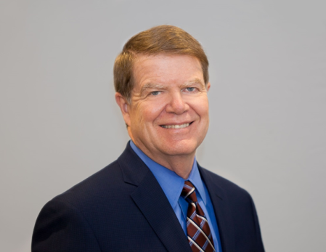
Legislative and Regulatory Issues From Washington PacWest SFS Conference
Harrison M. Wadsworth III
COHEAO/Bose Public Affairs Group
May 16, 2019

Slide 2
Legal Disclaimer
The views and opinions expressed by the Presenter are those of the Presenter and not necessarily representative of the Coalition of Higher Education Assistance Organizations or Bose Public Affairs Group.
This information is not intended as legal advice and may not be used as legal advice. Please rely on the advice of your own legal counsel.
Every effort has been made to assure this information is up-to-date but circumstances constantly change.

Slide 3
Congress

Slide 4
The 116th Congress
House
Senate
234 Democrats
198 Republicans
3 Vacancies
Majority always rules
Controls agenda including hearings
53 Republicans
47 Democrats
Majority controls agenda, hearings, BUT
60 votes needed to move most legislation
Judges, appointments need just 50
New rules limits debate
Notes:
4

Slide 5
House: Impact Election
Some highlights:
Democrats won big in suburban areas and flipped seats in unlikely places like Iowa, Kansas, Oklahoma, South Carolina, & Utah
103 women elected to Congress – 90 are Ds & 13 are Rs
First return of a Speaker (Pelosi) since Sam Rayburn in 1950s

Slide 6
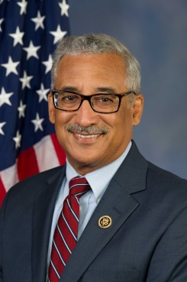
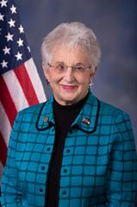
House Remakes Committee
Education & Workforce Labor Committee:
28 Ds and 22 Rs
16 new Democrats
10 new Republicans
Lots of Exiting Members:
Luke Messer (R-IN)
Todd Rokita (R-IN)
Lou Barletta (R-PA)
Tom Garrett (R-VA)
Jason Lewis (R-MN)
Karen Handel (R-GA)
Jared Polis (D-CO)
Carole Shea Porter (D-NH)
Chrissy Houlahan (D-PA)
Bobby Scott (D-VA)
Chairman
Virginia Foxx (R-NC)
Ranking Member
Subcommittee on Higher Education and Workforce Training:
Susan Davis (D-CA) is Chair
Brett Guthrie (R-KY) is Ranking Member
AIM Higher Act instead of the PROSPER Act
Oversight, Oversight, Oversight
6

Slide 7
New Ds on Ed & L
The new Democratic Members of the Committee on Education and Labor are:
Congressman Joaquin Castro (TX-20)
Congressman Josh Harder (CA-10)
Congresswoman Jahana Hayes (CT-05)
Congresswoman Pramila Jayapal (WA-07)
Congresswoman Susie Lee (NV-03)
Congressman Andy Levin (MI-09)
Congresswoman Lucy McBath (GA-06)
Congressman Joe Morelle (NY-25)
Congresswoman Ilhan Omar (MN-05)
Congresswoman Kim Schrier (WA-08)
Congresswoman Donna Shalala (FL-27)
Congresswoman Haley Stevens (MI-11)
Congressman David Trone (MD-06)
Congresswoman Lauren Underwood (IL-14)
Congresswoman Susan Wild (PA-07)

Slide 8
Rs Ed & Labor Members
New Republican Members:
Rep. Mark Walker, North Carolina
Rep. James Comer, Kentucky
Rep. Ben Cline, Virginia
Rep. Russ Fulcher, Idaho
Rep. Van Taylor, Texas
Rep. Steve Watkins, Kansas
Rep. Ron Wright, Texas
Rep. Dan Meuser, Pennsylvania
Rep. William Timmons, South Carolina
Rep. Dusty Johnson, South Dakota

Slide 9
Senate: Pretty Much the Same
Republicans gained seats but Democrats were defending many more
53 Republicans – Lost 2 Seats, Flipped 4 Seats
47 Democrats – Lost 4 Seats, Flipped 2 Seats
States that flipped: Florida, Missouri, Indiana, North Dakota, Nevada, & Arizona
Democrats lost in places where President Trump was popular but managed to blunt their losses by winning in West Virginia, Wisconsin
More breathing room for nominations

Slide 10
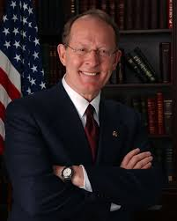
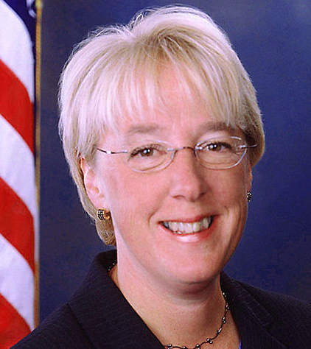
Key People In Senate
Senate HELP Committee, 12 Republicans, 11 Democrats
(Health, Education, Labor and Pensions) Controls Higher Education Act
Key HELPers:
Sanders (I-VT)
Collins (R-ME)
Baldwin (D-WI)
Burr (R-NC)
Casey (D-PA)
Isakson (R-GA)
Enzi (R-WY)
Kaine (D-VA)
New:
Doug Jones (D-AL)
Tina Smith (D-MN)
Mike Braun(R-IN)
Mitt Romney (R-UT)
Jackie Rosen (D-NV)
Maggie Hassan (D-NH)
Lamar Alexander (R-TN)
Patty Murray (D-WA)
Chairman
Ranking Democrat

Slide 11
Budget and Appropriations
There are 12 separate appropriations bills
Budget year Oct 1st – Sept 30th
Process starts in spring with President’s budget request.
Issued March 11, 2019
House Appropriations Committee moving quickly
Senate moving slowly
End game: September, hopefully before start of 2020 fiscal year Oct. 1, 2019

Slide 12
President’s FY 2020 Requests
Maximum Pell Grant award of $6,195
Eliminate SEOG program
Cut Work Study from $1.1 billion to $500 million
Proposes a consolidation of the 5 income-driven loan repayment plans into one plan that would set monthly payments at 12.5% of discretionary spending and eliminate standard repayment cap.
Notes:
Undergraduate borrowers eligible for forgiveness after 15 years, graduate after 30 years.

Slide 13
HEA Reauthorization
HEA last authorized in 2008
In 115th Congress both parties introduced a bill in the House. Senate did not.
PROSPER Act H.R. 4508 – House Rep. bill
Aim Higher Act H.R. 6543 – House Dem. Bill
Senate: FAST Act by Chairman Alexander introduced in 2015: basis for his current plans
Negotiations underway in Senate, hearings in House. Reauthorization in 2019????

Slide 14
House R’s: PROSPER Act
Promoting Real Opportunity, Success, and Prosperity through Education Reform Act
No Perkins or SEOG
Major changes to loans
No Grad Plus
Parent Plus capped
Unsubsidized Direct increased loan limits
Eliminate subsidized Direct
Eliminate PSLF
Notes:
The PROSPER Act would eliminate a number of federal student aid programs in favor of simplification; however, there is no significant attempt to backfill the loss in aid elsewhere, which would leave students worse off.
Pell Grant Leveling: The PROSPER Act does not include an increase to the Pell Grant maximum award and does not return the annual inflation-based increases to the maximum award.
Mandated Weekly or Monthly Disbursements: “Aid like a paycheck”
This bill passed committee on Party lines. Did not make it to the floor to vote, Reps. Lost the tea party conservatives, no Dem supported it and their is tremendous opposition from higher ed. community, and veteran support groups.

Slide 15
House D’s: Aim Higher Act
SEOG remains – base guarantee phased out.
Repeal loan origination fees and reduce repayment options to two
Expand PSFL job definition
Keep subsidized Direct
Create Federal Direct Perkins Loans
Same provisions as Direct
6 billion in funding
Notes:
D’s alternative proposal to PROSPER it is 180 reversal on many things.
The Perkins proposal is closely based on the Obama Administration's original 2009 proposal. Campus allocation would be based on need and several other factors. Servicing handled by direct loan servicers.

Slide 16
Perkins Access, Retention and Completion (ARC) Loan
Revised Perkins-style plan extended to more schools with better funding mechanism
Terms like legacy Perkins: 5%, no in-school interest, public service forgiveness
Include Grad students
Include more schools
Campus-based awards, servicing
Funding limited nationally and per institution

Slide 17
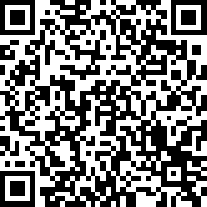
COHEAO Survey
Campus-based Funding -
Impact on Retention & Completion
Help COHEAO collect pertinent information to share with Congress about the impact of the expiration of the Perkins Program and to gage support for a new/modified Perkins Program.
Please contribute to this process by completing a very brief survey! Click the link below or scan the QR Code to participate. Responses are confidential.
https://www.surveymonkey.com/r/BNBMF6F
Notes:
Lori

Slide 18
Administrative Cost Allowance
June 30, 2018 was last date for charging ACA to the Perkins fund
ACA is the key to sustaining quality campus-based servicing and institutions should be compensated.
COHEAO advocated for a change in the law and Congress passed a spending bill that provides ED with the authority to pay schools that service their Perkins loans; House bill for FY2020 has same wording.
“…funds appropriated under this heading may be available for payments for student loan servicing to an institution of higher education that services outstanding Federal Perkins Loans under part E of title IV of the Higher Education Act of 1965…”

Slide 19
Cancellation Reimbursement Efforts
COHEAO, NASFAA, & ACE are advocating on behalf of schools for ED to pay back the institutional share of unreimbursed cancellations - mandated in the Perkins statute.
ED acknowledged its obligation to reimburse schools – but claim they have been unable to do so because of the lack of Congressional appropriations.
NASFAA & ACE wrote to ED urging them to reimburse institutions for cancelled Perkins Loans
The failure of Congress to appropriate funds does not absolve ED from meeting its statutory obligation .
Suggested that ED delay the notification to schools regarding the return of FCC until this issue is resolved
ED has delayed collection of federal share of Perkins which considering reimbursing schools for cancellations

Slide 20
ACA and Cancellation Reimbursement
What you can do to help advocate for the ACA and cancellation reimbursement actions:
Calculate what is owed to your school using the FISAP
Educate your government relations and upper administration personnel
In campus outreach to Congressional Members – state your support and appreciation
Share this information with colleagues
20

Slide 21
7 Reasons to Continue Servicing….
Recover your institution’s investment (ICC).
Utilize the ICC to fund an institutional loan program or provide additional aid to students.
Foster the borrower/alumni relationship.
Convert as many loans to paid-in-full as possible (fewer loans to assign in the future = less work and less liability).
Clean up and/or reconcile your Perkins portfolio first
Rejected loans in liquidation result in a cost to the campus – must buy the loan if you can’t resolve but rejected loans in an assignment do not result in a cost – you can continue to service the loan.
Jobs retained.

Slide 22
Perkins Notices From ED

Slide 23
Perkins Related Guidance on IFAP
Electronic Announcements
10/06/17: DCL GEN-17-10: Wind-Down Instructions
07/11/18 Distribution of Assets
10/04/18 Administrative Responsibilities and Reporting Requirements
10/06/18 Perkins Cash on Hand due 12-04-18
12/20/18 Perkins Awarded or Disbursed After Expiration of the Program
01/11/19 Revised Perkins Assignment Form Available
03/05/19 FSA Perkins Assessments: Cancellation, Due Diligence, Forbearance & Deferment
04/29/2019 Updated DRAFT FISAP Guide released
05/03/2019 FSA Releases updated Perkins Loan Assignment and Liquidation Guide
Notes:
Maria

Slide 24
FISAP Guide Update
Part III, Section B, Fields 1–8
Fields 1–8 have been updated to no longer allow for data entry on new loans due to the expiration of the authority to award new Federal Perkins Loans (Perkins Loans).
Part III, Section B, Fields 12 & 13
Fields 12 and 13 have been added to collect data on permissible servicing costs and cancellation reimbursement, if applicable, respectively.
Part VI, Section A, Fields 1a–26a & 1b–26b
Federal Perkins Loan Recipients (column a) and amount of funds (column b) fields have been updated to no longer allow for data entry due to the expiration of the authority to award new Perkins Loans.

Slide 25
DCL GEN-17-10: Perkins Wind-Down Instructions
Institutions are not required to assign their Perkins loans or liquidate their portfolio.
Institutions may continue servicing their Perkins Loans until all loans have been paid-in-full, retired or assigned
Institutions may liquidate at any time and may assign defaulted or non-defaulted Perkins loans at any time.
The institution loses all rights to assigned loans and will not receive any share of future funds collected.
Institutions that continue servicing their Perkins Loan portfolios must continue to service in accordance with the regulations and report the portfolio on the FISAP.
No ACA can be charged to Perkins after June 30, 2018.

Slide 26
July 11, 2018: Distribution of Assets
The Distribution of Assets process replaces the previous excess cash process
ED will require a capital distribution from institutions’ Perkins funds annually
Institutions will receive a notification with the amount of federal and institutional share that must be returned/removed and the deadline for doing so
Notification to schools was expected in December 2018 – delayed due to request for reimbursement of institutional share of cancellation monies owed

Slide 27
July 11, 2018: Distribution of Assets
Institutions must return the federal share through G5 (likely within 30 days)
Institutional share may be used for any purpose (note that your ICC cannot be withdrawn prior to the notification from ED)
Schools may ask for an adjustment if the return of the federal share creates a shortfall (related to costs charged to the fund)
Proportional share calculation comes from most recent Fisap filed
Notes:
Maria

Slide 28
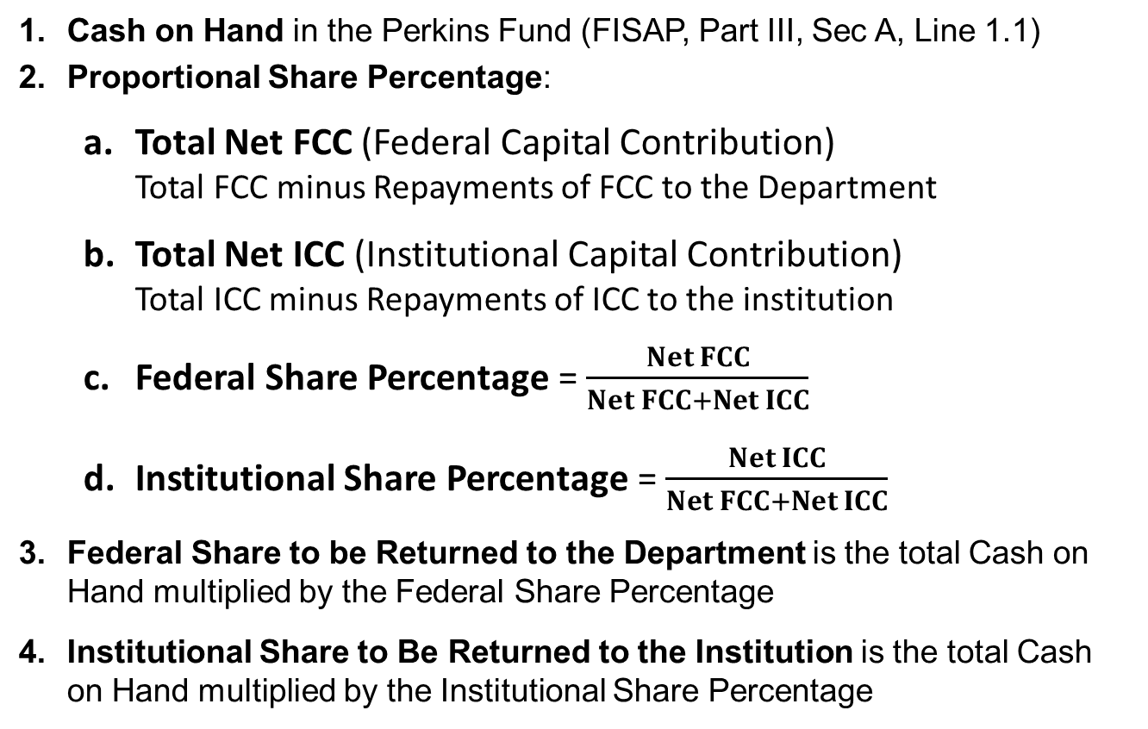
Distribution of Assets Proportional Share Calculation
Cash on Hand in the Perkins Fund (FISAP, Part III, Sec A, Line 1.1)
Proportional Share Percentage:
Total Net FCC (Federal Capital Contribution)
Total FCC minus Repayments of FCC to the Department
Total Net ICC (Institutional Capital Contribution)
Total ICC minus Repayments of ICC to the institution
Federal Share Percentage = $\frac{Net FCC}{Net FCC+Net ICC}$
Institutional Share Percentage = $\frac{Net ICC}{Net FCC+Net ICC}$
Federal Share to be Returned to the Department is the total Cash on Hand multiplied by the Federal Share Percentage
Institutional Share to Be Returned to the Institution is the total Cash on Hand multiplied by the Institutional Share Percentage
= 100%
Notes:
Maria

Slide 29
October 4, 2018: Perkins Administrative Responsibilities & Reporting Requirements
Schools who service their Perkins portfolio must service the loans according to the program rules:
Due Diligence (34 CFR 674.41(b))
Use of contractors for billing and collection (34 CFR 674.48)
Collection procedures (34 CFR 674.45)
Ceasing Collections (34 CFR 674.47)
NSLDS (34 CFR 674.16(j))
Report timely and accurately
Include enrollment data for each loan
Ensure borrower loan information is accurate and current; especially for Perkins assignment purposes
Request a reconciliation report from NSLDS - reconcile any discrepancies

Slide 30
January 11, 2019: Revised Perkins Assignment Form Now Available
Revised form replaces the previous version that expired 12/31/18
New expiration date 12/31/21
Date of First Disbursement was moved from the Institutional Certification page to the Borrower and Loan Information Page resulting in the renumbering of data fields
Schools and servicers should begin using the new form immediately; however, the Department will continue to accept the previous form through 6/30/2019
Notes:
Maria

Slide 31
More Updates

Slide 32
Department of ED -- FSA
Gen. Mark Brown is New Chief Operating Officer = key player for student aid programs.
Retired Air Force Major General
Dr. Wayne Johnson leads FSA Office of Strategy and Transformation
Next Gen: Next Generation Processing and Servicing Environment under construction
Will transform direct loan systems
Servicers taking steps to delay it or force major changes
RFP for pilot re-released
FAFSA app released, a step

Slide 33
Higher Education Policy People
Diane Auer Jones: Acting Under Secretary
Lynn Mahaffie: Deputy assistant secretary (career staff)
Brian Smith: Lead career staff on campus based issues
John Huston: Special Assistant to Jones – former Messer LD
Jeff Appel: FSA liaison with OPE – key person now handling the admissions scandal
Cynthia Hammond – working on Perkins servicing issue
Daniel J. Miller: Deputy Assistant Secretary for Management and Planning

Slide 34
Defense to Repayment Rules
Defense to Repayment – New Regs to come, but 2016 Obama rules now taking effect on defenses, “financial responsibility.”
Defenses honored for loans first disbursed on or after 7/1/19
Based on judgements against institutions, breaches of contract, substantial misrepresentation.
Campuses must have disclosed by May 14, 2019 all Direct loan or “educational services” related lawsuits filed against them since July 1, 2017 that are still active.
Another issue: reporting of low composite scores required – schools must disclose “low” scores even though score formulas are outdated.
No pre-dispute arbitration clauses; class action bans; internal dispute process requirements.
ED Guidance issued March 15, 2019: https://ifap.ed.gov/eannouncements/030719GuidConcernProv2016BorrowerDefensetoRypmtRegs.html

Slide 35
CFPB Collection Rule Revisions
553-page Proposed Regs Revising FDCPA Issued May 7, Comments due May 2020.
Many Complex issues covered…
Flow chart shows ow to make electronic disclosures
Safe harbors for collectors who unintentionally communicate with unauthorized third party
Can’t use emails collector should know are employer’s
Can’t call more than 7 times in a week about a debt, with one conversation (safe harbor also)
Time barred debt: can’t threaten to sue over it
https://www.consumerfinance.gov/policy-compliance/rulemaking/rules-under-development/debt-collection-practices-regulation-f/

Slide 36
TCPA: FCC Debates What to Do
Considering revisions to FCC order that set very strict limits on calls to cell phones using predictive dialers.
New majority, but no changes so far
One call allowed to re-assigned number, then lawsuits
Political pressure over “robocalls” from spammers
New bill, Stopping Bad Robocalls Act, in Congress goes after fraud, illegal spoofing, but others would be caught in the net making calls to consumers
Conflicting court decisions leave great uncertainty – Appeals Court decision struck exemption from TCPA consent requirement for collection of federal debt
Definition of Autodialer system unclear

Slide 37
TCPA Regulatory Issues
ACA International Decision on autodialers now in doubt
Pending FCC Proceedings Focus on Three Key Issues
What constitutes an Autodialer: How to more narrowly interpret “capacity”? What basic functions are required to be considered an Autodialer?
Reassigned Numbers: How to define “called party”?
How can consumers revoke consent?

Slide 38
Cyber Security
Entire section devoted to Cyber Security on IFAP – found under information pages.
Now part of the single audit
“Legal obligation to protect student information”
Refer to Dear Colleague Letter GEN-16-12
GLBA to become part of annual audit
Notes:
GLBA Safeguards Rule Identity Theft Red Flags Rule FERPA State Privacy Laws (48+ states) International Laws (if global) – GDPR….

Slide 39
HEA, TCPA, FDCPA, DTR, GLBA
So many initials, so little time
Several new regulatory initiatives coming:
NPRM from ED on negotiated rulemaking on accreditation, state licensing of distance education, Teach Grants, faith-based institutions
Final revised Title IX rule changes
Keep a Scorecard!

Slide 40
Become a Member of COHEAO
Membership Benefits:
3 FREE Webinars per year
Regulatory & Legislative Updates – Torch & Sparks
Lead organization on Perkins advocacy
A LOT More than just Perkins:
Advocacy and training on legal and compliance issues that impact you and your institution directly
TCPA & CFPB Compliance
Student Tuition and Accounts Receivable (STAR),
Institutional Loan Task Force
Financial Wellness – Newsletters, Training, Whitepapers
A Voice on Capitol Hill – Advocacy and Relationships
Institutional membership rates are very affordable: $210 - $595 based on FTE (10% discount when you join within 30 days of this presentation).
NEW

Slide 41
COHEAO Fall Workshop
Affordability, Payment Options & Funding Trends
This one-day workshop will dive into key topics that impact campus funding such as Trends in Accounts Receivable, Prior Term Loans, Developing and Managing Institutional Loans, Innovations in Tuition Payment Plans and Best Practices in Third-Party Collections.
Tuesday, Sept 17th 2019
8:30 am – 4:00 pm
Wellesley College
Wellesley, MA
For more information go to COHEAO.Org and select Events & Webinars

Slide 42
Contact Information
Harrison Wadsworth
Executive Director, COHEAO
Principal, Bose Washington Partners
202-349-2303
hwadsworth@bosewashingtonpartners.com
Jared Solomon
Associate Director, COHEAO
Assistant Vice President, Bose Washington Partners
202-289-3910
jsolomon@bosewashingtonpartners.com
Greg Marak
Director of Publications and Membership, COHEAO
Public Policy Specialist, Bose Washington Partners
202-289-3910
gmarak@bosewashingtonpartners.com

Slide 43
Any Questions???

