Slide 1
Collections Best Practices Compliance + Performance
Brian Hill
President
General Revenue Corporation
Notes:
Dividing this up into 2 sections, compliance and performance because you can’t have one without the other. You can try, but you won’t be in business very long if you do.

Slide 2
Agenda
Part I-Collection costs on non-federal debt types
Part II-UDAAP
Part III-Improving Recoveries

Slide 3
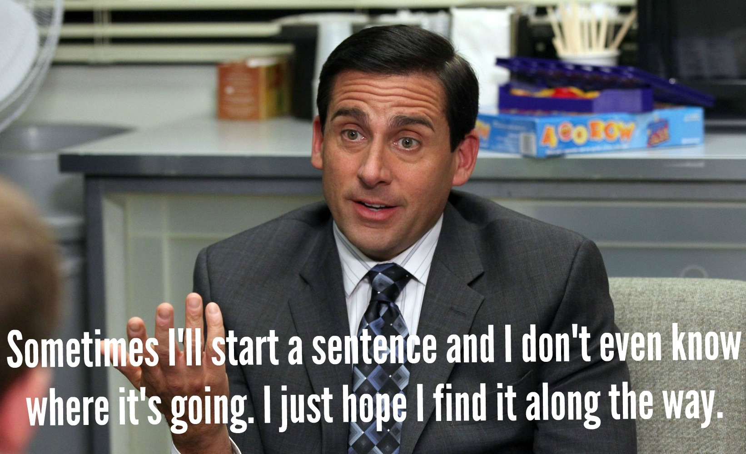

Slide 4
This presentation does not constitute legal advice. Prior to any legal or compliance changes within your organization, please consult your legal counsel.
Finally, although we believe the information in this presentation is accurate as of this date, the statutes, regulatory guidance and case law in this area is ever changing.
Please continue to monitor for changes.

Slide 5
Part I: Non Federal
Master Promissory
Notes for AR
Confidential and Proprietary information ©2017 General Revenue Corporation

Slide 6
Dr. Seuss says:

Slide 7
The Government’s Response - CFPB
Created by the Dodd-Frank Wall Street Reform and Consumer Protection Act of 2010 in response to the recession of 2008.
Formally began operations in 2011.
Works with other regulators, including State Attorney Generals and financial regulators, targeting UDAAP and other violations.
Has announced that it will focus on, among other topics, student lending and debt collection.
All creditors and debt collectors should also be conscious of litigation risk associated with asset recovery.

Slide 8
Types of Debt
Perkins Loans:
Federal Loan Program
Regulated by federal regulations and guidelines
Master Promissory Note
Types of Debt Subject to State Collection Cost Restrictions:
Any type of Accounts Receivable debt, including;
Tuition loan extended directly to student
Any extension of credit directly to student
Student Receivables such as Library Fines, Parking and Cafeteria fees, etc.
DOES NOT include federally guaranteed student loans, which are regulated by other federal guidelines (34 CFR 682.410)

Slide 9
Need for Written Agreement-FDCPA
FDCPA - it is a violation to collect any amount that is not “expressly authorized by the agreement creating the debt or permitted by law.”

Slide 10
Collection Costs Case Law
Kojetin v. C U Recovery, Inc., 212 F.3d 1318 (8th Cir. 2000), collection costs must be specifically laid out in the agreement between the creditor and debtor; must be related to actual costs of collection.
Seeger v. AFNI, Inc., 548 F.3d 1107, 1113 (7th Cir. 2008), percentage-based collection fee permissible under FDCPA if collection costs allowable under state law and contract that creates debt also includes language authorizing the fee.
Bradley v. Franklin Collection Service, Inc., 739 F.3d 606 (11th Cir. 2014). Court holds that written agreement must specify exact percentage of collection costs.

Slide 11
Elements of a Written Agreement
To recover the maximum allowable collection costs in states that permit such costs, you should include the following in your written agreement;
The terms of the loan or the extension of credit.
The repayment terms.
The conditions of default.
The CONSEQUENCES of default laid out in VERY SPECIFIC detail. Written agreement must specify whether collection costs will be added if the student defaults and at what percentage.
If there are internal collection fees, you should disclose them separately because some states, like KS, regulate those fees separately.
Late fees or other fees attached to default, or additional legal fees if you choose to enforce the written agreement in court.
Written agreement may be electronic, but to validate the debt the signature should be printable.

Slide 12
Financial Responsibility Agreement
From NACUBO Advisory Report 2015-1:
A financial responsibility agreement provides relevant information about official institutional policies to students and contractually binds them to those policies. It is intended to potentially protect student debts from bankruptcy discharge and set parameters for internal and external collection efforts
Members are encouraged to consider requiring students to sign an agreement prior to registering for classes and periodically thereafter. The institution will need to determine how often students are asked to reaffirm the financial responsibility agreement, taking into account state law, characteristics of the student population, and coordination with other processes. Current practices vary widely by institution.
No matter how an institution handles this issue, the legal goal remains: a clear contract that binds the student to the most current policies of the institution and covers all of the amounts that become due and owing during a student’s tenure with the institution.

Slide 13
Best Practices for Financial Responsibility Agreements
Collin College, Plano, TX
“I understand a delinquent account may be placed with an outside collection agency and/or reported to the national credit bureaus. I understand I will be responsible for all late payment fees, percentage based collection fees (up to 33.33% of the original principal balance), attorney fees, interest and any other costs and charges necessary for the collection of any amount not paid when due and/or any balance resulting from an adjustment to financial aid awards and/or amounts not covered under a third party funding agreement made on my behalf between Collin and another entity.”
Collection costs should be included in the promissory note as seen above in the example from Collin College.

Slide 14
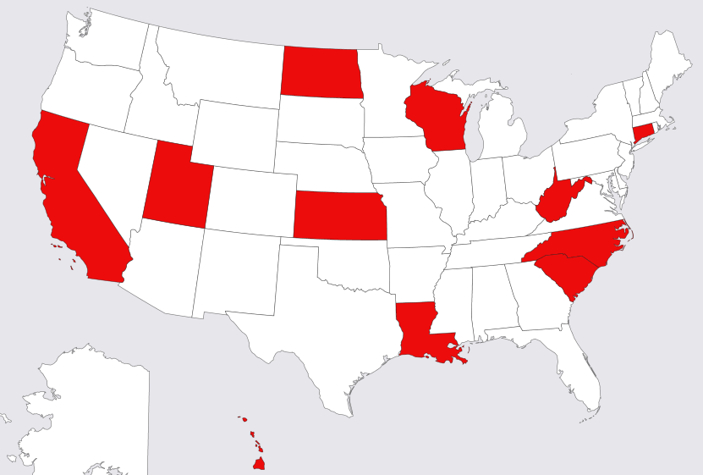
Collection costs
California
Connecticut *
Guam
Hawaii
Kansas *
Louisiana
North Carolina
North Dakota
South Carolina
Puerto Rico
Utah
West Virginia
Wisconsin
These States either Prohibit or Restrict the amount of Collection Fees to be collected, even with a signed Student Financial Agreement. Many State Laws Prohibit or Restrict certain collection activities such as billing, dunning, the size font, what disclosures have to be printed on the back of letters, etc.

Slide 15
State Collection Cost Laws*
*more restrictive than just requiring a written agreement, and/or imposing a limit
State | Collection Cost Status | Notes
California | • Prohibited | Cal. Civ. Code § 1788.14(b)
Connecticut | • If debtor is liable, not more than 15% of the amount collected | Conn. Gen. Stat. Ann. § 36a-805(a)(13)
Guam | • Prohibited | 14 G.C.A. § 3204 (page 7)
Hawaii | • Prohibited, except for debts to the University of Hawaii | Page 10 of http://cca.hawaii.gov/pvl/files/2013/08/hrs_pvl_443b.pdf
Kansas | • May not exceed 15% | Kan. Stat. Ann. 16a-2-507
Louisiana | • Prohibited – however, attorney’s fees are permitted | La. Rev. Stat. Ann. § 9:3534(B)
North Carolina | • Prohibited | N.C. Gen. Stat. § 58-70-115(2)

Slide 16
State Collection Cost Laws*
*more restrictive than just requiring a written agreement, and/or imposing a fee limit of 11.3%
State | Collection Cost Status | Notes
North Dakota | • Prohibited | N.D. Admin. Code § 13-04-02-09(3) & (4) (page 6)
Puerto Rico | • Prohibited | 10 P.R. Laws Ann. § 981p(10)
South Carolina | • Prohibited | S.C. Code Ann. § 37-2-414
Utah | • Cannot be more than 40% of principal | Utah Code Ann. § 12-1-11
West Virginia | Prohibited, except for schools located in WV: | W. Va. Code Anno. § 46A-2-128(c), (d)
Wisconsin | • Prohibited, except that Wisconsin state universities may assess collection costs | Wis. Admin. Code § DFI-Bkg 74.11(1)-(2)(a)

Slide 17
Which state law applies?
Although the contract originates in a state that differs from consumer's state of residency, the applicable law is the law of the state of residence of the debtor
Courts are more likely to apply their own consumer protection statutes to protect their citizens.
Choice of law provisions unlikely to be enforced when there are restrictive consumer protection statutes at issue.

Slide 18
Fees are a concern for creditors and collectors alike
Both the University/School and the Debt Collector can be liable in a lawsuit if the debt collector refuses to abide by applicable state laws on collection costs and fees.
Patzka v. Viterbo Coll., 917 F. Supp. 654 (W.D. Wis. 1996) – both the school and the debt collector were found liable for violations of the FDCPA and the Wisconsin Consumer Act (“WCA”). Court states that even if fees were not prohibited by the WCA, there was no written agreement disclosing collection fees and attorneys fees.

Slide 19
Fees are a concern for creditors and collectors alike
State laws directed at the Creditor: “An extender of credit may not contract with a consumer for the reimbursement of fees paid to a collection agency employed to collect the consumer's indebtedness” La. Rev. Stat. Ann. § 9:3534B.
UDAAP, and other state consumer protection statutes, may implicate creditors who do not comply with various state requirements for the addition of fees.
All collection contracts require the debt collector to abide by federal, state and local law, which is what we are always striving for.

Slide 20
Fees are a concern for creditors and collectors alike
“Ohio law doesn’t allow private creditors to make debtors pay collection costs, Torguson said. But in these cases, where the plaintiff is the state of Ohio, collection costs of up to and above 70 percent are added to the amount claimed due, he said. This is an unreasonable burden to place on former students struggling to get on with their lives.” DeWine spokesman Dan Tierney said the office allows collection fees so that taxpayers don’t have to cover the cost. "We try to make (collecting debts) as cost-neutral as possible to the state agencies that are owed money, he said.
http://www.dispatch.com/content/stories/local/2016/08/16/ohio-sued-over-student-loan-collection-fees.html

Slide 21
California law
California civil code 1788-14
(b) Collecting or attempting to collect from the debtor the whole or any part of the debt collector's fee or charge for services rendered, or other expense incurred by the debt collector in the collection of the consumer debt, except as permitted by law;
See more at: http://codes.findlaw.com/ca/civil-code/civ-sect-1788-14.html#sthash.oyNvZyrQ.8qRYYvv9.dpuf

Slide 22
Legal precedence
Freeman vs GRC
In 2012, the plaintiff alleged that GRC violated the FDCPA by attempting to collect collection costs that were not expressly authorized by the agreement creating the debt, or permitted by law.
Client had placed delinquent account with GRC. Plaintiff asked for copy of her signed agreement when she was a student.
GRC requested validation of debt document from the client
Client was unable to produce the document
Lawsuit became certified as a class action lawsuit
As settlement negotiations began, client located the requested document

Slide 23
Part II: UDAAP
Confidential and Proprietary information ©2017 General Revenue Corporation

Slide 24
What is UDAAP?
Unfair: Does the act or practice hinder a borrower’s decision making?
Deceptive: Is the statement prominent enough for the consumer to notice? Is the information in a easy to read format? Is the placement of the information in a location where the borrower can be expected to look? Is the information in close proximity to the claim it qualifies?
Abusive Acts or Practices: Is the borrower able to make an educated decision based on the disclosures provided to him or her? Does the borrower understand the risks, costs & conditions? Does the borrower appear confused? Does the borrower keep asking the same questions?

Slide 25
Unfair
To be considered unfair the act or practice must contain at least one of these elements:
It causes or is likely to cause substantial injury, usually monetary to consumers
It cannot be reasonably avoided by consumers
The resulting injury is not outweighed by benefits to consumers

Slide 26
Deceptive
To be considered “deceptive” the act or practice must contain at least one of these elements:
The representation, omission or practice misleads or is likely to mislead the consumer
The consumers interpretation of the representation, omission or practice is reasonable under the circumstances
The misleading representation, omission or practice is material

Slide 27
Abusive
To be considered “abusive” the act or practice must contain at least one of these elements:
Materially interferes with the ability of a consumer to understand a term or condition of a consumer financial product or service
Takes unreasonable advantage of:
a consumer’s lack of understanding of the material risks, costs, or conditions of the product or service;
a consumer’s inability to protect his or her interests in selecting or using a consumer financial product or service
a consumer’s reasonable reliance on a covered person to act in his or her interests
It is important to note that, although abusive acts or practices may also be unfair or deceptive, each of these prohibitions are separate and distinct, and are governed by separate legal standards.

Slide 28
Part III: Maximizing Recoveries
Confidential and Proprietary information ©2017 General Revenue Corporation

Slide 29
Solving the skip tracing puzzle
Social Media Usage Search Facebook/LinkedIn to find
possible POE, phone #, family contacts etc.
Search for fishing or hunting licenses Do a reverse
search of the address associated with the license.
Search for professional licenses Search for the type of employer e.g if the consumer has an RN license- search for nursing homes and or hospitals in the area the consumer lives. Call the possible POE’s (if you cant find a # to a POE, call the county clerk)
Neighbor
SS#
POE
Landlord
Check Voter Registration Do a reverse search of the address on the
registration card
Search consumer last name in the area he/she resides If you can’t find anyone, search the oldest area the consumer lived in (e.g. where they grew up) you may find a parent or grandparent who still lives in that area
*If the consumer is self-employed, call the chamber of commerce or the clerk who handles business licenses.
*Manta.com is a great website for searching POE’s, results include the names of subsidiaries and affiliates.

Slide 30
Properly Overcoming Objections
“It seems like”
“I understand”
“It appears”
Acknowledge the Objection
Ask the next logical question based on the conversation.
Example: The student states “I never attended classes”
Ask: Did you sign up for classes?
Did you properly withdraw?
Did you get it in writing?
Do you have a copy of the withdrawal slip?

Slide 31
Encourage creative thinking-never stop innovating!

