Slide 1
Vendor Audits & Relationship Management
Best Practices for auditing your VENDORS
ensuring positive relationships Through Relationship management
Joe Weglarz, Marist College
MyVan Hua, CSU Pomona
James Jones, Reliant Capital Solutions, Inc.

Slide 5
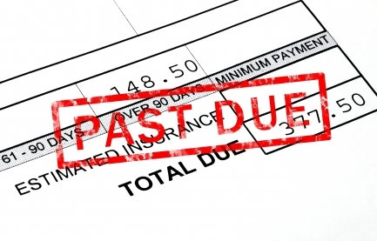
Who today is auditing their vendors?
If you are auditing, who are you auditing?
Collection agencies
Loan service vendors
Cashiering System vendor(s)

Slide 6
Why the need to audit and pay attention to your vendors?
New rules and regulations
Ex: AB 1160
Ex: AB 1313
Impact Campus and Business Practices

Slide 7
California State Polytechnic University, Pomona
* Found in 1938
* Undergrad 26,973
* Graduate 2,130

Slide 8
Rules and Policy – What to include
Consumer Financial Protection Bureau (CFPB)
Credit Reporting
Consumer Disputes
Litigious Society – who is responsible?
Small Claims – campus practice? Resource?
Bankruptcy
Debt Consolidation

Slide 9
The need to audit
Audits should be structured
Audits should be timely
Mitigating and minimizing risks
Ongoing risk assessment, language within contracts, prom notes & FRAs, review of defined measurements, performance and protection of your confidential information, data and ensuring secure practices
CFBP
Original creditors are ultimately responsible for who they work with and how they are portrayed by their vendor

Slide 10
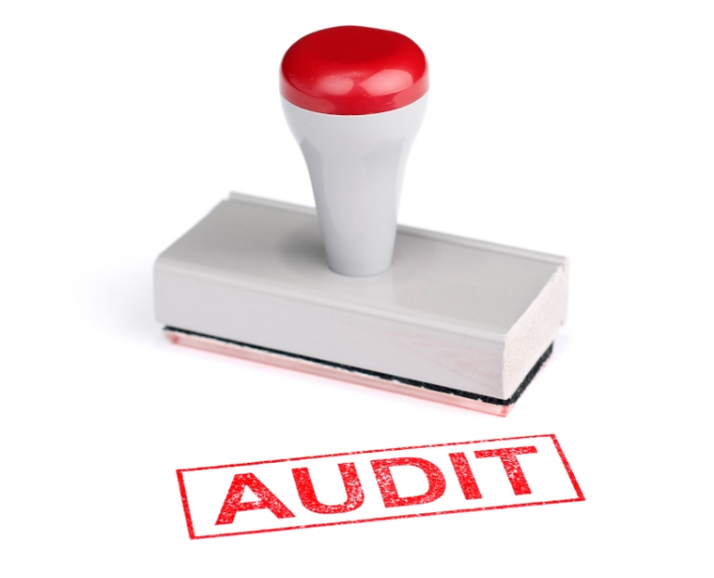
A Checklist of Audit Items to Ask Your Agencies For
Does your existing review of your agencies look like this?
Audited Financials
Current Red Flag policy
PCI DSS Compliance Certification
Copy of collection letters (including whether attorney reviews letters)
Internal Customer complaint log and compliant policy & procedures
Dispute policy & procedures
QA/QC policy & procedures (including call score card)
Sampling of accunts with notes, recordings, documentation of correspondences
Certificate of Insurance and Licensing
Security documentation
Training policies & procedures (including a review of what training is conducted annually)
Review of invoices
Review of commission (collector and possibly manager bonus plans)
Reconciliation of invoices, payments and accounts

Slide 11
Planning for an audit
Contract review
Security, insurance, liability, contract language, up to date documentation and when does this contract renew?
Does it auto renew? Is that a best practice?
Choose when to audit: annual or bi-annual basis
Draft a letter to your vendor
Ensure you have access to their websites
Select a sample population to review at random
Send the request for information

Slide 12
What to request
Sampling of accounts
Depends on size of portfolio
Audio file of calls
Documentations of correspondences
Certificates of Insurance
Certifications & licensing required
Security documentation based on your institution’s requirements
Training policies and procedures
Complaint logs
Webinars , Newsletter

Slide 13
Campus Audit Best Practice
Regulation F
Format data
Ex: Prefer name
Campus due diligent
Validation of debts
Account updates
Campus policy

Slide 14
Sample draft letter

Slide 15
Other items to take into consideration
Review of invoices
Review of commission
Reconciliation of invoices, payments, accounts
Effectiveness
What % are these agencies collecting for you?
Vendor-client relationship
How do you and your staff feel your relationship is with this vendor?

Slide 16
Review & Feedback
Review all material
Follow up with the agency
Provide feedback
Use this audit to assist you with determining if this is a vendor you want to continue working with
Were they timely in their responses to you?
Did you find the phone calls, letters, general processes and communications effective and appropriate? Did they represent you well?
Do you need to re-work your contract?
Are their security documents up to date and meet your institution’s requirements?

Slide 17
Importance of Vendor-Client Relationship - Benefits
What is a Vendor-Client Relationship?
Why are we talking about this?
Products and services need to respond to consumers’ needs and expectations
Beneficial to both the vendor and the client
Prevents breakdown of relationship – work to not only create the relationship but maintain it
A vendor who is familiar and comfortable with a client is more open to making recommendations – creating opportunities
Client
Cost efficiency
Save money on projects and business functions
Offer discounts

Slide 18
How do you create this relationship?
Understanding and managing the vendor client relationship will increase the benefit and utility of your investment.
As an added bonus, a constructive client-vendor relationship removes stress-points and overhead for those who implement and manage solutions in your organization.
Mutually beneficial relationships are established when the vendor is viewed as a supplier of specialist services.
Vendors hold a wealth of knowledge relating to their products or services. A vendor also holds knowledge on utilization within industry. That knowledge helps you, as a client, achieve your objectives.

Slide 19
Management of the Relationship
Your ability to use awareness of your own emotions and the emotions of others to manage interactions successfully
Inspirational leadership
Influence
Communication
Developing others
Change catalyst
Conflict management
Teamwork & Collaboration

Slide 20
Questions?

