Slide 1
Biscuit Bites – Leadership Lessons of Ted Lasso
PacWestSFS – San Diego – May, 2023
The Power of Connection Through Change
Diane M. Fennig

Slide 2
The Power of Consistency

Slide 3
#1. Everyone is Worthy of Your Attention

Slide 4
# 2. Learn Peoples’ Names

Slide 5
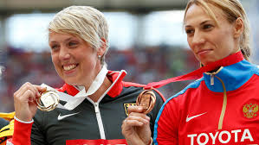
# 3. Invest in Relationships

Slide 6
# 4. Leverage Rituals to Build Camaraderie

Slide 7
#5. Family First - Always

Slide 8
#6. Strong Teams Learn and Win Together

Slide 9
# 7. Make Others Look / Feel Good

Slide 10
# 8. Be Open

Slide 11
#9. Play like a Child
Fit & Match

Slide 12
#10. Be Vulnerable

Slide 13
#11. Lead with Empathy

Slide 14
#12. Try Not to Take it Personally

Slide 15
#13. Optimism is Infectious

Slide 16
#14. Humor

Slide 17
#15. Growth

Slide 18
#16. Hard Stop

Slide 19
The Moral

Slide 20
Resources for Ted Lasso Lessons
https://www.peoplestorming.com/post/10-leadership-lessons-from-ted-lasso
https://www.rochester.edu/emerging-leaders/leadership-lessons-from-ted-lasso/

Slide 21
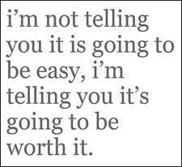
What is Missing?

Slide 22
Parting Thought

Slide 23
It has been my pleasure… Diane Fennig, Senior Consultant Diane_Fennig@ajg.com 678.234.1196 www.linkedin.com/in/dianefennig @fansoffennig
We make a difference in your business…by doing things differently in ours.

