Slide 1
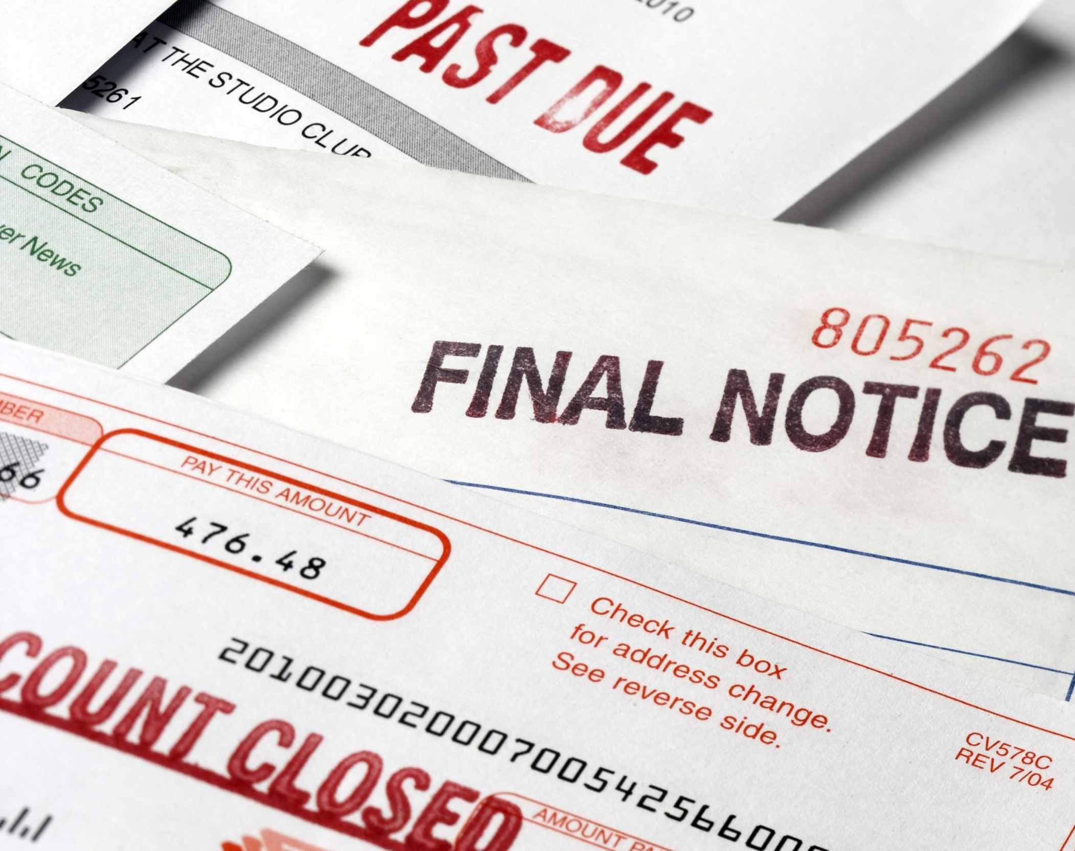
Collections 101
James Macias
Matt Fryc
Karen Reddick

Slide 2
Write Off
PCA Placement
In-House Collections
PreCollect
Extract
A.R. Debt

Slide 3
Understand Your Process
Collections is constantly evolving don’t get left behind
Identify process improvement opportunities
Adapt to new regulations
Adapt to how students are communicating
Don’t be afraid to try something new

Slide 4
Extract Process
A.R. Debt

Slide 5
Helpful Data
Demographic information
Principal / Interest / Late fees
Financial Agreement
Regulation F Data
Type of debt
Enrollment type
GPA / Grades
Academic level / Credits Completed
Financial Aid status
History of Payments
FERPA information / Authorized Users-payer information

Slide 6
Pre-Collections
Self Service Site
Automatic notices
Email / Text
Robo Calls
A.R. Debt

Slide 7
In-House Collections
A.R. Debt

Slide 8
Know Your Audience

Slide 9
Have a resolution proposal before you make contact
Research the account
Review notes, has there been any interaction with this student in the past?
Understand the nature of the charges and confirm accuracy
Correct proposition of their name
Are they eligible for any petition options?
Financial Aid availability?
What is their payment history?
Has the student graduated?
Will the student need to enroll in the next term?

Slide 10
Forms of Communication
Paper letter / bill
Video Conferencing
Unaddressed Documents
E-Mail
Text Messages
Face to Face
Social Media
Phone Calls / Voicemails
Least Effective
Most Effective

Slide 11
Payment Methods
How easy is it for people to make a payment?
Don’t create any unnecessary hurdles
Do you accept alternate forms of payments?
Do you offer auto-draft payments?

Slide 12
Private Collection Agencies
Prepare accounts
Regulation F
Tax Offsets
Alert PCA of Disputes
Alert PCA of Combative students…
A.R. Debt

Slide 13
Private Collection Agencies
Validating, loading, scrubbing, scoring accounts
Initial and ongoing collection efforts
Dispute resolution, Legal opportunities
Payment plans, Settlements, Rehabilitation, etc.
Performance tracking
A.R. Debt

Slide 14
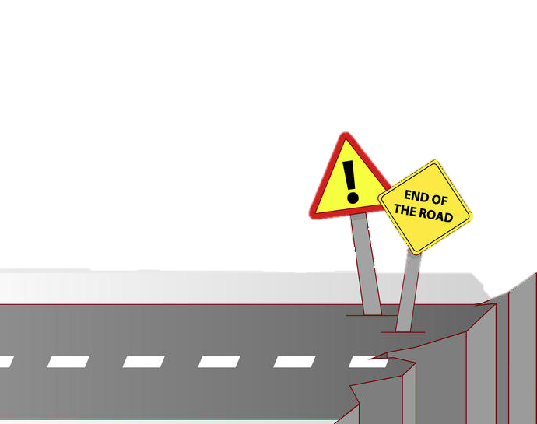
End of the Road
Passive Collections
Tax Offsets
Balance Write-Off
A.R. Debt

Slide 15
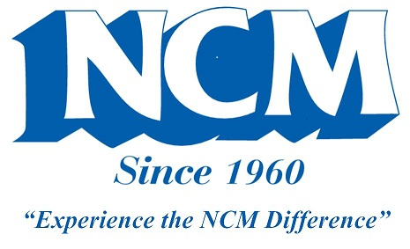
Questions?
James Macias
University of Colorado
303-492-3565
Jimmy.macias@colorado.edu
Matt Fryc
ConServe
585-364-8709
mfryc@conserve-arm.com
Karen Reddick
National Credit Management
314-603-9500
kreddick@ncmstl.com

