Slide 1
2023 Conference – San Diego, CA
Updates and trends in the collection of student debt
Chad Echols, partner with frost Echols, LLC
Brought to you by: Williams & fudge, Inc.

Slide 2
DISCLAIMER
This presentation should be construed as an overview of the issues discussed. The presentation is not legal advice to anyone attending the conference or reviewing the materials. Specific legal questions regarding the concepts and any application to your entity should be directed to your attorney.
NOTICE: Comments made during this presentation and the presentation itself are not for use on the public record and should not be utilized by any member of the media without the express written consent of the presenter.

Slide 3
Being on the Pacific Coast – Mt. Rainier

Slide 4
Today’s Presentation
Updates on Legal Issues & Trends in Debt Collection
Letters become a challenge
The industry gets some TCPA clarity
REGULATION F!!!
Student paid collection fees
Visa Rules
California
Etc…
Q&A

Slide 5
Student Debt is a Major Issue Getting Significant Attention (6 suits - 2 before the US Sup. Ct.)

Slide 6
Get accounts into repayment!
With payments on large federal loans paused, it is a good time to get consumers into appropriate repayment plans. It is much easier to keep a payment arrangement going than to get one started.

Slide 7
Hunstein v. Preferred Collection & Management Services, Inc.

Slide 8
Hunstein Development -

Slide 9
The CFPB is Looking at All Aspects of Student Debt

Slide 10
CFPB and Higher Education

Slide 11
CFPB and Higher Education

Slide 12
CFPB Funding Challenged

Slide 13
Supreme Court to hear case regarding funding

Slide 14
Late March development …

Slide 15
The Telephone Consumer Protection Act
Briefly – Because we have found some peace!!
Also – Be careful when you pick a fight!

Slide 16
The Telephone Consumer Protection Act

Slide 17
The FDCPA Generally
Some history;
Creditors are not subject to the FDCPA (generally);
The FTC & CFPB;
Are debt collectors less compliant today or more compliant?
CFPB – CMS;
Call recording;
Account documentation;
Voice analytics; and
AI & utilizing data.
The explosion of litigation and a strict liability statute;
Etc…

Slide 18
Visa

Slide 19
Medical Debt (why does it matter to higher education?)
The North Carolina Medical De-Weaponization Act
The deal cut with the national CRAs regarding furnishing medical debts to credit reports.

Slide 20
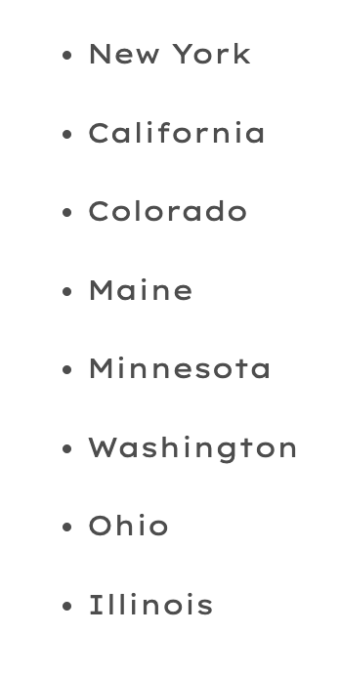
Trends in State Transcript Laws
https://www.bestcolleges.com/news/2022/05/19/states-that-ban-college-transcript-withholding-student-debt/

Slide 21
California looks at banning higher education collections (CA AB1160)
I strongly suggest the higher education community in California meet with Assembly Member Blanca Pacheco well before the next term of the California Assembly.

Slide 22
California Civ. Code Section 1788.202

Slide 23
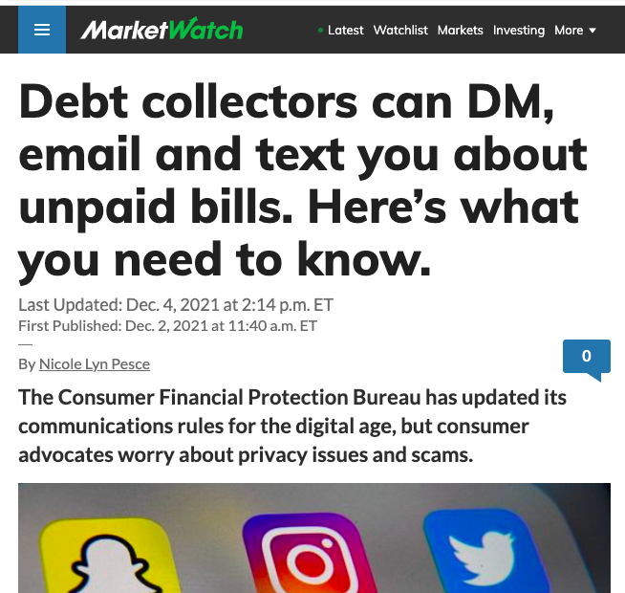
Regulation F
How did we get here?
The FDCPA - some background – my practice as an example
What were the FDCPA regulations prior to Regulation F?
The CFPB – where it was, where it went, and where it is now?
State activity following the implementation of Regulation F
The CFPB’s intention and the actions of consumer attorneys
are different issues.

Slide 24
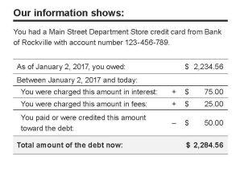
Model Validation Notice (MVN)
The CFPB wants an information piece and offered the safe harbor to try and implement that policy position.
The MVN – The breakdown of the debt & what does that mean?

Slide 25
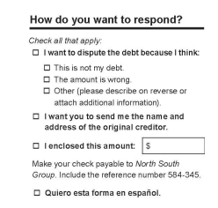
Model Validation Notice
How will the new MVN create more stalls & what can schools do??

Slide 26
Multiple Communication Channels and Today’s Consumer Experience – What Does Reg F Say?

Slide 27
Issues with Email and Texting Consumers
The main operational issue is that consumers are now consistently more comfortable dealing with universities (and other creditors) via various communication channels including text messages. Therefore, not using the applicable technologies (email/text/etc…) is not “welcomed” by consumers – it just seems odd to them.
Email is a 35 year old technology – think about that for a second.
Texting has various hurdles due to certain use restrictions of both aggregators and carriers.
Agencies have to integrate the experience into their collection software to properly incorporate email and/or texting communication channels.
Agencies have to remain aware of the TCPA issues associated with sending text messages as they are typically sent in some form similar to predictive dialing.
There is the potential for class action liability with any operational decision that is used consistently and done in the same manner (FDCPA class actions are capped and creditors are not governed by the FDCPA)

Slide 28
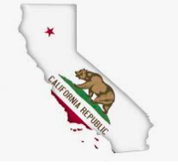
CA Collection Agency License Requirement
CA law does define ”debt collector” to include those entities collecting their own debt (i.e. creditors).
Work with licensed entities – that’s for sure!

Slide 29
Two Primary Reasons to Understand the Statute of Limitations (SOL):
It impacts recovery rates. Debts past the applicable statute of limitations are much less likely to be collected; and
The passing of the SOL has lots of consequences for your collection agency partners (required text, etc…)

Slide 30
New York City SOL Text Requirement Example:
“WE ARE REQUIRED BY LAW TO GIVE YOU THE FOLLOWING INFORMATION ABOUT THIS DEBT. The legal time limit (statue of limitations) for suing you to collect this debt has expired. However, if somebody sues you anyway to try to make you pay this debt, court rules REQUIRE YOU to tell the court that the statute of limitations has expired to prevent the creditor from obtaining a judgement. Even thought the statute of limitations has expired, you may CHOOSE to may payments. However, BE AWARE: if you make a payment, the creditor’s right to sue you to make you pay the entire debt may START AGAIN.”
This text has to be in 12-point font, near the amount due, and in a contrasting color.

Slide 31
Fair Credit Reporting Act
Do you furnish to CRAs (you – the actual school – not via a servicer or agency)?
What is furnisher?
What is the risk (1681s-2(b))(note triggered by notice from a CRA – not direct notice from a student)?
Q&A

Slide 32
Questions…

Slide 33
Let’s Connect
Phone Number
803.329.8971
Email Address
chad.echols@frostechols.com
Chad Echols
Outside General Counsel for Williams & Fudge, Inc.
Managing Partner at Frost Echols, LLC
Website
frostechols.com

