Slide 1
Government Assignments from A to Z
Presented by:
Lara Allworth
Client Relationship Coordinator, SME
ECSI

Slide 2
Learning Objectives
The goal of this session is to walk through the process of assigning a Perkins loan to the Dept. of Education.
During the session, details on the process, best practices, and common errors will be addressed. If you are new to Perkins and this process or have been doing assignments for years, this is the session for you.

Slide 3
Government Assignments, A to Z
Communications from the Department
Auditing your portfolio
Completing the assignment forms
Institutional Certification Form (1845 Form)
Borrower and Loan Information Form (1845 Form)
Supporting Documentation
Providing the right supporting documentation
Tips & tricks to avoid rejections

Slide 4
COMMUNICATIONS FROM THE dept. of ED

Slide 5
Department’s Communication
August 27, 2021
Section 463(a)(4)(A) of the Higher Education Act of 1965, as amended, states that if an institution knowingly failed to maintain an acceptable collection record for a defaulted Federal Perkins Loan (Perkins Loan), the Secretary may require the institution to assign the loan to the Department of Education (the Department) without recompense.
As part of the wind down of the Perkins Loan Program, the Secretary requires all institutions to assign to the Department all Perkins Loans that have been in default for more than two years. Unless the institution has documentation that these borrowers are making payments toward their Perkins loan debt, you are required to assign all Perkins Loans that have been in default for more than two years to the Department.
Institutions will have through June 30, 2022 to either assign or purchase loans that have been in default for more than two years. If an institution determines that borrowers who have defaulted Perkins Loans are making payments, the institution may notify the Department that documentation showing an acceptable collection record is available upon request. If the documentation is requested and reviewed by the Department, the institution will be notified whether these loans are required to be assigned, purchased, or if the institution may continue collecting on these loans.

Slide 6
Department’s Communication
August 27, 2021
In early 2022, the Department will assess all active Perkins loan assignment activity. If it is determined that an institution has shown insufficient effort assigning, purchasing, or providing acceptable collection records to the Department for review, a warning letter may be sent to the institution’s financial aid office as well as to the campus CEO/President reminding them of the requirement to take action on these loans by the June 30, 2022 deadline.
For subsequent Fiscal Operations and Application to Participate (FISAP) reporting periods beyond June 30, 2022, institutions will be required to assess their Perkins Loan portfolio to determine if additional accounts have exceeded two years in default status. The institution will then have until the end of the subsequent FISAP reporting period to assign those accounts. For example, a Perkins loan reaches 24 months in default status without collections activity in December 2022. The institution will have until June 30, 2024 to assign or purchase the loan.
If between the time the loan reached the 24-month default status and reaching the deadline to assign, the institution is able to collect payments on the loan, they may continue collecting on the loan in lieu of assigning or purchasing it. The Department will continue to monitor all school Perkins Loan assignment activity in subsequent years to ensure continued compliance with this requirement.
Any Perkins Loans required to be assigned that have been placed with a Private Collection Agency (PCA) must be returned to the institution so that the institution may meet the required assignment deadlines.

Slide 7
Department’s Communication
If the institution, or the firm it engages, pursues collection activity for up to 12 months and is not successful in converting the account to regular repayment status, or the borrower does not qualify for deferment, postponement, or cancellation on the loan, the institution shall:
Litigate in accordance with the procedures in § 674.46;
Make a second effort to collect the account as follows:
If the institution first attempted to collect the account using its own personnel, it shall refer the account to a collection firm.
If the institution first attempted to collect the account by using a collection firm, it shall either attempt to collect the account using institution personnel, or place the account with a different collection firm; or
Submit the account for assignment to the Secretary in accordance with the procedures set forth in § 674.50.

Slide 8
Department’s Communication
Purchasing a Perkins Loan Ineligible for Assignment
34 CFR 674.50(g) of the Federal Perkins Loan Program regulations states that the Secretary may require that the institution reimburse its program Fund for the entire portion of the outstanding principal balance (OPB) plus any accrued interest on a loan the Department determines is unenforceable.
An institution reports school-purchased loans on its FISAP in Part III, Section A the same as it would report funds it received from a borrower’s repayment of a loan balance. The amount deposited into the program Fund to purchase the loans is reported in cash-on-hand (Field 1.1). The portion of the total cash deposited that is principal is reported as loan principal collected (Field 5) and the portion that is interest is reported as interest income on loans (Field 31).

Slide 9
Department’s Communication
Individual notices dated January 26, 2022 sent to every Perkins school.
Reminder to schools of the June 30, 2022 deadline.
Schools received this notice even if they were making progress towards complying.

Slide 10
Department’s Communication UPDATE
A deadline extension from June 30, 2022 to June 30, 2023 has been announced (CB-22-10 dated May 4th).
The Department of Education (ED) is reminding schools to continue to work on their assignments.
Schools are being asked to provide the reason(s) for not meeting the June 30, 2022 deadline for assignments of loans two years or greater past due.
ED will be reviewing 2022 FISAP filings and will be reaching out to schools they deem to not be making sufficient progress.

Slide 11
Department’s Communication UPDATE
WARNING! In Part III, Section C, you reported borrowers in default for more than two years in fields 5.3b and/or 5.4b. Please confirm this is correct and explain why your school continues to hold the loan(s) in default. You must provide an explanation on the "Additional Information" screen in enough detail for the Department to assess whether your school will be notified whether these loans are required to be assigned, purchased, or if your school may continue collecting on these loans. If your school determines that the borrowers are making payments, your school confirms that it can provide documentation showing an acceptable collection record is available upon request. Please refer to guidance provided in an Electronic Announcement, Subject: Mandatory Assignment of Federal Perkins Loans in Default for More than Two Years (EA ID: GENERAL-21-53) on the Campus-Based Processing Information page on the FSA Partner's Knowledge Center website for further detail.

Slide 12
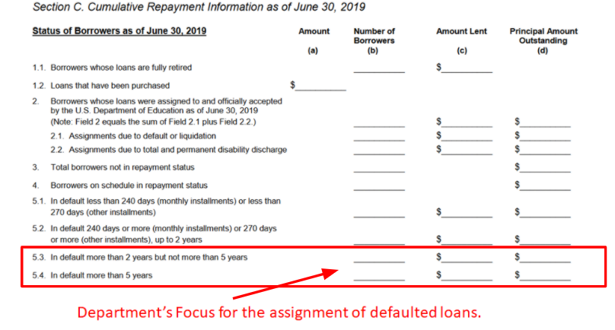
What is a healthy Perkins portfolio?

Slide 13
AUDITING YOUR PORTFOLIO

Slide 14
Auditing Your Portfolio
Review school’s collection process
Ensure every account is receiving annual collection attempt
Skip trace addresses twice per year
Clean-up and reconcile portfolio
Ensure all required due diligence was completed
Clean-up NSLDS Error report
Request reconciliation file, clean up any inconsistencies

Slide 15
Auditing Your Portfolio
Identify oldest accounts for potential assignment and review file for required documents
Promissory notes, bankruptcy and judgment documents (if applicable), repayment history
If documents missing, identify alternative documents and submit a cover sheet that details why you do not have the promissory note, and what you are providing
Determine electronic or paper process
Set reasonable timeline and account quantity

Slide 16
Loans that Cannot Be Assigned
Small Balance Loans
Total amount outstanding is less than $25.00 unless the borrower has multiple Defense, Direct, or Perkins loans that when combined equal more than $25.00
Borrower is deceased
Total and Permanent Disability (TPD)

Slide 17
Types of Assignments
What is Selective Assignment?
Selective Assignment is when a school has determined that they have exhausted all of their available collection options on its defaulted Perkins Loans and they no longer want to maintain the defaulted loan in their Perkins Loan portfolio. The Department has collection tools that are not available to schools, such as administrative wage garnishment, Treasury offset, and litigation by the Department of Justice. When a school is doing selective assignment, it means that they are only assigning some of their Perkins Loans.
What is Liquidation?
Liquidation means that a school is unable or unwilling to service the loans in their school’s Perkins Loan portfolio. This could mean that they are voluntarily withdrawing from the Perkins Loan program, their eligibility to participate in Title IV programs or the Perkins Program have been terminated by the Department of Education, or the school is closing or has closed. When a school is liquidating, it means they are transferring all of their Perkins Loans, regardless of whether they are current, delinquent, or defaulted, to the Department.

Slide 18
Selective Assignment Process
Step 1: The school needs to notify the borrower prior to assigning the loan. This notification can come directly from the school or through the school’s third-party loan servicer.
Step 2: Assigning the loans. We will cover all of the duties in the more detail during the assignment procedures review.
NOTE: During this process, some of the loans will be accepted and can be transferred to the Department. However, some may not be accepted for various reasons. If a loan is not accepted, the school must purchase the loan, meaning that they must reimburse the Perkins Program fund with funds that come directly from the school.
Step 3: The last step for the school is to report the assigned or school purchased loans to NSLDS.

Slide 19
Liquidation Assignment Process
Step 1*: Notify the Department of their intent to liquidate. This is done through the Department’s Common Origination and Disbursement (COD) System.
Step 2: The school must notify the third-party servicer that the school uses to service their Perkins Loan portfolio of their intent to liquidate.
Step 3: The school needs to notify the borrower prior to assigning the loan. This notification can come directly from the school or through the school’s third-party loan servicer.
Step 4: Assigning the loans. We will cover all of the duties in the more detail during the assignment procedures review.
NOTE: During this process, some of the loans will be accepted and can be transferred to the Department. However, some may not be accepted for various reasons. If a loan is not accepted, the school must purchase the loan, meaning that they must reimburse the Perkins Program fund with funds that come directly from the school.
Step 5: Update NSLDS, perform that Perkins closeout audit, remit the federal share of the Perkins funds, complete their final FISAP data, and submit the official liquidation completion letter.

Slide 20
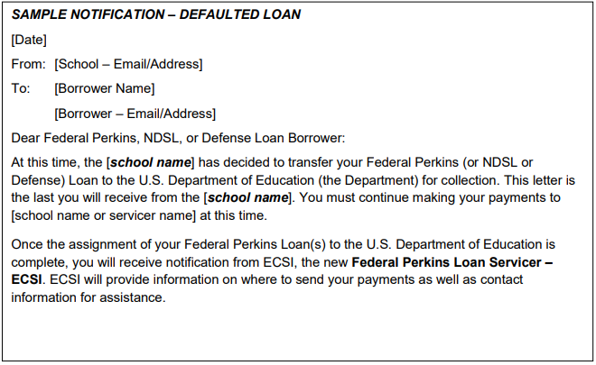
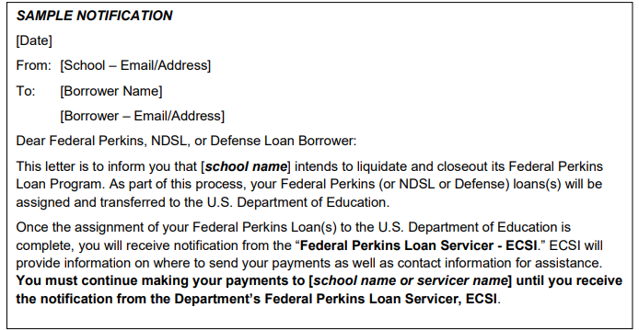
Sample Borrower Notification

Slide 21
ASSIGNMENT FORMS

Slide 22
Assigning the Loans
Perkins Loan assignments must include the following documents:
Institutional Certification Form (OMB 1845-0048)
Assignment Manifest
Borrower and Loan Information Form (OMB 1845-0048)
Original Promissory Note or Perkins Master Promissory Note (MPN)
Repayment History (also called Payment History)
Disbursement Records (if applicable)
Judgment Information (if applicable)
Bankruptcy Information (if applicable)

Slide 23
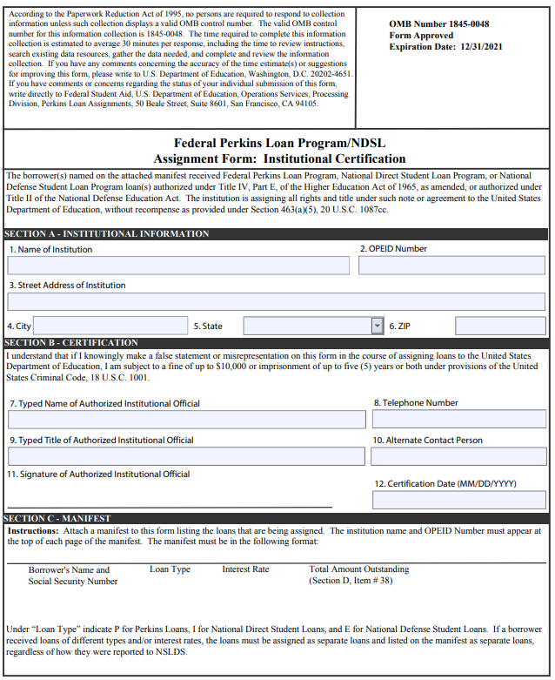
Institutional Certification Form
A school is required to complete only one Institutional Certification page of the Perkins Assignment Form for each assignment submission package (also referred to as a batch).

Slide 24
Filling Out the Institutional Certification Form
SECTION A - Institutional Information
Name of Institution
Must be as shown under your OPEID with the Department
OPEID Number
Institution’s Street Address
Institution’s City
Institution’s State
Institution’s Zip Code

Slide 25
Filling Out the Institutional Certification Form
SECTION B - Certification
Typed Name of Authorized Official
Should be someone who is authorized to certify information on behalf of the school
Vice President of Finance, Director Student Loan Accounts, etc.
Telephone Number
Typed Title of Authorized Official
Name of Alternate Contact
Signature of Authorized Official
Certification Date
Should match the date the school reported to NSLDS when transferring loans

Slide 26
Assignment Manifest
SECTION C - Manifest
You must include a manignmentifest for each assignment that is included in the submission package (batch).
The manifest must include the following:
Borrower’s Name and Social Security Number
Loan Type (“P” for Perkins Loans)
Interest Rate
Total Amount Outstanding

Slide 27
Sample Manifest

Slide 28
Assignment Manifest
Loans Needing Split Due to Fiscal Year Error
After 2008, loans are now required to be split per FISCAL YEAR (July 1 to June 30).
Example: If a student has two (2) disbursements with the first being in April 2016 and another in September 2017, these need to be two (2) separate loans, requiring them to be listed separately on the manifest and requiring two (2) separate Borrower and Loan Assignment forms.

Slide 29
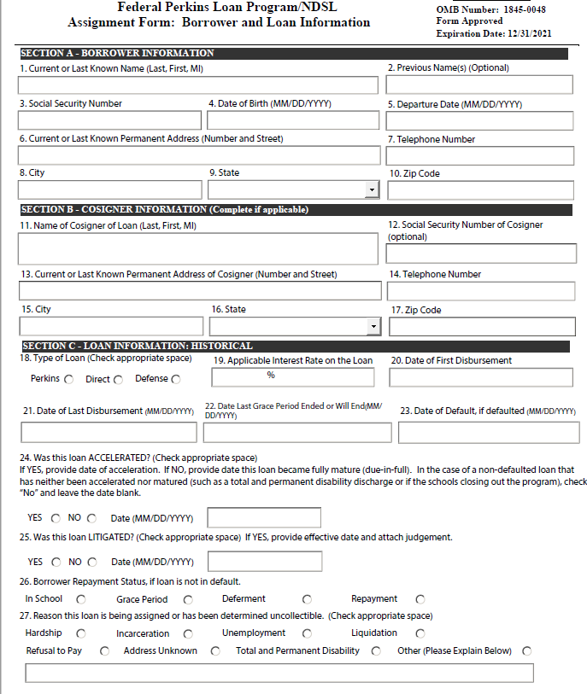
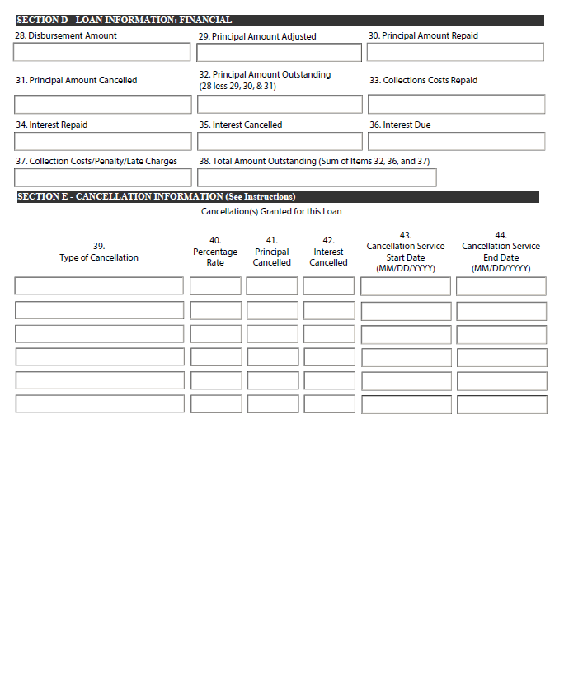
Borrower and Loan Information Form (OMB 1845-0048)
The Borrower and Loan Information page of the Perkins Assignment Form should be completed for each loan included in the submission package (batch).

Slide 30
Filling Out the Assignment Form
SECTION A - Borrower Information
Current or Last Known Name of the Borrower (Last, First, MI) REQUIRED
Previous Name(s)
Borrower’s Social Security Number REQUIRED
Borrower’s Date of Birth REQUIRED
Borrower’s Departure Date From the School REQUIRED
Borrower’s Current or Last Known Permanent Address (Number and Street) REQUIRED
Borrower’s Current or Last Known Phone Number REQUIRED
Borrower’s City REQUIRED
Borrower’s State REQUIRED
Borrower’s Zip Code REQUIRED

Slide 31
Filling Out the Assignment Form
SECTION B - Cosigner Information
Name of Cosigner of Loan (Last, First, MI)
Cosigner’s Social Security Number
Cosigner’s Current or Last Known Permanent Address (Number and Street)
Cosigner’s Current or Last Known Phone Number
Cosigner’s City
Cosigner’s State
Cosigner’s Zip Code

Slide 32
Filling Out the Assignment Form
SECTION C - Loan Information: Historical
Type of Loan REQUIRED
Applicable Interest Rate REQUIRED
Must match the interest rate reflected on the promissory note or subsequent interest rate changes due to litigation or presence of a judgment
Date of First Disbursement REQUIRED
Must match the disbursement date listed on the promissory note
If MPN, must match the disbursement history
Must match information provided to NSLDS
If a borrower’s Perkins Loans were reported to NSLDS as one loan, report the date of the first disbursement of the first loan the borrower received.

Slide 33
Filling Out the Assignment Form
SECTION C - Loan Information: Historical
21. Date of Last Disbursement REQUIRED
The date of last disbursement must be prior to the departure date unless an explanation is attached detailing why it is not.
22. Date Last Grace Period Ended or Will End REQUIRED
Must show that the full grace period began after the departure date

Slide 34
Filling Out the Assignment Form
SECTION C - Loan Information: Historical
23. Date of Default
Date following the day on which payment was due and not received
In cases where the borrower was considered to be in default but made a few additional payments under a repayment arrangement, the date of default becomes the day following the day on which the first rescheduled payment was due and not made.
In cases where the borrower made sporadic payments outside of a repayment arrangement, the date of default remains the original date of default.
In the case of TPD for a loan that has not defaulted, leave the field blank.
If the loan is not in default, leave this field item blank.

Slide 35
Filling Out the Assignment Form
SECTION C - Loan Information: Historical
24. Acceleration Yes/No Checkbox and Acceleration Date
If the loan has matured, check No and enter the date the loan matured
In the case of non-defaulted loans that have not been accelerated nor matured (such as TPD or school closing), check No and leave the date blank
25. Litigation Yes/No Checkbox and Litigation Date
26. Borrower Repayment Status (In School, Grace Period, Deferment, Repayment)
27. Reason the Loan is Being Assigned
Hardship, Incarceration, Unemployment, Liquidation, Refusal to Pay, Address Unknown, Total and Permanent Disability, Other with Explanation

Slide 36
Filling Out the Assignment Form
SECTION C - Loan Information: Historical
28. Disbursement Amount REQUIRED
Original amount loaned to the borrower as indicated on the promissory note or disbursement records
29. Principal Amount Adjusted REQUIRED
Any amount refunded or never disbursed that would reduce the principal
If none, enter $0.00
30. Principal Amount Repaid REQUIRED
Total amount repaid and credited to principal as of the certification date
If none, enter $0.00

Slide 37
Filling Out the Assignment Form
SECTION D - Loan Information: Financial
31. Principal Amount Cancelled REQUIRED
If none, enter $0.00
32. Principal Amount Outstanding (28 less 29, 30, 31) REQUIRED

Slide 38
Filling Out the Assignment Form
SECTION D - Loan Information: Financial
33. Collection Costs Repaid REQUIRED
This includes any collection fees that were repaid
If none, enter $0.00
34. Interest Repaid REQUIRED
If none, enter $0.00
35. Interest Cancelled REQUIRED
If none, enter $0.00
36. Interest Due REQUIRED
If none, enter $0.00

Slide 39
Filling Out the Assignment Form
SECTION D - Loan Information: Financial
37. Collection Costs/Penalty/Late Charges REQUIRED
Include any collection costs that have been assessed on the loan
Include any penalty or late charges assessed
Include any costs of activities such as skip-tracing, litigation, address searches, and generation of letters
If none, enter $0.00
38. Total Amount Outstanding (Sum of Items, 32, 36, and 37) REQUIRED

Slide 40
Filling Out the Assignment Form
SECTION E - Loan Information: Financial
39. Type of Cancellation
40. Percentage Rate
41. Principal Cancelled
42. Interest Cancelled
43. Cancellation Service Start Date
44. Cancellation Service End Date
NOTE: The sum of the amounts in Field 41 must equal the amount in Field 31.
NOTE: The sum of the amounts in Field 42 must equal the amount in Field 35.
NOTE: You do not need to submit the cancellation documentation with the assignment, but you must retain it for three (3) years from the date the loan is assigned.

Slide 41
SUPPORTING DOCUMENTS

Slide 42
Original Promissory Note or
Perkins Master Promissory Note (MPN)
Original Perkins promissory notes are required for all loans, if available.
All promissory notes submitted for assignment must be valid legal instruments.
The promissory notes must contain signatures, loan amounts, and dates for each loan period.
Perkins Master Promissory Notes (MPNs) must contain the borrower’s signature and the principal amount loaned must be substantiated by institutional disbursement records.
Perkins Loan promissory notes that were signed electronically are acceptable.
If the original promissory note is no longer available and only a photocopy exists, the photocopy (front and back) can be used and must be certified as a true copy by an appropriate school official such as the Controller or Vice President of Finance.

Slide 43
Original Promissory Note or
Perkins Master Promissory Note (MPN)
Must have a borrower signature for disbursements and/or rights and responsibilities
Must have the name of the college or university
Must be dated
Must show the interest rate
Must be signed before the loan is disbursed unless it is
Signed within 30 days of the disbursement
School sends a letter providing correct disbursement dates or explaining why the note was signed late

Slide 44
Original Promissory Note or
Perkins Master Promissory Note (MPN)
True and Certified Copy Statement Certified True Copy “I declare under penalty of perjury that the foregoing is a true and correct copy of the original promissory note.”
Signature
Title Date

Slide 45
Disbursement Records
If disbursements were made under a Perkins MPN, disbursement records must be provided.
Disbursement records must show the dates and amounts of each disbursement.

Slide 46
Repayment History
Also referred to as Payment History
A copy of the student's loan repayment history (financial profile of the account) must be provided.
The repayment history must include a record of all payments made
On a payment-by-payment basis
How individual payments were applied (such as what portion of the payment was applied to principal, what portion was applied to interest, etc.)
Requests for cancellation, forbearance or deferment, if applicable
Must be less than 60 days old to be considered current and acceptable
Required whether payments were made or not
If no payments were made, a letter can be sent stating that there were not payments made.

Slide 47
Judgment Information
If a school has initiated legal action against a borrower as part of its collection efforts, the loans of that borrower cannot be assigned to the Department until the litigation is completed and a judgment is rendered for the institution and against the borrower or endorser or the judgment is denied. If the institution chooses to assign the loan immediately, the legal action will need to be withdrawn from the courts.
Must transfer the judgment to the Department and provide original or certified true copy of the judgment
Some states require that school to notify the courts of the transfer and file the transfer at the courthouse to make the judgment enforceable.
Judgments made prior to April 9, 1991, are no longer active and do not have to be provided.
There is no FSA approval process for missing judgment documentation, meaning that the loan cannot be assigned and the school must buy back the loan.

Slide 48
Bankruptcy Information
If a school receives notification that a bankruptcy petition has been filed prior to the time the school submits the loan to the Department, the account cannot be assigned until the court has ruled on the bankruptcy petition, except in the case of a school that is liquidating or closing.
If the school is not liquidating or closing, it cannot assign any account pending a bankruptcy decision by the court.
In addition to all documents related to the bankruptcy filing received, the school must provide documentation that it requested the bankruptcy court to name the U.S. Department of Education or the Secretary of the U.S. Department of Education as the creditor.
If the court rules that loan can be discharged in the bankruptcy, the account cannot be assigned.
If the court rules that the loan cannot be discharged in the bankruptcy, this documentation should be included with the assignment.
If the bankruptcy is dismissed, the dismissal paperwork should be included with the assignment.

Slide 49
Bankruptcy Information
If the schools receives a petition for bankruptcy after the account was sent for assignment, the school should notify ECSI Federal Perkins Loan Servicer so the bankruptcy can be posted.
Send a secure message to productionprocessing@efpls.ed.gov
A discharge in bankruptcy prevents further enforcement of this loan against a borrower.
If a cosigner is listed, they are still legally responsible for the debt.
The institution should perform due diligence requirements with respect to the cosigner before attempting to assign the loan.

Slide 50
Common Errors
Disbursement dates do not match NSLDS or history
Section D does not total correctly.
Default date is after the acceleration date
Date of last grace is after the default date
Reason the loan is being assigned

Slide 51
Common Errors
Judgment documents need to have the figures broken down
Prom note was not signed
Missing prom notes
Missing all pages of the prom note
Prom note is a copy, we need a true certified copy letter

Slide 52
Common Errors
Prom note has altered dates/other info
Date of first disbursement is prior to the date the prom note was signed
0 to 30 days accepted
31 day to 6 months requires a letter of explanation
6+ months requires FSA approval

Slide 53
FSA Approval for Missing or Questionable Information (UPDATE April 6, 2022)
Schools should attempt to assign the loans first using the alternative documentation in place of the missing promissory note first. Examples of alternative documentation include entitlement forms, signed term and conditions, signed exit interview, proof of previous payments, etc.
Such loans will be examined to see if the assignment is acceptable and if there are any other issues that need to be addressed.
If not accepted, such loans will be sent back to schools on a Pending Report. If approval is needed via FSA, the error message on the Pending Report will direct schools to obtain the approval and if received, re-submit the loan for assignment.

Slide 54
Important Contact Information
ECSI Federal Perkins Loan Servicer
Phone: 1-844-301-2620
Email: clientsupport@efpls.ed.gov
(NEW) Assignment Packages and Correspondence should be mailed to:
ECSI Federal Perkins Loan Servicer
1200 Cherrington Parkway, Suite 200
Moon Township, PA 15108
Payments received after loans have been accepted for assignment should be mailed to:
U.S. Department of Education
ECSI Federal Perkins Loan Servicer
P.O. Box 6200-31
Portland, OR 97228-6200

Slide 55
Need assistance with your assignments?
ECSI offers a Standard Government Assignment Packet services and Enhanced Government Assignment Packet services. Contact your Client Relationship Coordinator (lara.allworth@e-hps.com –or- cstompanato@ecsi.net) or Dedicated Client Support Rep to find out how we can further assist with the assignment process.

Slide 56
Contact Information
Lara Allworth
Client Relationship Coordinator/SME
ECSI
412.889.9740
Lara.Allworth@e-hps.com

Slide 57
Questions…

