Slide 1
Mirror Mirror on the Wall
PacWestSFS – Professional Development
The Power of Connection Through Change
May, 2023

Slide 2
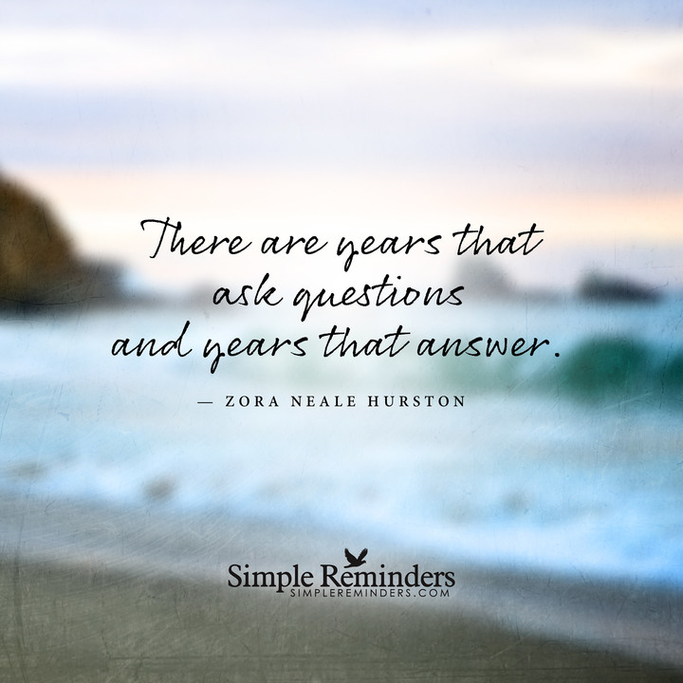
Continue Curiosity in 2023

Slide 3
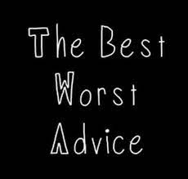
Best / Worst Advice

Slide 4
#1 Define Your Direction

Slide 5
# 2 – Is Education the Answer?

Slide 6
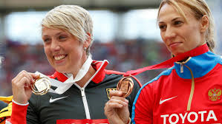
# 3 - Enlist a team of Mentors, Champions, & Sponsors

Slide 7
# 4 - Raise Your Hand

Slide 8
#5 Define & Craft Your Network

Slide 9
# 6 - Make Gracious Introductions-Become the Mentor

Slide 10
# 7 – Support Your Teammates

Slide 11
# 8 – Authentic/Genuine & Consistent

Slide 12
# 9 - Fit & Match
Fit & Match

Slide 13
#10 - “Work Out”

Slide 14
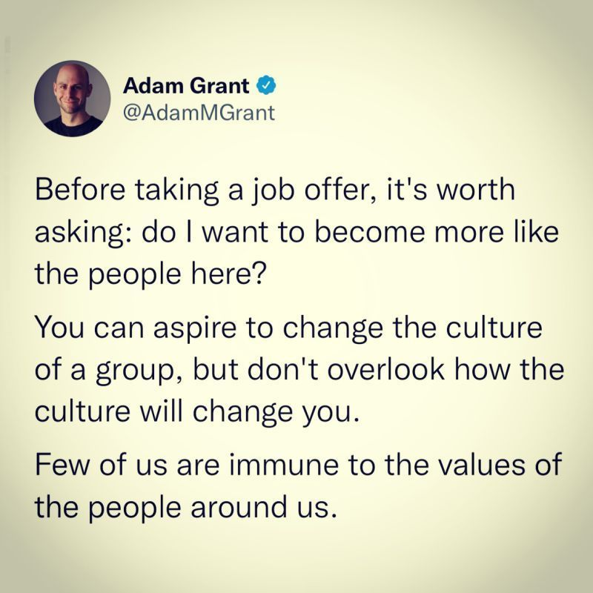
Interesting Perspective – a la Adam Grant

Slide 15
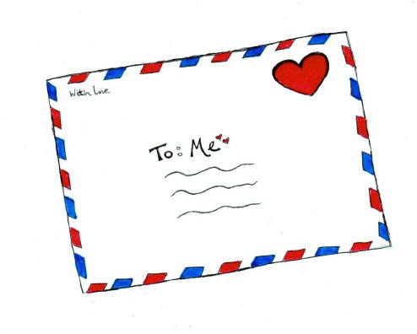
Your Challenge

Slide 16
Your Challenge
Letter to yourself
https://www.futureme.org/
Penzu – Journal -- https://penzu.com/app/signup
C/O DMFennig
1068 Dogwood Forest Drive, NE
Marietta, GA 30068

Slide 17
Resources
Journaling Prompts – Link for Year End Thoughts
https://dayoneapp.com/blog/end-of-year-journaling-prompts/
https://www.fastcompany.com/90824133/forget-resolutions-write-new-year-letter
Think Like A Scientist Amy Edmonson
https://www.linkedin.com/pulse/todays-leaders-must-learn-think-like-scientists-amy-edmondson/
Higher Ed Dead End Jobs
https://www.chronicle.com/article/higher-ed-is-a-land-of-dead-end-jobs?
https://www.highereddive.com/news/7-higher-education-trends-to-watch-in-2023/639131/

Slide 18
What’s Next?

Slide 19
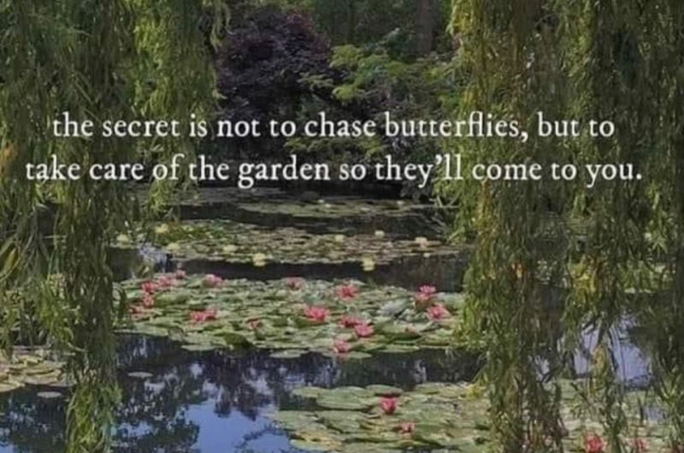
Final Thought

Slide 20
It has been my pleasure… Diane Fennig, Senior Consultant Diane_Fennig@ajg.com 678.234.1196 www.linkedin.com/in/dianefennig @fansoffennig
We make a difference in your business…by doing things differently in ours.

