Slide 1
Providing Customer Excellence in a Hybrid Environment
University of California San Diego
Veronica Olvera-Salce: Operations Analyst, UCSD Student Financial Solutions
Mark Adams: Supervisor, Student Account and Client Services, UCSD Student Financial Solutions

Slide 2
Customer Service.
What it means to Student Financial Solutions.

Slide 3
Business Model Pre-Pandemic
Websites
Desk phones
Walk in traffic
Emails

Slide 4
Adapting to COVID-19
The need to build a remote working environment

Slide 5
Options for staffing during a pandemic
Fully remote
Partial hybrid (1 remote day a week)
Hybrid (2 or more remote days a week)
On Site every day

Slide 6
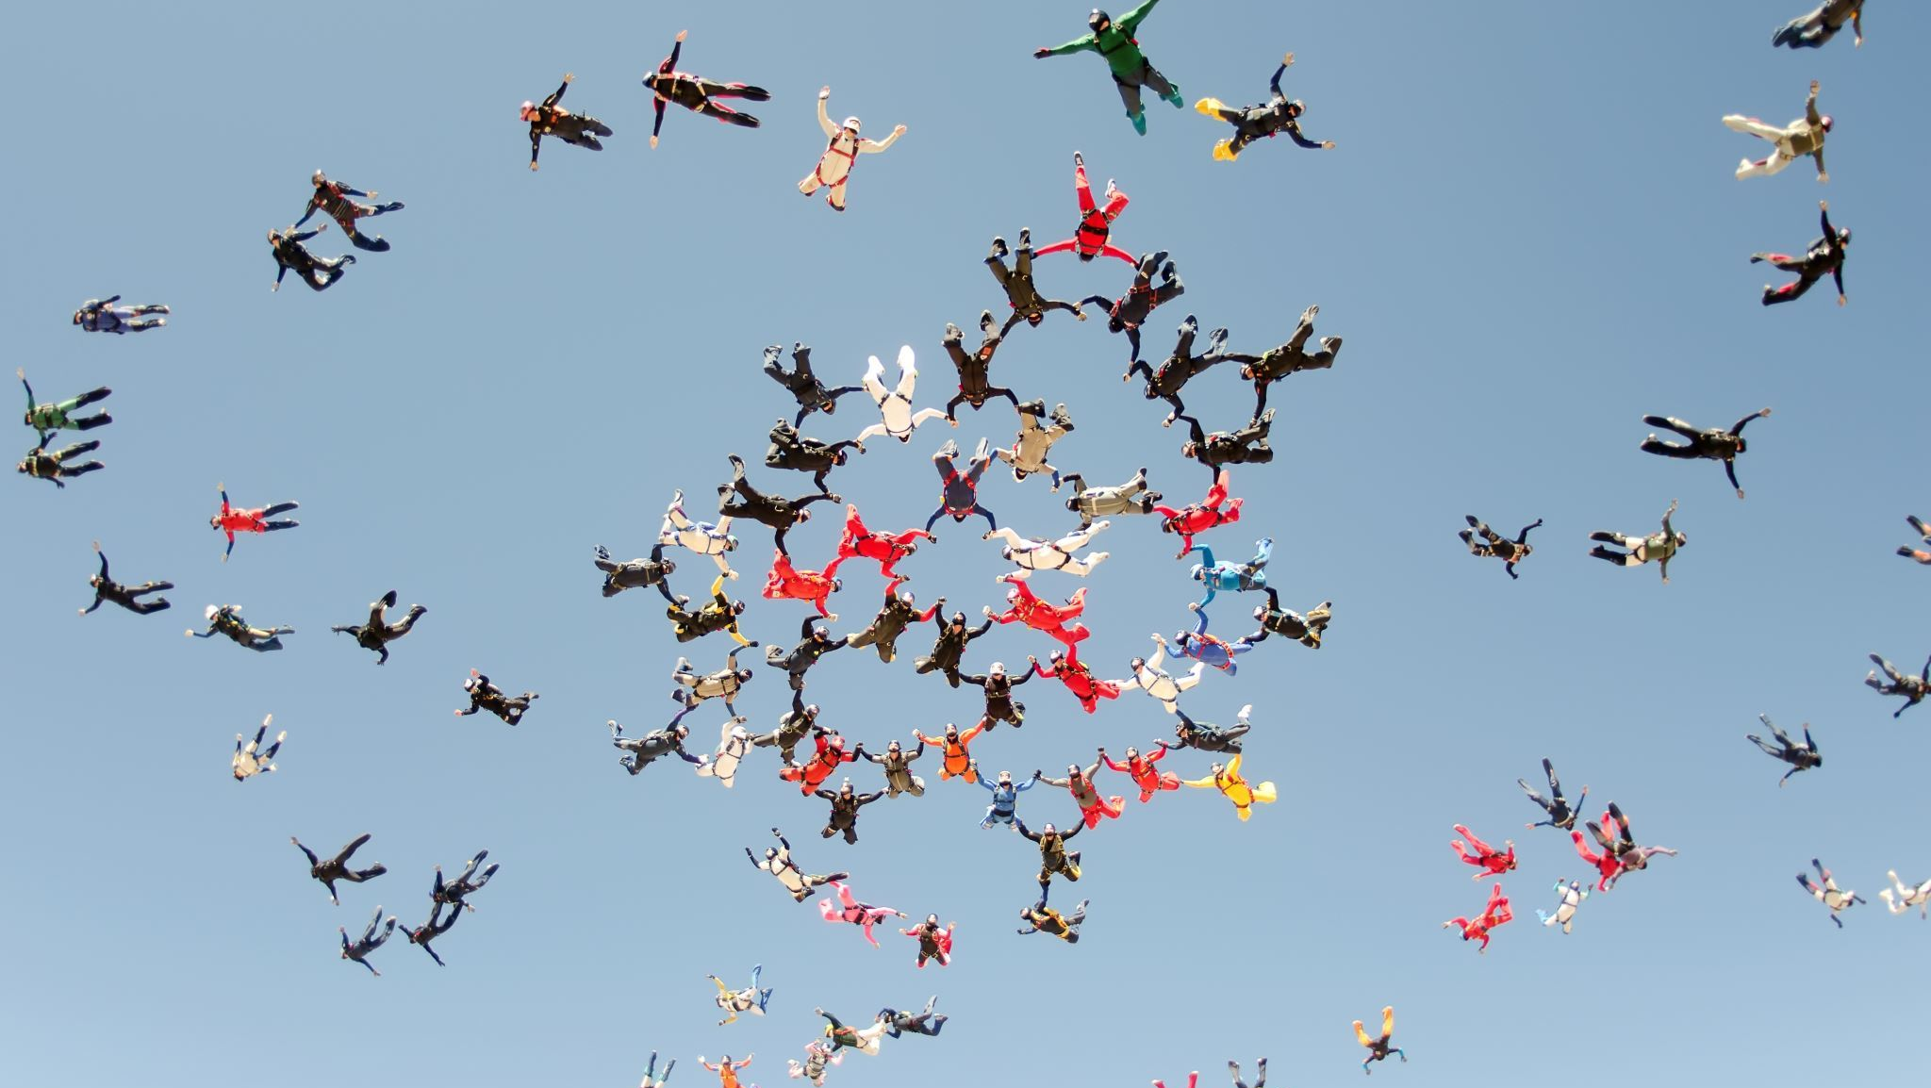
COVID-19 Closure
What are our immediate needs?
Serving our customer base
Outreach and communication with our process partners
Ensuring daily processes continue with interruption
How to ensure staff productivity?
Communication
Supervision
Accountability
Keeping up morale!
Increased outreach
Group activities
Callouts and Kudos

Slide 7
Serving our Customers
Service Now
TalkDesk
Virtual Advising
Webinars

Slide 8
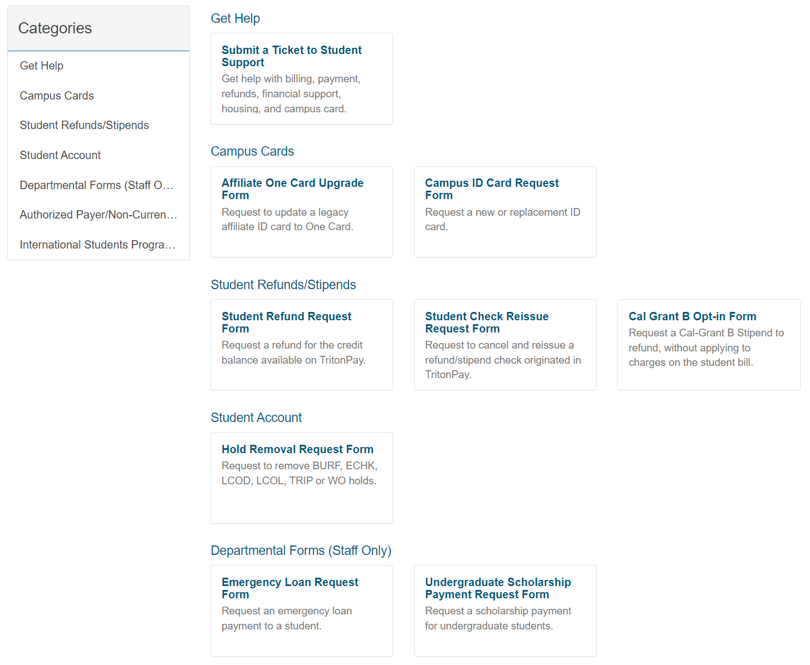
Introducing
Servicenow

Slide 9
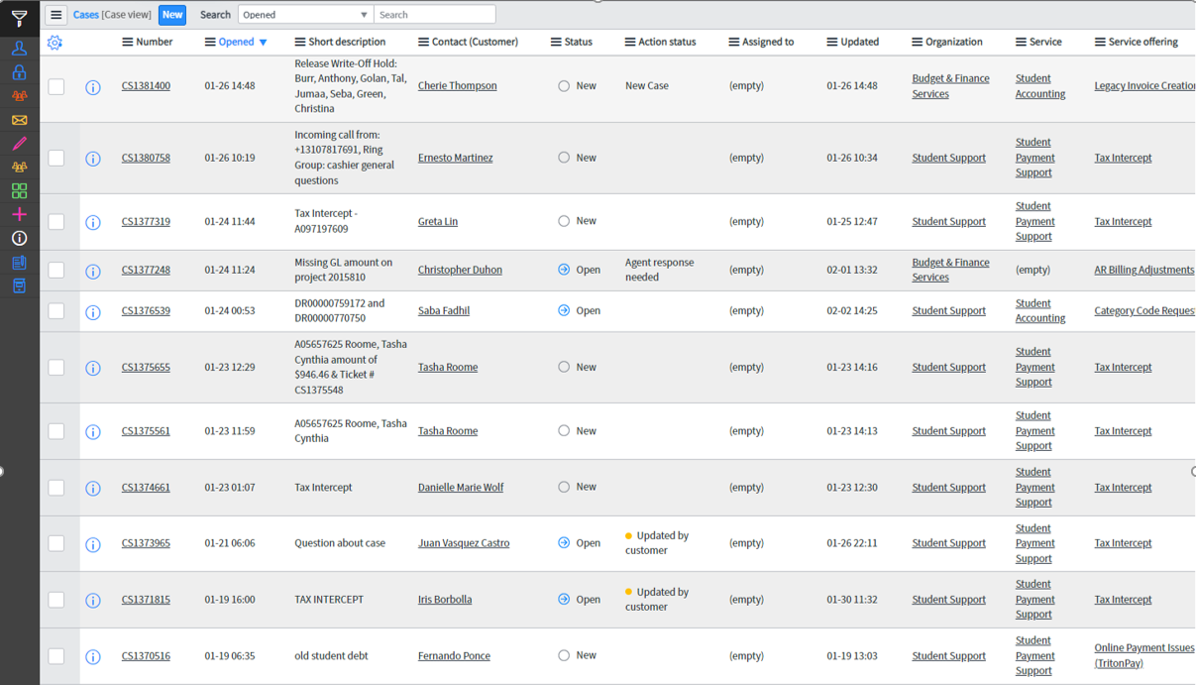

Slide 10
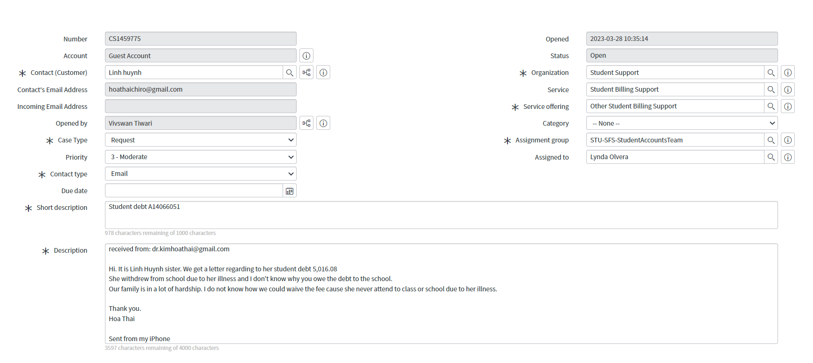
Incoming Case

Slide 11
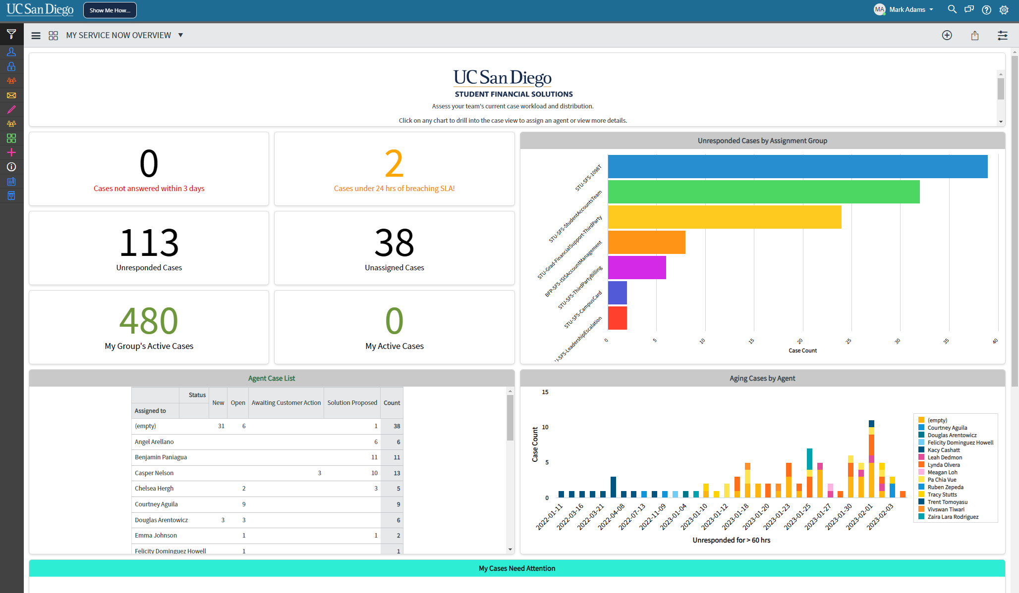
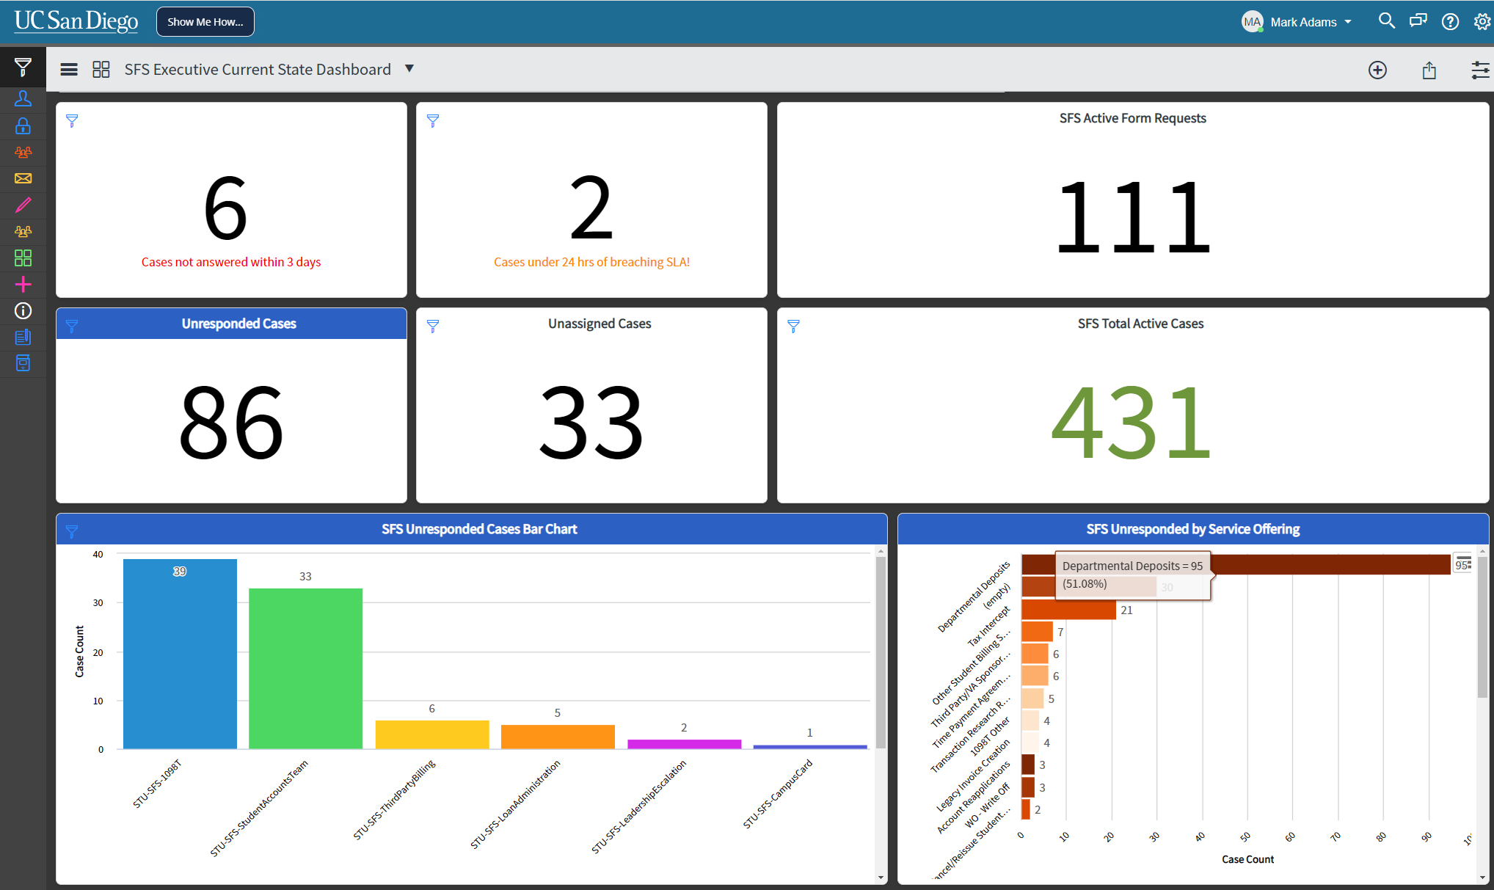
Dashboards

Slide 12
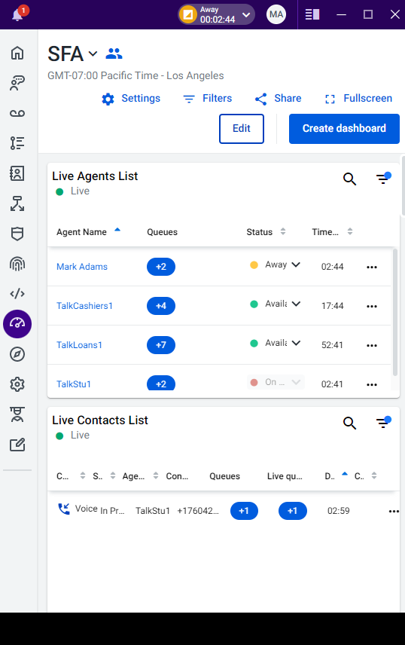
Introducing TalkDesk

Slide 13
Understanding the volume

Slide 14
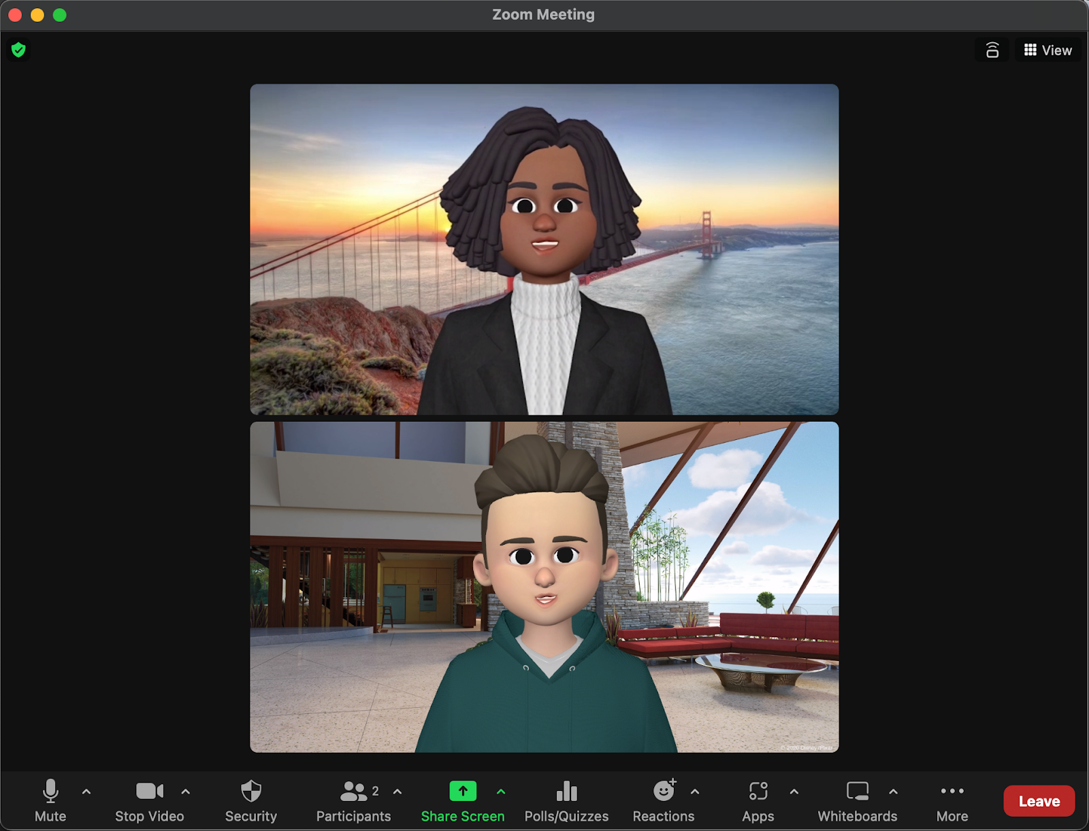
Zoom and Virtual Advising

Slide 15
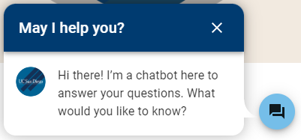
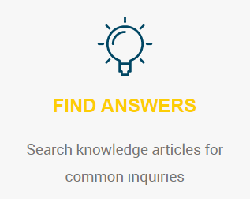
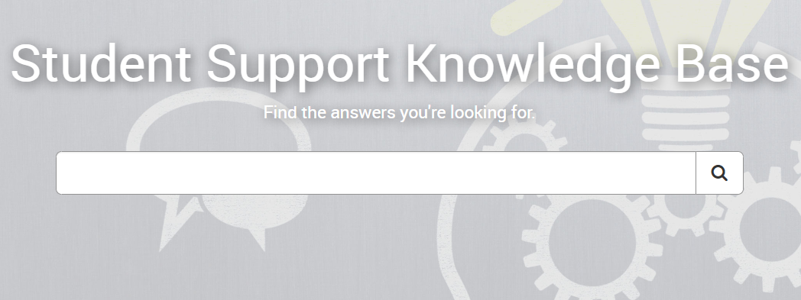
Webinars, Website Chatbot & Knowledge Based Articles

Slide 16
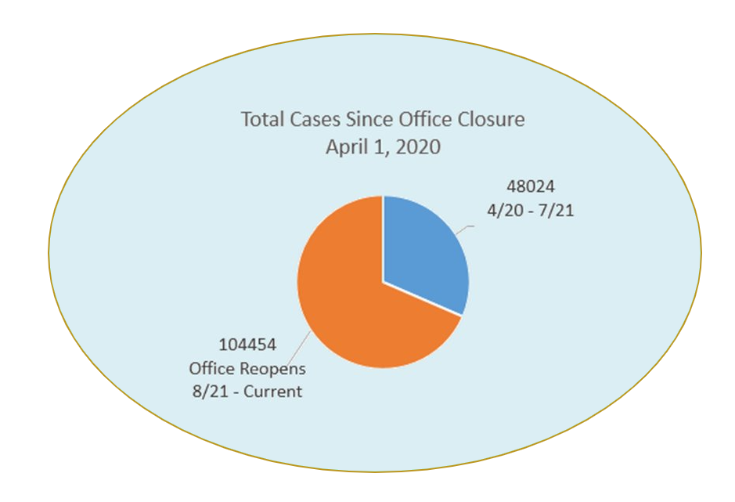
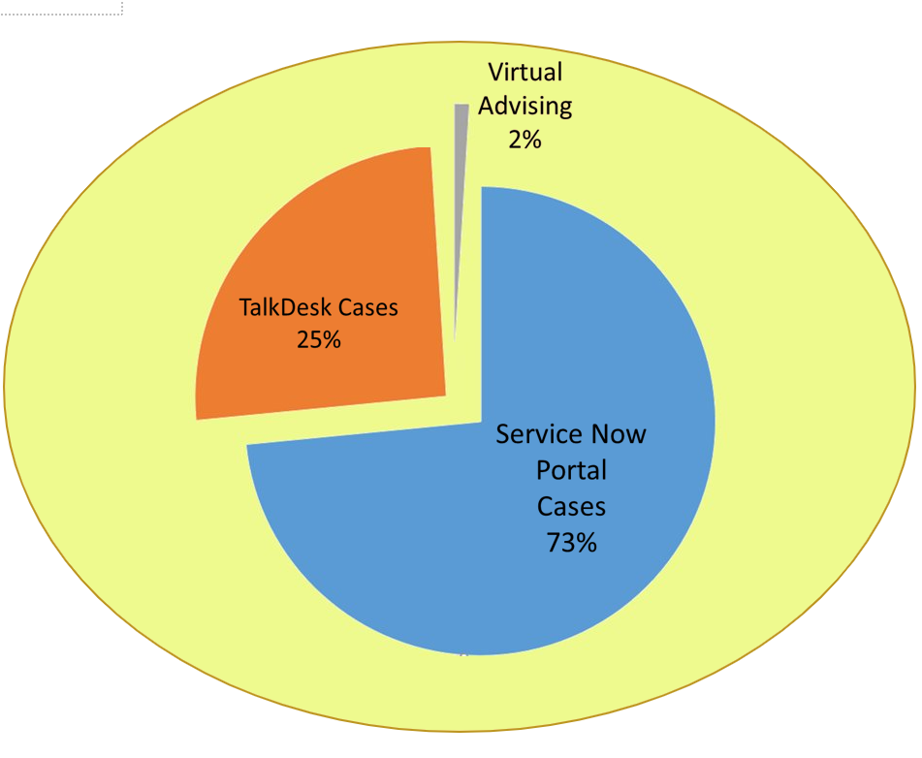
Metrics
Analyzing the data to meet our needs
Volume and Case Load

Slide 17
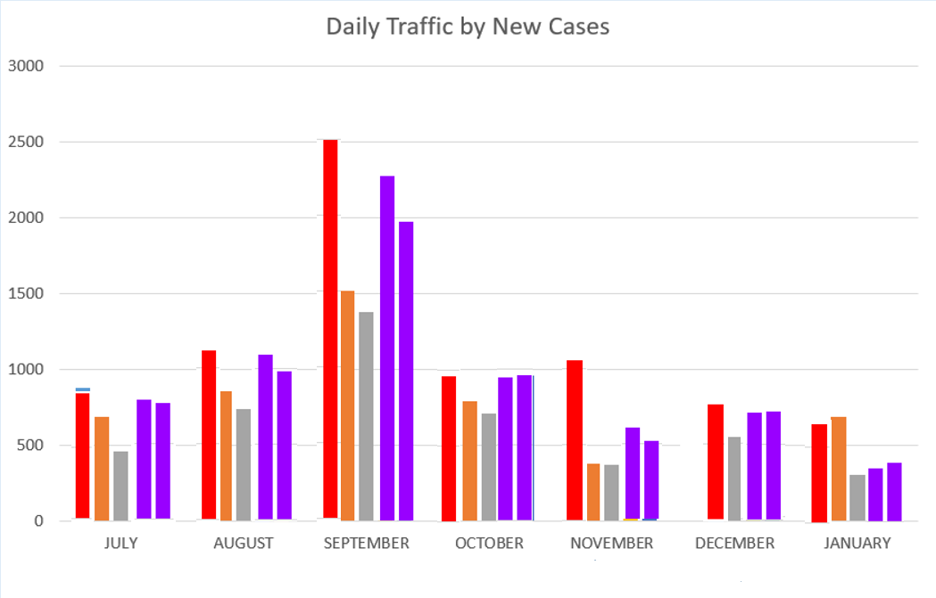
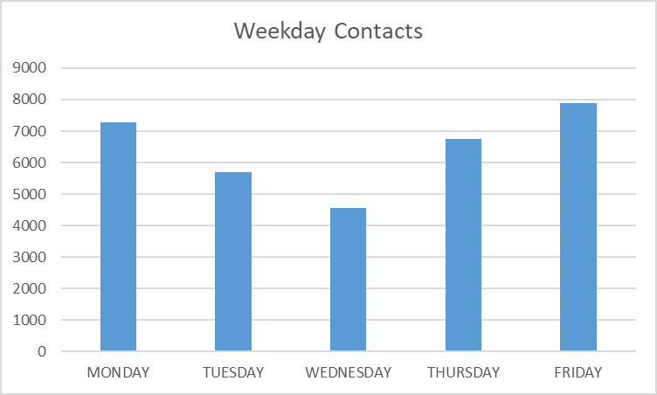
Metrics
Analyzing the data to meet our needs
Monthly and Daily volume
Time on case per contact method

Slide 18
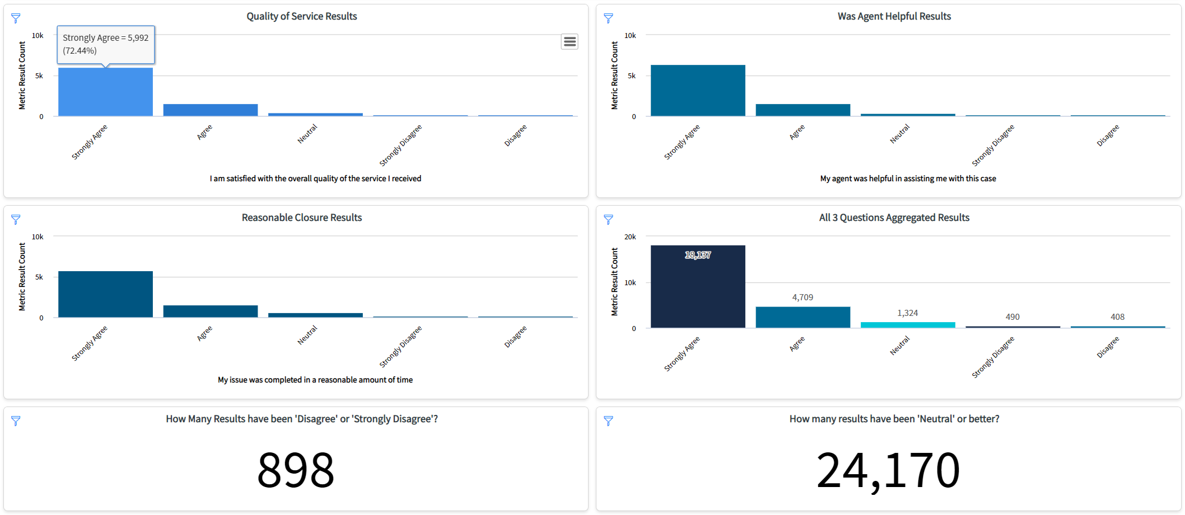
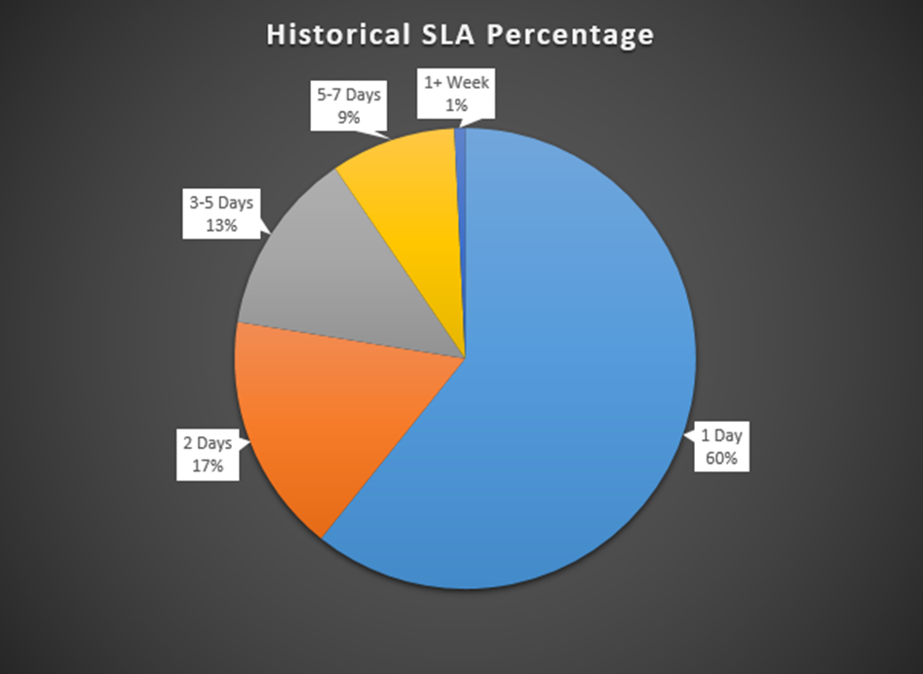
Metrics
96.7%
Positive
4.71
Average
Analyzing the data to meet our needs
Service Level Agreements
and
Case Survey Responses

Slide 19
Ensuring Staff Productivity
Weekly Huddles ( all staff meetings)
Meeting with our individual units for a recap on new or existing projects
Having consistent one on one's with supervisors.
Using Microsoft teams was a lifeline for all, here we can send a message to process partners, our student's, and coworkers.

Slide 20
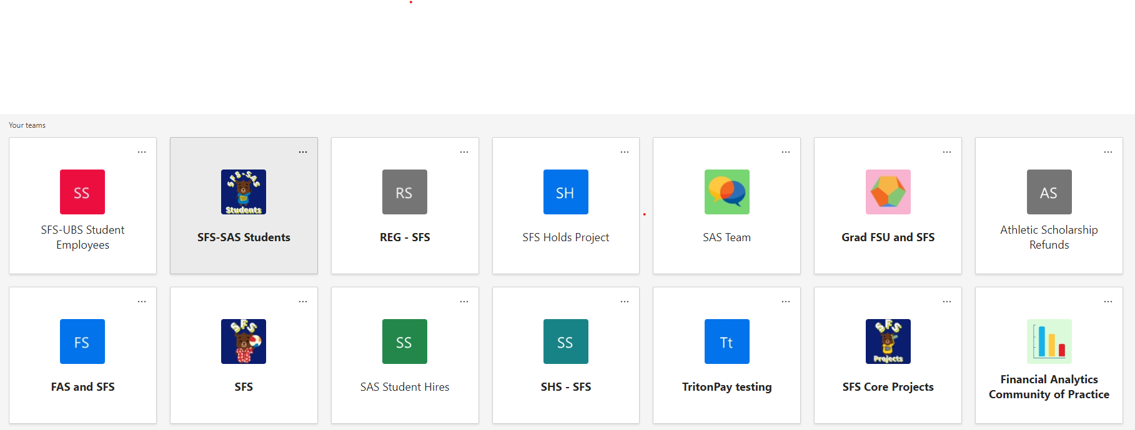
Microsoft Teams

Slide 21
Keeping up Morale
Online Celebrations
Birthday's
Retirement's
Holiday's
Lunch time socials
Crosswords
Trivia games
Weekly check ins with staff
Moving forward we continued our social events to monthly, having different units organize an event . (i.e, Basebal games, revisiting our campus, happy hour)

Slide 22
Thank you! Veronica Olvera Student Account Advisor UCSD Student Financial Solutions lovlvera@ucsd.ed Mark Adams Supervisor, Student Account and Client Services UCSD Student Financial Solutions maadams@ucsd.edu SBS.ucsd.edu

