Slide 1
No Holding Back: Lessons in Analyzing Administrative and Student Success Holds Data
PacWest SFS Conference
May 17-29, 2023
San Diego, CA

Slide 2
Agenda
Introductions
Presentations
What do you know about holds on your campus?
What do we know about the use of registration and transcript holds?
Small group work
How can you analyze data and inform policy?
How would you undertake this work on your campus?

Slide 3
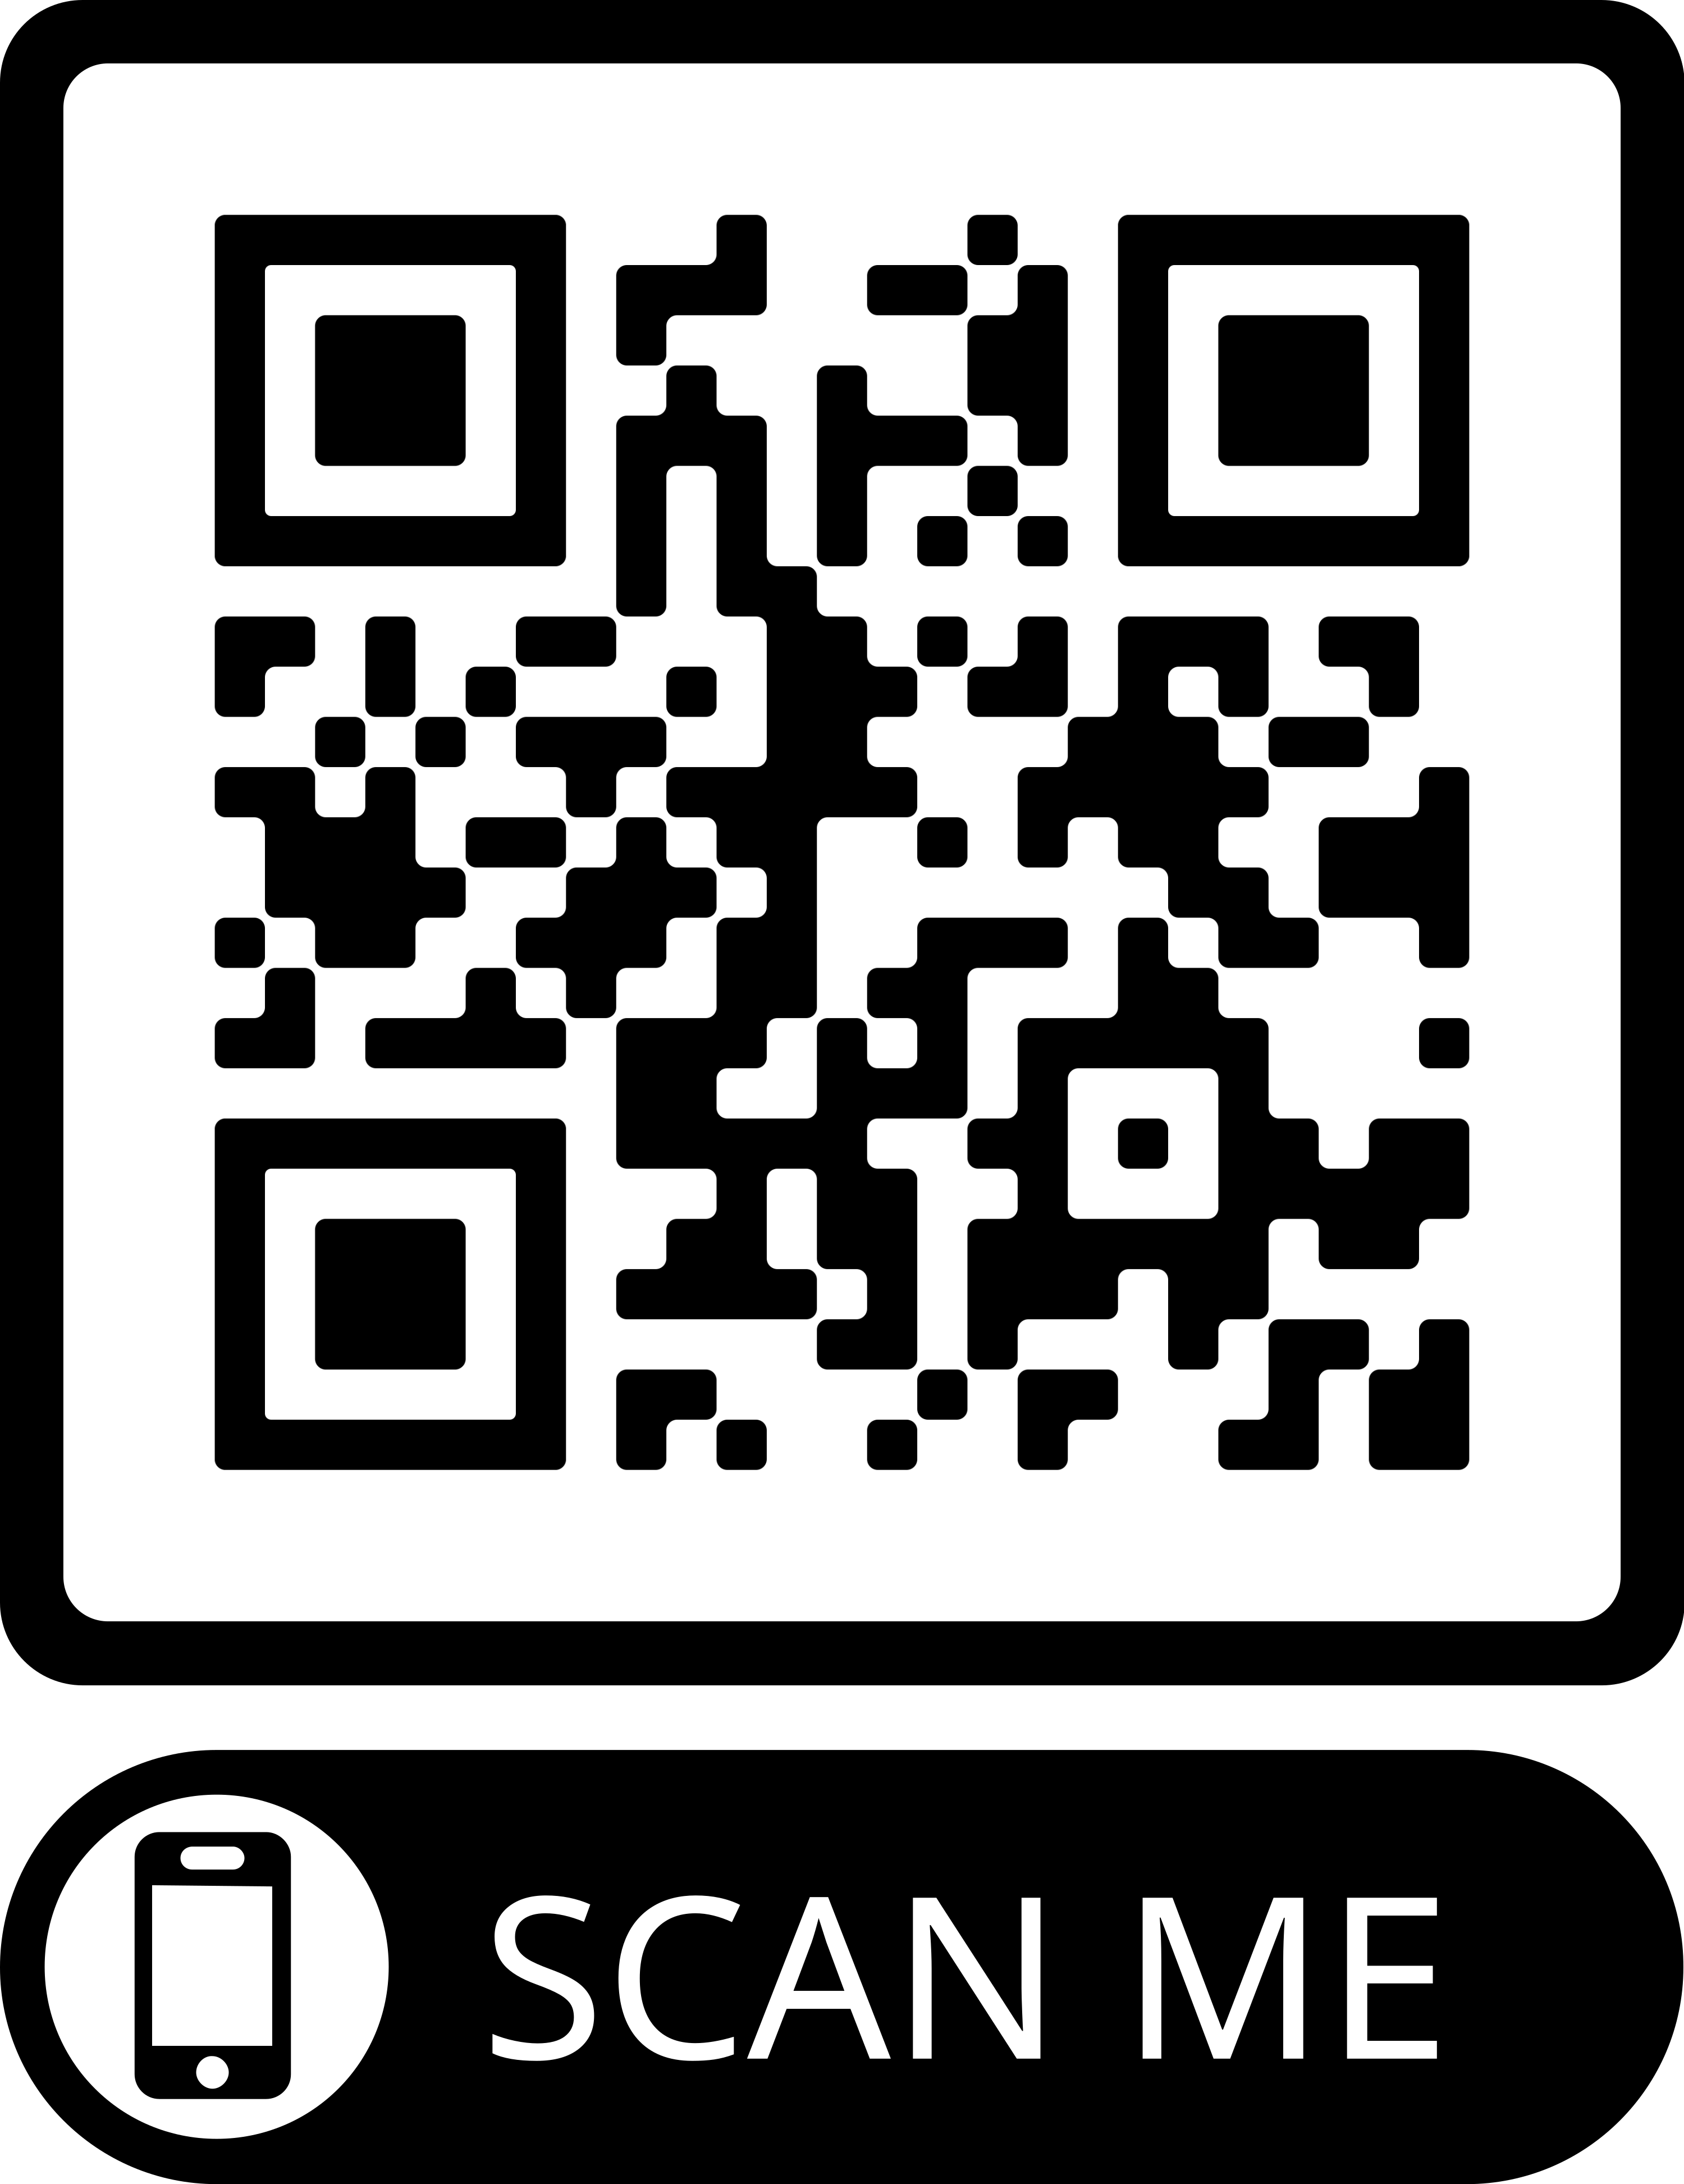
INTRODUCTION TO THE NO HOLDING BACK PROJECT
Academic Partnerships
Collaborations and Learning Circles
Leadership Development Opportunities

Slide 4
2021 Research conducted by AACRAO
A quantitative examination of student level holds at 14 institutions over the course of the 2017-2018 and 2018-2019 academic years
126,500 students in the sample
370,754 holds
A benchmark of practice and policy from 317 undergraduate serving U.S. institutions

Slide 5
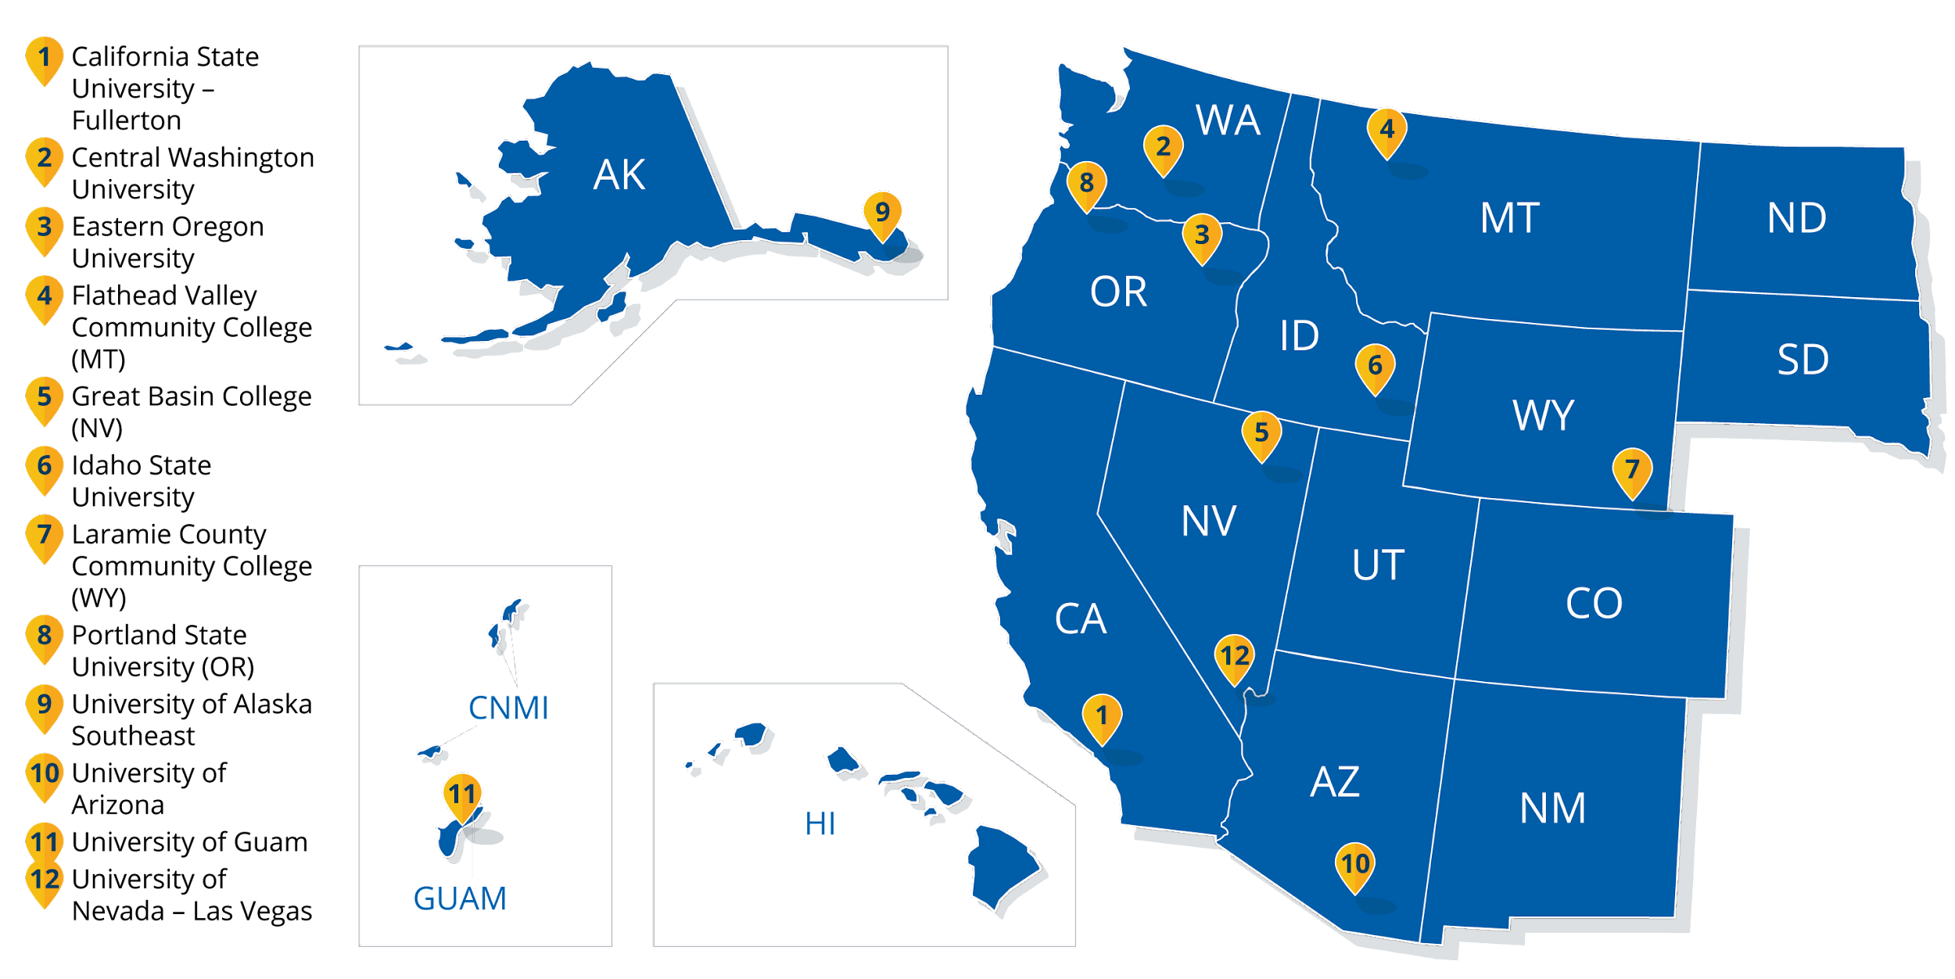
NO HOLDING BACK- A COMMUNITY OF PRACTICE

Slide 6
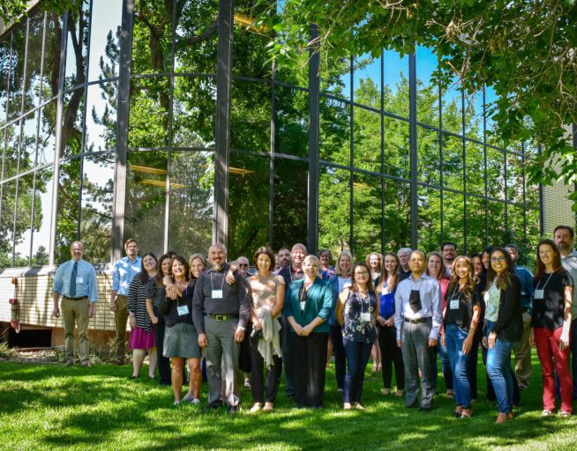
NO HOLDING BACK- A COMMUNITY OF PRACTICE
12 institutions with cross-unit teams:
Registrar
Bursar
Enrollment Management
IT/Technical Support
Institutional Research
Administrative champions

Slide 7
NO HOLDING BACK- A COMMUNITY OF PRACTICE
Over the course of 15 months:
1 in-person training in Boulder, Colorado
3 virtual quarterly calls
12 debrief conversations (one with each institution)
6 focus groups of students (across the institutions)
Institution teams
Making policy recommendations after gathering and analyzing data
AACRAO
Drafting the technical guidebook and providing training to the COP, and supported institutions as they conducted the analysis
WICHE
Drafting the seminal brief and providing logistical support to the COP

Slide 8
THE STUDENTS

Slide 9
THE STUDENTS

Slide 10
Overview of PSU
Urban Research Institution
44 acres in downtown, 52 buildings
Enrollment: 23,000 (80% undergrad)
65% receive some form of financial aid
46% Pell eligible
46% First Gen
80% from Oregon
51% BIPOC first year students

Slide 11
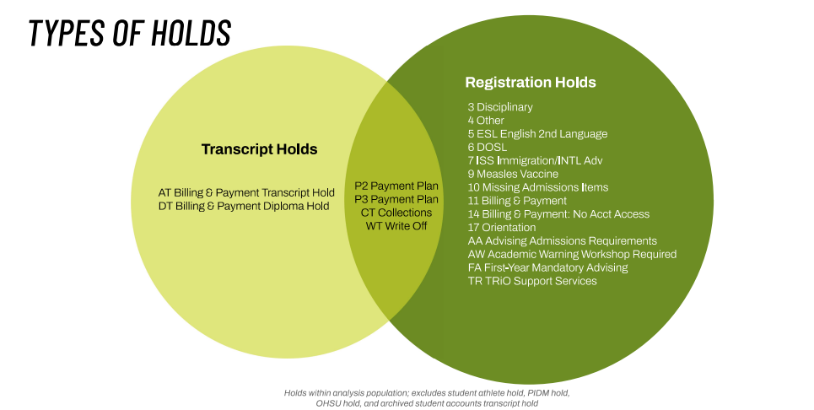
Holds at Portland State University
30% of holds originate from Student Financial Services (using data from 2021-2022 AY)

Slide 12
DISCUSSION QUESTIONS PT. 1
What do you currently know about holds on campus?
What would you do to start this analysis on your campus?

Slide 13
PSU-Limitations of Analysis
Re-constructing holds looking at audit tables of deleted holds, inaccuracy of reconstruction
Some holds applied in error or with inaccurate dates or frequency
Holds data for prior years is not included in analysis
Timeline to resolve hold only exists between start and end of academic year; holds placed in Spring term unlikely to be resolved in time to be considered ‘resolved’ for analysis
Temporary changes in collections/non-payment plan financial holds during pandemic

Slide 14
Student Population Included in Study
16,330 Undergraduate, degree-seeking students enrolled at any time during the 2021-22 academic year (excluding summer)
56% Female | 44% Male
35% First-Generation
76% Enrolled Full-Time
46% Received Pell Grant
3% International
16% Freshman
15% Sophomore
29% Junior
40% Senior
Duplicated Race:
15% Asian
8% Black
20% Hispanic/Latino
4% Native American
2% Pacific Islander
65% White

Slide 15
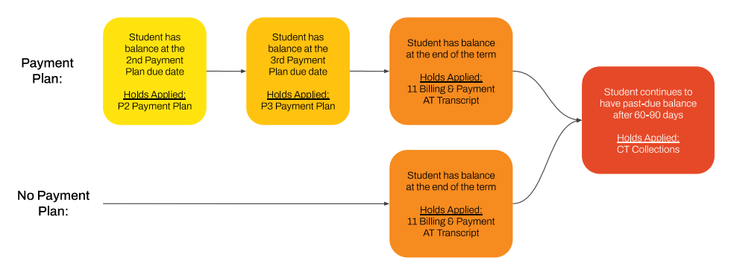
PSU-Financial Payment Plan Process

Slide 16
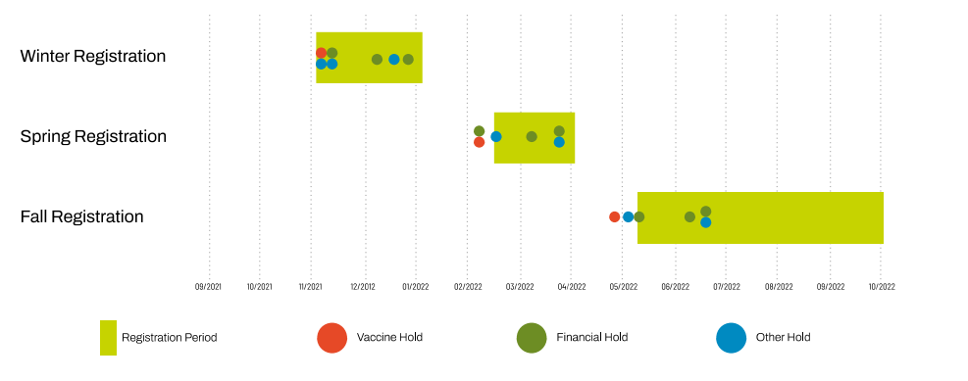
PSU-Registration Periods and Holds

Slide 17
NO HOLDING BACK- A COMMUNITY OF PRACTICE- PSU Research Questions
Are there differences in student’s experiences of holds at PSU?
Do specific populations receive more holds?
Do they have higher hold amounts?
Are specific populations able to resolve their holds at higher rates?
What hold barriers do new students face when starting at PSU?
Are outcomes for new students different than continuing students?
What is the relationship between financial holds and academic success?
What impact do holds have on persistence?

Slide 18
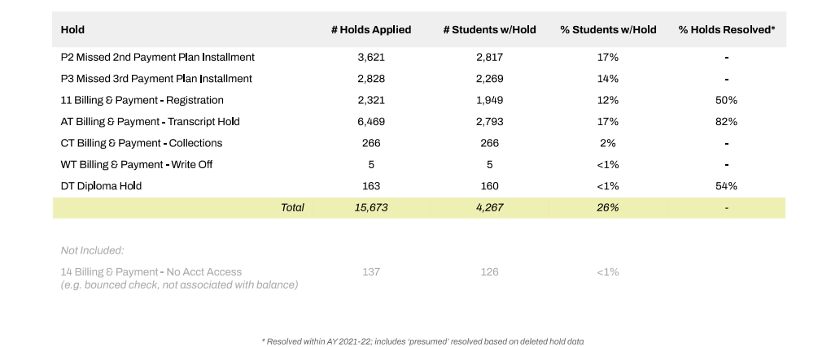
PSU- Overview of Financial Holds

Slide 19
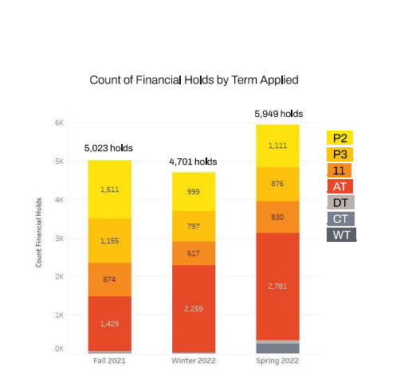
PSU-Holds by Term
Spring term 2022 had the most financial holds applied, representing about 40% of all financial holds in AY 2021-22. This is largely due to the AT Transcript holds and CT Collections holds.
The P2 Hold accounts for 30% of the financial holds applied in Fall and decreases to 21% of Winter financial holds and 19% of Spring financial holds.

Slide 20
PSU-Impact of Financial Holds
26% of undergraduate students had one or more financial holds during the 2021-22 academic year
The following populations are more likely to receive a financial hold:
Part-time students
Students who do not identify as Asian
Black students
Native American students
Pacific Islander students
International students
Non-resident students
New first-year students
New first-year students with a less than 3.0 HS GPA
Students paying for SHAC Health Insurance
Students with Housing charges
Students with one or more financial hold(s) in a term have a term GPA 0.75 pts lower than students without financial holds.

Slide 21
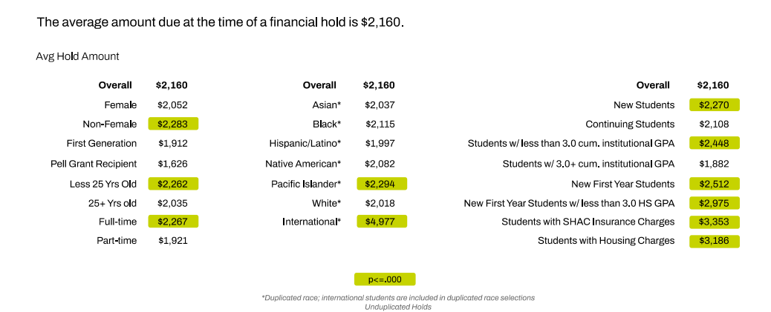
PSU-Impact of Financial Holds-Amount Due

Slide 22
PSU-Impact of Financial Holds-Amount Due
80% of financial holds were resolved during the 2021-22 academic year
The following student populations are less likely to resolve a financial hold than average:
Part-time students
First generation students
New students
Students with a less than 3.0 term GPA in the term of the hold
About 80% of debt-related holds were resolved within the academic year; the total value of unresolved debt holds is about $3.2 million
Students with an unresolved debt-related hold owe on average $2,626

Slide 23
DISCUSSION QUESTIONS PT. 2
If you were to do this work on campus, what stakeholders would you need to involve?
Where would resistance come from?

Slide 24
Recommendations
Dedicated consolidation system for holds that only involve one person or one office contact (i.e. liaison system)
Proactive behavior from the institution to avoid holds or ensure students are not surprised if a hold is unavoidable
Need consistent and clear communication and procedure after receiving a hold

Slide 25
PSU- Policy Changes and Further Work
Expansion of our largest tuition remission program to include part-time Pell eligible students
Financial Onboarding for new students
Student success interventions for students with GPA below 3.0
Evaluating use of hardship/emergency funding earlier in the term

Slide 26
DISCUSSION QUESTIONS PT. 3
How can our community of practice help?
Other questions?

Slide 27
THANK YOU!
Amanda Bierbrauer
Associate Vice President of Enrollment Management & Student Finances
Portland State University
nguyenaf@pdx.edu
Olivia Tufo
Manager, Community Engagement and Development/Impact
Western Interstate Commission for Higher Education
otufo@wiche.edu

