Slide 1
UCSD’s Journey to a Cashless Future
​
Larry Angel
U.C. San Diego
hangel@ucsd.edu

Slide 2
A cashless society is an economic state in which goods, services, or contracts are purchased using credit cards, digital wallets, or other methods rather than physical currency notes or coins.​
-Anonymous

Slide 3
UCSD Cashier’s Office Functions/Services
Payment/Invoice Services
Deposit Services
Financial Research Request
E-Market Services
Vault Services
Cash Control Training

Slide 7
Why Cashless?
Improve customer satisfaction
Speed: Complete transactions in seconds
Flexibility: Expand payment options
Convenience: Deliver funds while simplifying the reconciliation
Enhance transparency
Reduce costs

Slide 8
What does it mean to be “cashless” ?
Transitional spectrum with a focus on reducing cash​
Minimal cash transactions​
Transition away from cash in favor of modern electronic payment methods (i.e. e-check, credit card, WU/Flywire, campus card, ACH/wires)​
Opportunity to provide other value add services such as e-market, virtual stores, etc.​

Slide 9
Cashless University Research​ Findings
All still accept cash & checks​
Focus changed from “eliminate cash” to reducing physical cash to pre-determined percentage
Transition experience was easier with student population versus department ​
Reliance on nearby banks to provide students with cash alternatives: cashier’s checks, money orders, open bank accounts​
Use of armored car service to deliver checks and cash deposits​
Use of payroll deductions to add money to campus card to use for small purchases on campus​

Slide 10
UCSD’s Cashless Considerations​
Lockbox services for student payments​
Direct Loomis pickup of department deposits ​
Check 21 scanners distributed to departments if we allow them to do their own bank deposits​
Maximize Technologies – e-check, virtual terminal, e-store​
Controller's Support, Discussion with Internal Controls​
Decrease the flow of hard cash transactions around campus. Reduce change services.​
Phased implementation and communication plan​
Possible legal and auditor engagement, Vendor engagement​

Slide 11
Cashless Currency Options ​
Mobile payments– payments made on the go through a mobile phone​
Digital wallets– Apple Pay, Google Pay, and Samsung Pay. PayPal and Venmo are also considered digital wallets
Credit cards​ & debit cards
Payment Kiosks
Cryptocurrency– a digital payment that does not use banks to verify transactions​

Slide 12
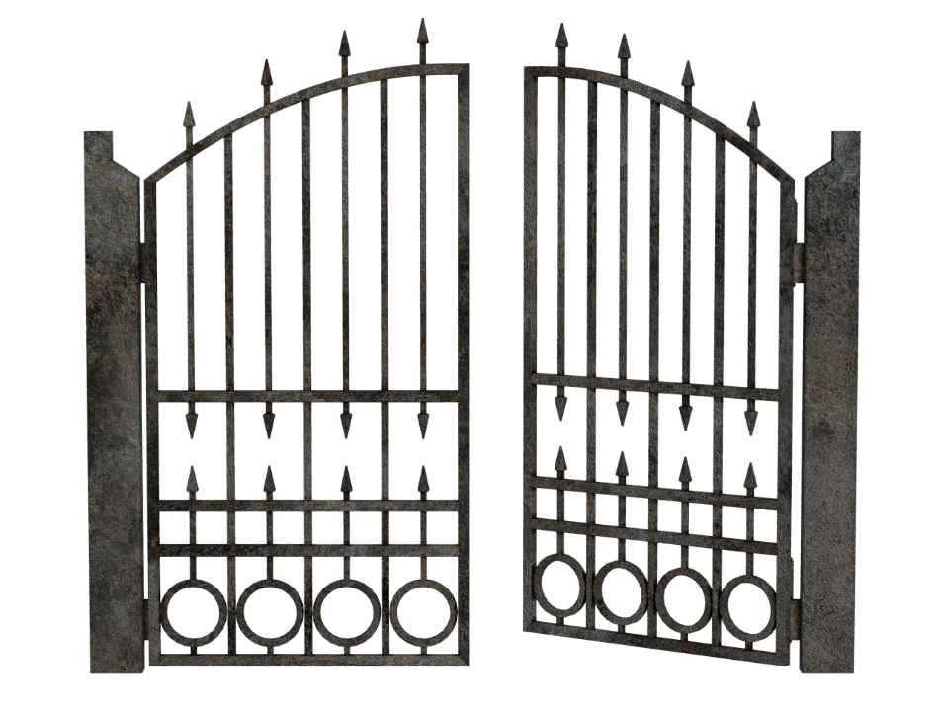
UCSD’s Barriers to being truly cashless​
Scholarship checks, 529 plan checks​
Unbanked students/families, Low income students/families​
How students are billed for small items like library fees, etc.​
Current 50 cent e-check fee ​
Culture – students and parents
Campus departments that receive cash​
Petty cash funds
Resistance/culture change​ on campus

Slide 13
UCSD’s Cashless Transition Strategy
Maximize Available Technologies – e-check, virtual terminal, e-store​
Phased implementation and communication plan​
Decrease the flow of hard cash transactions around campus​
Alternative/backup plan(s) when tech fails​
Campus engagement & support​
Controller’s Office & Internal Controls Support
Possible legal and auditor engagement, Vendor engagement​

Slide 14
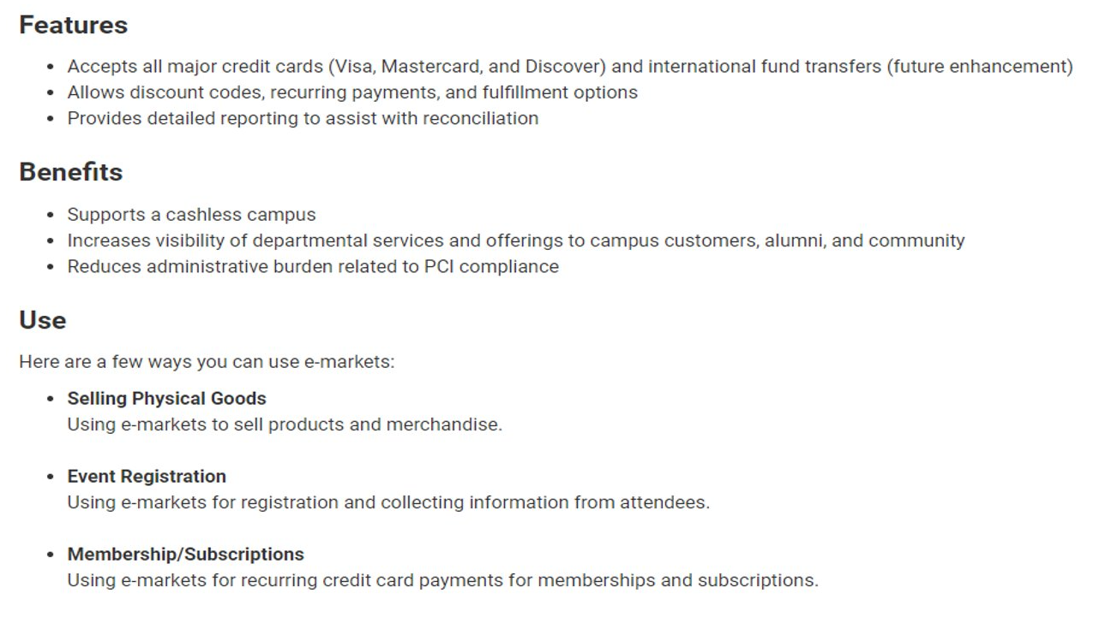
E-market Services​

Slide 15
Data Trends

Slide 16
Data Trends​

Slide 17
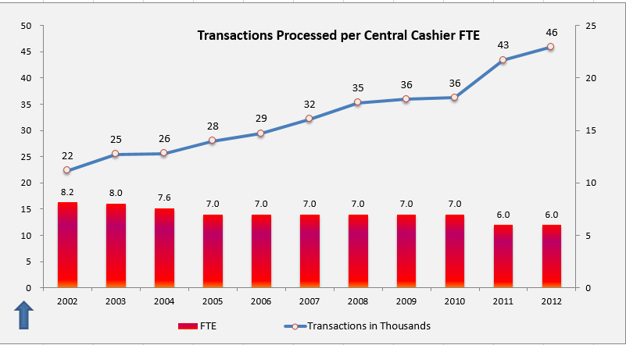
Cashless: Effect on Staffing
Efficiency
2002 to 2023 staffing reduced as efficiency increased
22/23- Four FTE’s will process 30K cash/check transactions
Reassignment
Expansion of services requires staffing
Examples
E-Commerce
Project Management
Manage additional Department - Passports

Slide 18
Impact of COVID at UCSD’s Cashier’s Office
Campus Closure
Most staff are working remotely (exception essential personnel)
Most students are off campus
Student Payments
In-person payments are very limited (appointment only)
Increase in payments by mail and drop box
Increase in online payments
Department Deposits
Limited access to incoming mailed revenue payments
Rapid exploration of alternative payment options (ex. Dining Facilities)

Slide 19
Is cash still needed?
Case Study: Technology out of commission
Problem:
Starbuck’s credit card reader down.
A couple of Housing and Dining Credit Card readers were down.
Solution:
CASH

Slide 20
Cashless – Future Consideration
Central Bank Digital Currency (CBDC)
Launching in July 2023
CBDC will be the digital or electronic form of the U.S. dollar issued by the Federal Reserve
Similar to cryptocurrencies, but will be backed and regulated by the Federal Reserve and act as a legal tender

Slide 21
Innovation + Increased Service = Reduced Cash
Student Payments 22-23
Cash & Checks Overall 22-23

Slide 22
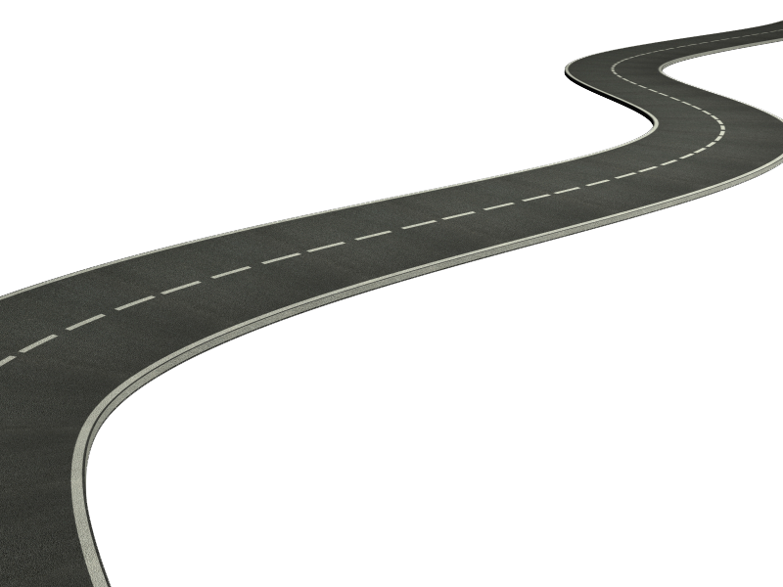
Good Luck on your Cashless Journey.
Thank You

