Slide 1
COHEAO Washington Update
Karen Reddick
National Credit Management
kreddick@ncmstl.com
314-603-9500

Slide 2
Agenda
118th Congress
Current Legislation
Administration
CFPB
Department of Education
Perkins Update
COHEAO Activity
Other Laws
Q & A
Notes:
Karen

Slide 3
About NCM
Karen Reddick, Vice President of Business Development
National Credit Management
Collection Agency
63 Years Experience
100% Campus Based Servicing
Compliance Leader
State/Federal Advocate

Slide 4
About COHEAO
Coalition of Higher Education Assistance Organizations
Established in 1981
Partnership between colleges, universities, organizations and their third-party servicers
Focus on advocacy and training on student financial services issues
Direct line of communication in DC
Join today at www.coheao.org
Annual Conferences
Spring and Fall Workshops (November 15-16)
Educational Free Webinars to membership
Membership Student Scholarship opportunities
Notes:
Karen

Slide 5
What’s Dominating Washington Today
Debt Limit
Reduced Federal Spending
FY 2024 Budget
President Biden’s released March 9
Congressional Budget?
Higher Education Act Reauthorization
Biden Administration Oversight

Slide 6
CONGRESS

Slide 7
November 2022 Elections
Republicans control a slim majority in the House of Representatives
Current Makeup: 222 R’s – 212 D’s / 1 Current Vacancies
Democrats control a very narrow majority in the Senate
Current Makeup: 51 D’s – 49 R’s
Republicans had hoped for big win
Democrats pick-up seat in Senate

Slide 8
118th Congress
Kevin McCarthy (R-CA) -Speaker of the House
Senator Chuck Schumer (D-NY) – Majority Leader in Senate
Senator Mitch McConnell (R-KY) -Minority Leader in Senate
Important House Leadership
Education & Workforce Committee: Chair Virginia Foxx (R-NC) & Ranking Member Bobby Scott (D-VA)
Appropriations Committee: Chair Kay Granger (R-TX) & Ranking Member Rosa DeLauro (D-CT)
Important Senate Leadership
HELP Committee: Chair Bernie Sanders (D-VT) & Ranking Member
Bill Cassidy (R-LA)
Appropriations Committee: Chair Patty Murray (D-WA) & Ranking Member Susan Collins (R-ME)

Slide 9
Fiscal Year 2023 Appropriations
Christmas/Hanukah present
Passed by Senate on December 22 by a vote of 68-29
Passed by the House on December 23 by a vote of 225-201
Signed by President Biden on December 29
Increased overall non-defense spending by $68 billion (9.3%) for a total level of $800 billion
Higher Education
$500 increase in maximum Pell Grant Award ($7,395)
SEOG increase of $15 million ($910 million)
FWS increase of $20 million ($1.2 billion)
TRIO increase of $54 million ($1.2 billion)
GEARUP increase of $10 million ($388 million)
HBCU’s and MSI’s increase of $137 million ($1 billion)

Slide 10
Speaker McCarthy’s FY 2024 Budget
Reduce the deficit by $4.5 trillion over 10 years
Raise debt limit cap by $1.5 billion – Spring 2024
Return non-defense discretionary spending to FY 22 levels
Results in 22% spending reduction
Rescind President Biden’s loan forgiveness program
Prohibit the revised IDR program
ED suggests may result in reduced max Pell award and fewer recipients.

Slide 11
WHAT’S NEXT?
Notes:
Karen

Slide 12
Notes:
Karen

Slide 13
Debt Ceiling
Need to come to agreement by this weekend
Could default as soon as June 1st
What would happen if the debt ceiling isn't raised?
If the amount of government debt reaches that threshold and lawmakers fail to lift the borrowing limit, the U.S. would be unable to pay what it owes and could default
Model indicates that unemployment would surge above 12% in the first six months,
The economy would contract by more than 10%
Triggering a deep and lasting recession,
Inflation would soar toward 11% over the next year.

Slide 14
ADMINISTRATION
Notes:
Karen

Slide 15
President Biden’s FY 2024 Budget
Reduce the deficit by $3 trillion over 10 years
Higher Education
Pell Grant
Max Award of $8,215 for AY 2024-25 ($820 increase)
Free Community College
$90 billion for Fed-State program
$30 billion for an HBCU/MSI program
$500 million for Accelerated Success: Free Community College program
Strengthening Institutions Program
$87 million increase
Increases in TRIO ($100M) and GEARUP ($20M)
Student Support Services

Slide 16
Biden Administration Activity – Part 1
Federal Student Loan Forgiveness
Up to $10,000 ($20,000 for Pell Grant recipients)
Individuals making less than $125,000 (Couples - $250k)
Application released early October – 8 million
Total of over 23 million before being halted
Several court challenges
Supreme Court hearing February 28
8th Circuit: Multi-state challenge
5th Circuit

Slide 17
Biden Administration Activity – Part 2
Department of Education Rule Making:
Income Driven Repayment Program
Change in determining discretionary income by increasing 150% deduction to 225%
Monthly payment is calculated using 5% of discretionary income rather than 10%
Government pays interest for borrowers in negative amortization
Third Party Servicer definition
Intend to hold Negotiated Rulemaking in late Spring/early Summer
Title IX final rule release expected in May

Slide 18
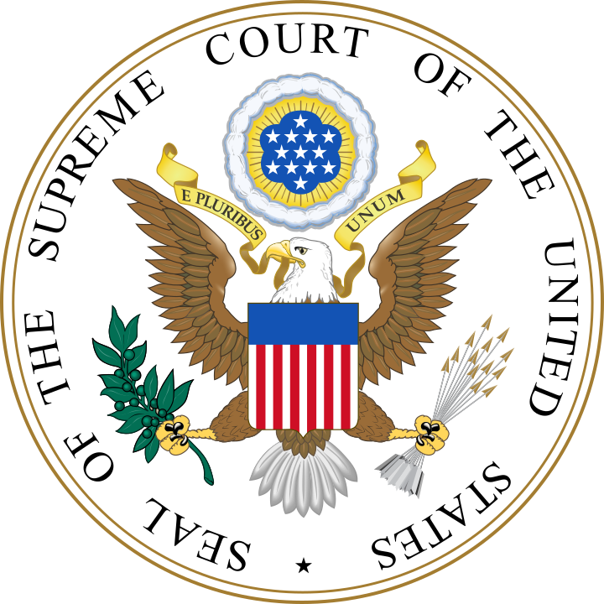
Student Debt Relief
Background
In August 2022, Biden announced a student loan forgiveness plan
In the time since the announcement, the administration has approved 16 million applications for forgiveness
Two cases before the Supreme Court
Biden v. Nebraska
Forgiveness causes financial harm to states and state authorized loan collectors
ED lacks the authority to forgive this debt Department of Education v. Brown
Certain borrowers were arbitrarily excluded from forgiveness
The administration did not allow proper opportunity for comment

Slide 19
Student Debt Relief, Cont.
The latest
No mention of loan forgiveness in President Biden’s State of the Union Address
Administration has said it is not working on alternative plans
End of national emergency announced
Stakeholders weighing in on both sides
SCOTUS heard oral arguments on February 28
Upcoming
A decision is expected in late June
Continued debate around Washington

Slide 20
Federal Loan Update
Administration Extended Payment and Interest Moratorium until December 31, 2022
Student Loan Debt Forgiveness
$10,000= $150,000 income per individual
$10,000= $250,000 income per couple
20,000 for borrowers who received a Pell Grant while in college
Consolidation loans comprised of any FFEL or Perkins loans not held by ED are also eligible, as long as the borrower applied for consolidation before Sept. 29, 2022.
One-Time Student Loan Debt Relief (studentaid.gov)
Application now live
Apply by mid November and will continue to process received through Dec. 31, 2023.
Relief is expected within six weeks for most borrowers, the government said prior to law suits
20
Notes:
Karen

Slide 21
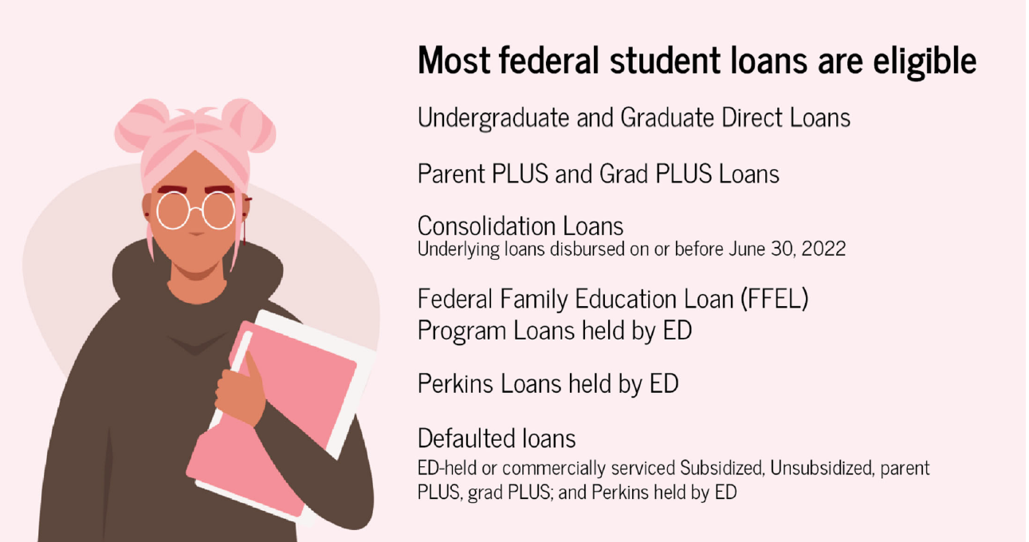
Federal Loan Update
21
Notes:
Karen

Slide 22
Supreme Court Hearing
February 28
2 Cases
8th Circuit – Six states
Allege financial harm to their tax revenue
5th Circuit – Texas organization on behalf of two borrowers
Claims they were harmed because they couldn’t take full advantage of the plan.
They also argue Education Secretary Miguel Cardona circumvented legally required procedures when devising the debt forgiveness program.
2 Questions
Plaintiff Standing
Legality of Biden Administration Action
HEROES Act of 2003

Slide 23
Other Federal Loan Updates
PSLF Waiver
Deadline October 31, 2022
PSLF Waiver Offers Way to Get Closer to Loan Forgiveness | Federal Student Aid
Will count all payment’s history prior to application
Navient and PHEAA exited.
Feds to propose a new IDR Plan negotiated rulemaking-held Neg Reg earlier this year.
Operation Fresh Start
Federal Student Aid
(CB-22-10) Extended deadline for mandatory assignment of Federal Perkins Loans in default for more than two years to June 30, 2023.
23

Slide 24
Neg Reg
All Topics Considered:
Ability to Benefit
Administrative Capability
Gainful Employment
Financial Responsibility
Changes in Ownership
Certification Procedures
90/10 Rule
New IDR plan
The group re-examined financial responsibility regulations and raised transcript withholding as a major concern.
Notes:
Karen

Slide 25
CFPB
Rohit Chopra
Confirmed – 10/1/21
Former CFPB Student Loan Ombudsman
Significant and enhanced enforcement action
Notes:
25
Maria
Chopra Confirmed as CFPB Director Friday, October 1, 2021 By a narrow 50-48 vote along party lines,

Slide 26
CFPB Examination Guide
1/20/22 Press Release –
Announced CFPB will begin examining the operations of post-secondary institutions.
Education loan examination guide updated 1/20/22
Guide found here:
https://files.consumerfinance.gov/f/documents/cfpb_education-loan-servicing-exam-manual_2022-01.pdf
Notes:
Maria
Summary
These procedures include guidance for examination of all aspects of private education loans and examination of servicing practices in connection with all types of student loans.
The examination procedures contain a series of modules, grouping similar requirements together. In many cases, the examination scope will focus on either origination or servicing. Depending on the scope, and in conjunction with the compliance management system and consumer complaint response review procedures, each examination will cover one or more of the following modules. The modules include:
Advertising, Marketing, and Lead Generation
Customer Application, Qualification, Loan Origination, and Disbursement
Student Loan Servicing
Borrower Inquiries and Complaints
Collections, Accounts in Default, and Credit Reporting
Information Sharing and Privacy
Examination Conclusion and Wrap-Up

Slide 27
CFPB Examination Guide
Specifically, CFPB Examiners looked at:
Placing enrollment restrictions: Students who are late on their loan payments may be restricted from enrolling in or attending classes, which could delay their graduation and prevent them from finding employment.
Withholding transcripts: When a school withholds academic transcripts from students that owe the school a debt, this prevents students from using their transcripts to demonstrate their education levels in the job market.
Improperly accelerating payments: Schools that use acceleration clauses in their loans when a student withdraws from the program could be putting a heavy financial burden on the student by making the loan immediately due and collectible.
Failing to issue refunds: If a borrower withdraws from a program early, they may be entitled to some refunds by the school.
Maintaining improper lending relationships: Schools that have preferential relationships with certain lenders may pose risks to students because, for example, they may end up paying more for their loan.
Notes:
Maria

Slide 28
CFPB Examination Results
CFPB Supervisory Examinations Find Violations of Federal Law by Student Loan Servicers and University-Owned Lenders
The CFPB examines private student lenders of all sizes, including entities that operate school-based lenders that extend loans directly to students.
Examination findings covering the practices of student loan servicers, and schools that lend to students directly.
The exams found that these schools had improper blanket policies of withholding transcripts to force students to make payments

Slide 29
CFPB Examination Findings
“Americans must exercise their right to their educational data to obtain a job or transfer schools,” said CFPB Director Rohit Chopra. “Our examinations of lenders found that blanket policies to withhold transcripts can run afoul of the law.”
The CFPB’s examinations found that the blanket withholding of transcripts to pressure borrowers is an abusive practice under the Consumer Financial Protection Act.
The CFPB’s exams also found that student loan servicers illegally hampered borrowers’ access to federal student loan payment relief and cancellation programs including Income-Driven Repayment, Public Service Loan Forgiveness and Teacher Loan Forgiveness.
Notes:
“Americans must exercise their right to their educational data to obtain a job or transfer schools,” said CFPB Director Rohit Chopra. “Our examinations of lenders found that blanket policies to withhold transcripts can run afoul of the law.”

Slide 30
Department of ED - Withholding Transcripts
Notes:
Karen

Slide 31
Withholding Transcripts – Department of Ed
Withholding transcripts from students who owe their colleges money drives inequitable outcomes, U.S. Education Secretary Miguel Cardona said, marking the first time ever the nation’s top education official has called for changing the widespread practice.
Notes:
Karen

Slide 32
Withholding Transcripts – Federal Efforts
Protecting Access to Student Transcripts Act of 2019 – H.R. 3761
Introduced July 15, 2019
Rep. Lee (D-NV), Finkenauer (D-IA),Wilson (D-FL), Sherrill (D-NJ), and Davis (R-IL)
This bill prohibits institutions of higher education that participate in federal student-aid programs from denying students' access to their transcripts, degree scrolls, or other certifications because of loan default.
Notes:
Karen

Slide 33
STATE LAWS

Slide 34
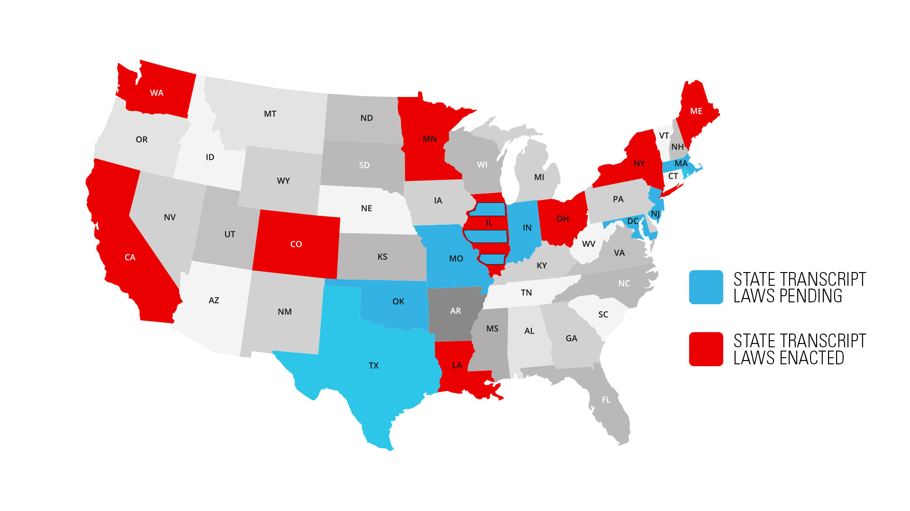
State Transcript Laws

Slide 35
State Transcript Laws – Enacted
CA – A.B. 1313 – Effective date 1/1/2020
WA – HB 2513– Effective date 6/11/2020
LA – HB 676 – Effective date 8/1/2020
MN – H.F. 6 & 7 – Effective date 7/1/2021
OH – HB 1110 – Effective date 9/1/2021
ME – LD 1838 – Effective date 3/31/2022
CO – HB 1049 – Effective date 4/21/2022
NY – S5924-C – Effective date 5/30/2022
IL – SB3032 – Effective date 5/27/2022
IN Bill 404 – Effective date 4/20/2023
Notes:
* this bill requires the schools to adopt a policy on the issue.

Slide 36
State Transcript Laws - Pending
IL SB 49 – Passed by Senate 3/24/23 – amends 2022 law
LA HB183 – Introduced in 2022 (prior session)
MA H1277– Reintroduced 1/2023
MD SB0248 – Passed and waiting for Governors signature, effective 7/1/23
MO HB 972 – Reintroduced 1/25/2023
NJ A1198 – Passed House, referred to Senate on 12/2022
S1115 – Introduced in Senate 1/2022 (prior session)
S3548 – Introduced 1/31/2022 – No action
OK B 2785 – Introduced 2/8/2023
RI S696 – Introduced 3/22/2023 – Referred Commerce Comm.
TX HB 306 – Introduced 2/2023 – Original bill 11/2020
VA SB159 – Prior Session
HB 732 – Prior Session
Notes:
MA bill is sMD SB 248 – Passed Senate 3/2/2023, House 4/4/2023
imilar to bill that was introduced in 2017 that did not move.

Slide 37
Cali had it again………………
CA – AB 1160 – protecting Students from Creditor Colleges Act.
Introduced 3/2023 – Committee Hearing 4/18/2023
Prohibit IHE from barring students registration/re-enrollment because they owe institutional debt
Prohibit IHE from withholding degree or certificate because they owe institutional debt

Slide 38
CA AB 1160 Continued…
Prohibit the placement of institutional debts with for-profit third-party debt collectors
Prohibits the state tax offset as a means to recoup monies owed to IHE

Slide 39
Outcome- What Now
COHEAO/ACA and others to the rescue
The bill has been cancelled for this year
Possibility that bill will be reintroduced next legislation
Need to keep the pressure on
Stay informed – follow the progress of the CA bill
Spread the word – share with your administration and government affairs what is happening in CA
Follow your own state’s legislative actions – be prepared for bills like this to be introduced elsewhere

Slide 40
PERKINS LOAN UPDATE

Slide 41
Timeline of the Department’s Guidance on the Wind-Down of the Perkins Program
September 30, 2017:
The authority to award new Perkins Loans to students expired and a wind-down of the program began.
The Department stated: “Institutions are not required to assign Perkins Loans to the Department or liquidate their Perkins Loan Revolving Funds due to the wind-down of the Perkins Loan Program. Institutions may choose to liquidate at any time in the future.
Institutions may continue to service their Perkins Loans and may assign both non-defaulted and/or defaulted Perkins Loans to the Department at any time.
Notes:
Maria-
I’m going to spend a few minutes reviewing the timeline of the guidance we have received from the Department since the Perkins Program expired just to set the stage a bit for the discussion.
Back in September of 2017, as the program was expiring, the Department provided us with reassurance that although the program was going into its wind-down phase, schools could continue to service their portfolios as long as they remained in compliance with the due diligence procedures. It was said that institutions were not required to assign their Perkins loans or liquidate their portfolio but the option to liquidate in the future was available, as was the opportunity to assign defaulted or non-defaulted loans at any time.
When we received this reassurance, I felt good about the ability to service my portfolio for many years to come.

Slide 42
Timeline of the Department’s Guidance on the Wind-Down of the Perkins Program
September 16, 2019:
The Department stated that due to the wind-down of the Perkins Program, the Secretary will require the assignment of all Perkins loans that have been in default for two or more years.
The referenced authority is Section 463(a)(4)(A) of the Higher Education Act of 1965, as amended, which states that if an institution knowingly failed to maintain an acceptable collection record for a defaulted Federal Perkins Loan, the Secretary may require the institution to assign the loan to the Department of Education without recompense.
The Department stated that a lack of payments on a loan equates to failing to maintain an acceptable collection record.
The higher education community strongly disagrees with this interpretation.
The The Department informed schools that they would be notified individually of their obligation to provide documentation of their collection efforts and the deadline by which loans without documentation must be assigned.
Notes:
Maria-
Fast-forward two years and suddenly things felt much different.
In September of 2019, the Department issued a communication which stated that due to the wind-down of the program, the Secretary is NOW requiring the assignment of all Perkins Loans that have been in default for two or more years.
The Department stated that the authority for this decision is based on a section in the Higher Education Act which states: “if an institution knowingly failed to maintain an acceptable collection record for a defaulted Federal Perkins Loan, the Secretary may require the institution to assign the loan to the Department of Education without recompense.” Which means, we assign without the opportunity to recover our institutional share should the Department collect on that loan once assigned.
The communication went on to say that a lack of payments on a loan equates to failing to maintain an acceptable collection record, an interpretation that many in the higher education community strongly disagree with.

Slide 43
Timeline of the Department’s Guidance on the Wind-Down of the Perkins Program
February 2020 - March 2021:
In February 2020, the first round of notices were sent to 75 schools with overall default percentages of 75% or more.
Soon after, the COVID shutdown occurred delaying further action for over a year.
In March of 2021, the second round of notices went to approximately 200 schools with overall default percentages of 50% or more.
Schools that received notices were provided 90 days to assign all loans in this category that had not made a recent payment.
Notes:
Maria-
In that same communication, the Department went on to say that schools would be notified individually of their obligation to assign those loans that were 2 or more years past-due and without acceptable documentation – which again means payments.
The notices were to go to the schools with the highest default percentages first and in February of 2020, 75 schools received a notice from the Department to assign all such loans.
The schools selected in the first round of notices had overall default percentages of 75% or greater.
Soon after those notices went out, the pandemic began, and we didn’t hear anything on these efforts for over a year. Then, in March of 2021, the Department sent out notices to 200 more schools, supposedly any that had overall default percentages of 50% or higher.
In both of these cases, the schools receiving the notices were given 90 days to assign all loans in this category without acceptable payment documentation.

Slide 44
Timeline of the Department’s Guidance on the Wind-Down of the Perkins Program
August 27, 2021:
The Department decided to cease sending individual notices to the schools based on percentage of defaults and instead sent a blanket notice to all institutions providing a deadline of June 30, 2022, to either assign or purchase all loans in default for two or more years.
If an institution determines that borrowers who have defaulted Perkins Loans are making payments, the institution may notify the Department that documentation showing an acceptable collection record is available upon request.
Schools were informed that in early 2022, the Department would assess activity regarding a school’s progress in assigning defaulted loans. Inactivity may result in a warning letter issued to financial aid office and CEO/President.
COHEAO encourage schools to contact the Department and many requested an extension.
Notes:
Maria-
Five months later, in August of 2021, the Department abruptly decided to cease sending individual notices and instead sent out a blanket notice to every Perkins school providing a deadline of June 30, 2022 to either assign or purchase all loans in default for two or more years without an acceptable repayment record.
If an institution determines that any borrowers in this category are making payments, they can notify the Department that documentation to support their retaining the loan is available upon request.
This notice went on to say that the Department would be assessing assignment activity in early 2022, and if it was determined that an institution had shown insufficient effort assigning, purchasing, or providing acceptable collection records to the Department for review, a warning letter may be sent to the institution’s financial aid office as well as to the campus CEO/President reminding them of the requirement to take action on these loans by the June 30, 2022 deadline.

Slide 45
Timeline of the Department’s Guidance on the Wind-Down of the Perkins Program
January 26, 2022:
The Department sent emails to all schools with active Perkins Loan portfolios reminding them of their obligation to assign all loans in default for two or more years by June 30, 2022.
May 4, 2022:
The Department sent emails to all schools with active Perkins Loan portfolios extending the assignment deadline to June 30, 2023 (CB-22-10).
All other conditions noted in the August 27, 2021 announcement still apply, and the Department will periodically assess all Perkins loan assignment activity throughout early 2023.
Schools must include the reason(s) why they were unable to assign Perkins loans in default more than two years by the June 30, 2022, deadline on the 2023–24 FISAP
Notes:
Maria
And sure enough, on January 26th, the Department sent an email to all Perkins schools reminding them of their obligation to assign all loans by June 30, 2022.
In early January, prior to these notices going out, I contacted the Department to request an extension. I shared with them that due to the size of my portfolio, (we have over 12,000 loans in this default category across the 29 campuses I service) and due to the fact that the majority of those loans have judgments, sharing that the timeframe for getting a judgment assigned is significantly longer due to the court paperwork that has to be filed, and due to the fact that many of the staff at our office and the NYS Attorney General’s office where the assignment of judgment is initiated, were working remote due to COVID… that I could not even come close to meeting the June 30th deadline. And my request was denied. BUT I was told that the Department would take all of these circumstances into account as they assessed progress and were sending out the notices. And They didn’t…
Almost all of my schools received an email that stated that we were not making sufficient progress in reaching this goal and had yet to submit any loans for assignment and that we needed to take immediate action. And as you can imagine, that created a LOT of panic and emails and phone calls from many of my campuses who are really out of the loop when it comes to Perkins because it is handled centrally.
One final point to note, not only is the department mandating that these loans be assigned by June 30th, they will be using the FISAP to assess progress in this area. The only way to get these accounts removed from your defaulted category on the FISAP is after they are accepted for assignment. And if you have been assigning loans lately, you are probably aware that most are taking 2 months or more to get accepted. So, what does that mean? It means we should have all loans assigned by early to mid-April if we want to have any chance of having them reflected on the next FISAP.

Slide 46
COHEAO Action
November 8, 2021:
COHEAO sent a letter sent to the Under Secretary, James Kvaal, stating that:
The Perkins recovery data does not support the 2-year mandate.
The Department’s guidance contradicts current binding regulation.
The guidance was issued with disregard for the HEA and current regulations and, as such, is sub-regulatory guidance that does not qualify as regulation.
The Department’s interpretation is not consistent with Congressional intent.
Congress narrowed the Department’s authority in the HEOA (8/14/2008) stating the Secretary is only permitted to require assignment of defaulted Perkins loans to the Secretary when an institution of higher education has knowingly failed to maintain collection records.
The fact that a loan has been in default for any period of time does not mean that the institution has failed to perform due diligence in its collection and is not grounds for the Secretary to require the assignment of the loan.
Notes:
Maria
First, right after the August 27th blanket notice mandating that all loans in default for 2 or more years be assigned, COHEAO sent our Perkins contact in FSA a list of questions. You can see the full text of these questions and the Department’s response in the slides we’ve included later in the presentation. But the overall theme and response to many of the questions we asked was that the Department would work with schools on a case-by-case basis if there were issues. They have provided more than sufficient time for schools to get these loans assigned, even with the staff shortages and remote work atmosphere due to COVID. And they want schools to make a good faith effort.
On November 8th, COHEAO sent a letter to the Under Secretary, James Kvall, which challenged the Department’s authority to mandate assignment of these loans. The letter raised three major points. One that the recovery data doesn’t support the 2-year mandate. Two, the Department’s interpretation is not consistent with Congressional intent and three, the Department's guidance letter contradicts current binding regulation.

Slide 47
What Should Your Institution Do Now?
Develop a plan and strategy and put it in writing.
Keep your leadership in the loop.
Reconcile your Perkins data with NSLDS and run a Death Status Conflict Report.
Review the updated Assignment and Liquidation Guide (revised April 6, 2022).
Assign your oldest, non-performing loans first
Begin with loans that have all of the required assignment documentation.
Then, work on those that require alternative documentation.
Notes:
Maria
If you have a really large number of loans to assign and it will be awhile before you get to those loans that are 2 to 3 or 4 years past-due, be aggressive with those loans as well to see if you can get a payment and retain the loan. Utilize your third-party collection agencies to assist with getting borrowers into a repayment plan, rehabilitation or consolidation.
Remember, before you can assign these loans, you must provide the borrower with a 30-day notice informing them of the pending assignment. In the notice we send out, we inform the borrower that if they make just one satisfactory payment within 30 days, it may prevent their loan from being assigned.
Make sure you notify the department if you are not going to meet the June 30th deadline. Although it probably won’t make a difference in the action the Department takes in the future, it may help to cover you if your president gets a notice that says you are not in compliance. Have a plan in place and put it in writing. For me, that is developing a priority list, training additional staff to assist and informing the Department that we are not going to meet the deadline.
Also, share what COHEAO is doing with your counsel’s office or government relations office. Ask them to get involved by writing to the Department or your representatives in DC. Remind them that not only is this a drain on your staff resources, but it is also a loss of institutional funds.

Slide 48
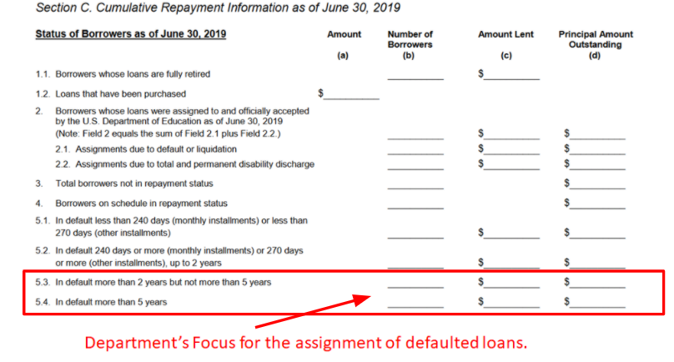
What is a healthy Perkins portfolio?

Slide 49
What Should Your Institution Do Now?
Maximize opportunities to collect on defaulted loans before assigning:
Utilize your third-party collection agencies to assist with getting borrowers into a repayment plan, rehabilitation or consolidation.
Perkins Borrowers who consolidate are eligible for the Direct Loan benefits including income-based repayment plans not offered to Perkins Borrowers.
Send a letter prior to assigning offering the borrower an opportunity to make payment so the loan is not assigned (incorporate this into the required 30-day assignment notice).
Remember, you only need one payment to justify retaining the loan while you are working to resolve the default.
If you cannot meet the June 30, 2023 deadline, reach out to the Department in writing with details and timeframes.
Notes:
Maria
If you have a really large number of loans to assign and it will be awhile before you get to those loans that are 2 to 3 or 4 years past-due, be aggressive with those loans as well to see if you can get a payment and retain the loan. Utilize your third-party collection agencies to assist with getting borrowers into a repayment plan, rehabilitation or consolidation.
Remember, before you can assign these loans, you must provide the borrower with a 30-day notice informing them of the pending assignment. In the notice we send out, we inform the borrower that if they make just one satisfactory payment within 30 days, it may prevent their loan from being assigned.
Make sure you notify the department if you are not going to meet the June 30th deadline. Although it probably won’t make a difference in the action the Department takes in the future, it may help to cover you if your president gets a notice that says you are not in compliance. Have a plan in place and put it in writing. For me, that is developing a priority list, training additional staff to assist and informing the Department that we are not going to meet the deadline.
Also, share what COHEAO is doing with your counsel’s office or government relations office. Ask them to get involved by writing to the Department or your representatives in DC. Remind them that not only is this a drain on your staff resources, but it is also a loss of institutional funds.

Slide 50
Portfolio Strategies – Assign or Liquidate?
Why Continue to Service your Perkins Portfolio?
Recover your institution’s investment (ICC).
Utilize the ICC to fund an institutional loan program or provide additional aid to students.
Set up a reserve account with your ICC. Rejected loans result in a cost to the campus – must buy the loan(s) if you can’t resolve.
Utilize ICC to offset the loss of ACA.
Convert as many loans to paid-in-full as possible (fewer loans to assign in the future = less work and less liability).
Clean up and/or reconcile your Perkins portfolio with NSLDS and third-party agencies before liquidating.
Foster the borrower/alumni relationship – reduce confusion for the borrower.
Notes:
Maria-

Slide 51
Sign the Petition Asking to Extend Perkins Assignment Deadline Another Year
Join over 350 Others!
COHEAO has established a Change.org petition requesting the Department of Education extend the current June 30, 2023 deadline for assigning Perkins Loans that are more than 2 years in default for another year to June 30, 2024.
Currently, there are over 350 signatures. Are you one of them? If not, please consider adding your name!
You can sign the petition here!

Slide 52
COHEAO Activity for the 118th Congress
Helping institutions maintain compliance
Federal law and regulation
State law and regulation
Perkins Access, Retention, and Completion (ARC) Act and/or help facilitate a gap funding solution
Help to facilitate Gap Funding
Financial Literacy/Wellness efforts
Mandatory Assignment – further deadline extension
Monitoring State Legislation
Transcript Withholding
Servicer/Collection Agency

Slide 53
Solution For Gap Funding
Alternative to the Perkins Loan Program
Matching Funds
Revolving Fund
Schools award based on need
Lender would originate the loan
Campus Based Servicing
Deferments
Forbearances
Competitive interest rate
Notes:
Maria-

Slide 54
Questions

