Slide 1
Mobile Payment Solutions and the EMV/PCI Impact
Steve Woods
Director of Student Accounts
Cal Lutheran University
Matt Camino
Director of eCommerce
University of the Pacific

Slide 2
Accepting Mobile Payments
So you’re ready to take your payment acceptance mobile? What do you need to know:
Software Platforms
Hardware
EMV
PCI
Notes:
Platforms: Which company will be you mobile payment provider. Many options on the market. HigherOne, TouchNet big in Higher Education. Most banks or acquirers have a program, f.e. US Bank uses Elavon Virtual Merchant Mobile. “Name Brand”, Square, PayPal, Intuit
Hardware: What hardware does the software you’ll be using run on? Many popular mobile apps are set to run on Apple’s iOS or Google’s Android operating systems. Banks/acquirers contract with on the spot device manufacturers for cellular enabled equipment.
October 1st 2015 is Liability Shift for EMV. What does this mean for you the merchant? It means that After October 1st, if a payer would like to make an EMV payment at the POS, and the merchant cannot process an EMV payment, and that transaction is fraudulent, the acquirer (and therefore, the merchant) would bear the cost of the fraudulent transaction, rather than the issuing bank, which bears responsibility for such fraud in today’s payment infrastructure.
PCI, must attest to version 3.0 in 2015, 12 requirements, #3 and #4 directly related to Mobile. As well as 3 categories of mobile types in best practices guide.

Slide 3
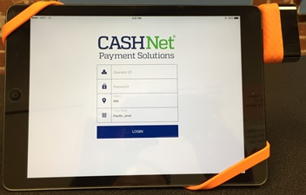
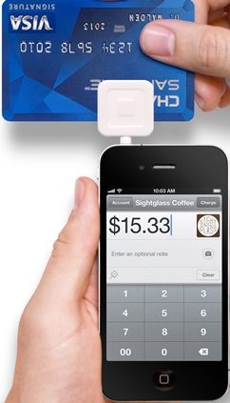
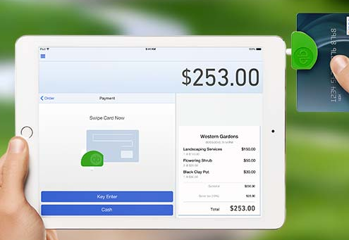
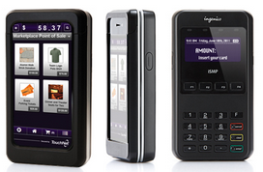
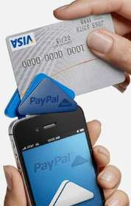
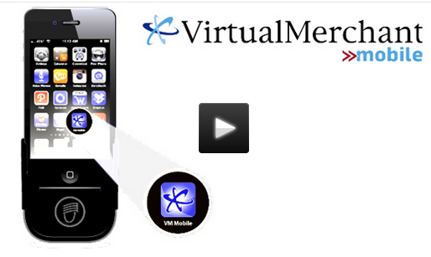
Software Platforms & Hardware
A few of the many options

Slide 4
Accepting Mobile Payments
So you’re ready to take your payment acceptance mobile? What do you need to know:
Software Platforms
Hardware
EMV
PCI
Notes:
Platforms: Which company will be you mobile payment provider. Many options on the market. HigherOne, TouchNet big in Higher Education. Most banks or acquirers have a program, f.e. US Bank uses Elavon Virtual Merchant Mobile. “Name Brand”, Square, PayPal, Intuit
Hardware: What hardware does the software you’ll be using run on? Many popular mobile apps are set to run on Apple’s iOS or Google’s Android operating systems. Banks/acquirers contract with on the spot device manufacturers for cellular enabled equipment.
October 1st 2015 is Liability Shift for EMV. What does this mean for you the merchant? It means that After October 1st, if a payer would like to make an EMV payment at the POS, and the merchant cannot process an EMV payment, and that transaction is fraudulent, the acquirer (and therefore, the merchant) would bear the cost of the fraudulent transaction, rather than the issuing bank, which bears responsibility for such fraud in today’s payment infrastructure.
PCI, must attest to version 3.0 in 2015, 12 requirements, #3 and #4 directly related to Mobile. As well as 3 categories of mobile types in best practices guide.

Slide 5
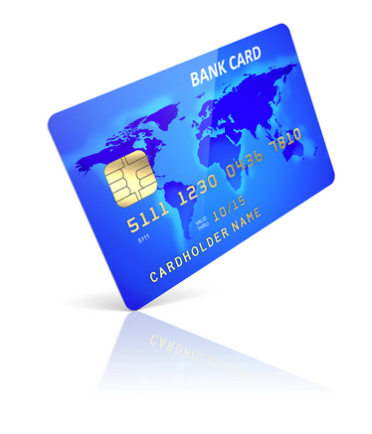
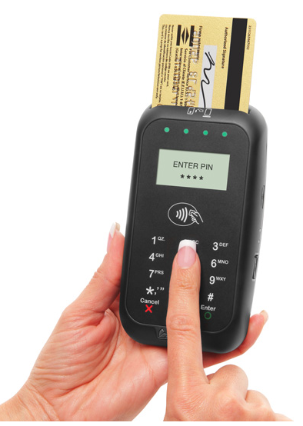
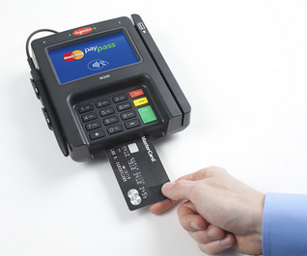
EMV (Europay, Mastercard, Visa)
October 1st, 2015
Chip + Pin or Chip + Sig
New hardware required
Notes:
October 1st 2015 is Liability Shift for EMV. What does this mean for you the merchant? It means that After October 1st, if a payer would like to make an EMV payment at the POS, and the merchant cannot process an EMV payment, and that transaction is fraudulent, the acquirer (and therefore, the merchant) would bear the cost of the fraudulent transaction, rather than the issuing bank, which bears responsibility for such fraud in today’s payment infrastructure.
The EMV style chip card creates a combination of static information normally found on the mag stripe, with a dynamic cryptogram generated by the smart chip to create a “one time transaction’ authorization combination. Add to this a PIN or customer signature, and card present fraud becomes incredibly difficult. This is very important in the mobile payment world since mobile transactions are a card present situation.

Slide 6
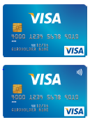
EMV (Europay, Mastercard, Visa)
Dual Interface Chip Cards
Contact Cards
Traditional magnetic swipe cards and new
chip encrypted cards
Contactless Cards
Communicate via radio frequency (RF), also referred to as
NFC (Near Field Communication), i.e., Apple Pay
Dual interface chip cards combine both technologies and can communicate either way. You can purchase hardware that will process all three types of payments

Slide 7
Accepting Mobile Payments
So you’re ready to take your payment acceptance mobile? What do you need to know:
Software Platforms
Hardware
EMV
PCI
Notes:
Platforms: Which company will be you mobile payment provider. Many options on the market. HigherOne, TouchNet big in Higher Education. Most banks or acquirers have a program, f.e. US Bank uses Elavon Virtual Merchant Mobile. “Name Brand”, Square, PayPal, Intuit
Hardware: What hardware does the software you’ll be using run on? Many popular mobile apps are set to run on Apple’s iOS or Google’s Android operating systems. Banks/acquirers contract with on the spot device manufacturers for cellular enabled equipment.
October 1st 2015 is Liability Shift for EMV. What does this mean for you the merchant? It means that After October 1st, if a payer would like to make an EMV payment at the POS, and the merchant cannot process an EMV payment, and that transaction is fraudulent, the acquirer (and therefore, the merchant) would bear the cost of the fraudulent transaction, rather than the issuing bank, which bears responsibility for such fraud in today’s payment infrastructure.
PCI, must attest to version 3.0 in 2015, 12 requirements, #3 and #4 directly related to Mobile. As well as 3 categories of mobile types in best practices guide.

Slide 8
PCI DSS
Source: https://www.pcisecuritystandards.org/documents/PCI_DSS_v3.pd
Notes:
12 requirements that must be met for to achieve PCI Compliance
PCI, must attest to version 3.0 in 2015, 12 requirements, #3 and #4 directly related to Mobile. As well as 3 categories of mobile types in best practices guide.

Slide 9
PCI Mobile Categories
Source: https://www.pcisecuritystandards.org/documents/pa-dss_mobile_apps-faqs.pdf
Notes:
Category 1: Stand alone cellular OTS device, runs only the payment application software and nothing else. Is PTS approved by PCI Security Council, currently 556 such devices on PCI site.
Category 2: Software/Hardware bundle, more GUI experience, example Clover from Electronic Payments proprietary Tablet/Software, also Sequoia Quadpoint POS.
Category 3: Consumer electronic device (iPad, iPhone, Android device), most common when thinking about mobile payments. Any of the options in slide 3 were this model. Hardest to achieve true PCI compliance, but not impossible.
Important factors to take into account when choosing to go mobile and discussing how the product being offered by vendor.

Slide 10
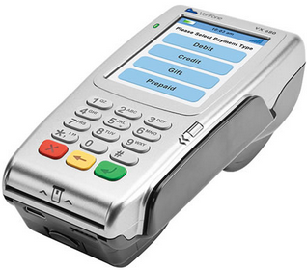
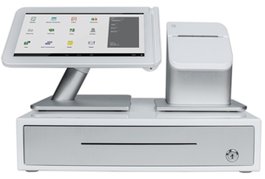
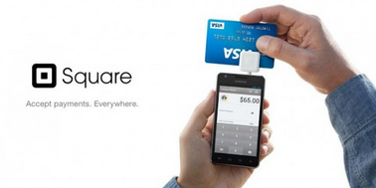
PCI Mobile Category Hardware
Category 1:
Category 2:
Category 3:

Slide 11
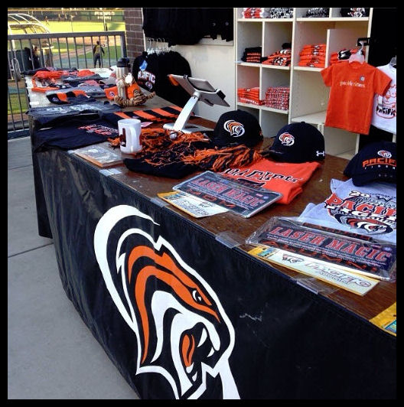
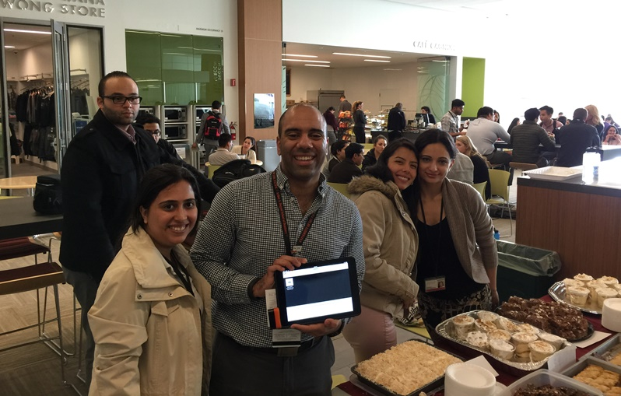
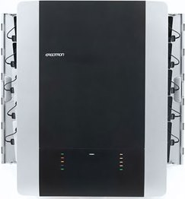
Mobile at Pacific
CASHNet Mobile Payments
Category 2 & 3 for PCI purpose
Existing CASHNet eMarket users
Started with 4 iPad’s (2 AT&T, 2 Verizon)
Stored in locked Ergotron wall mount
IDTECH Shuttle reader
Check out form
Notes:
Pacific chose to go with CASHNet Mobile Payments
The solution is a little of Category 2 and Category 3 for PCI purposes, device used for processing is a Consumer Electronic Device but is iOS, iPad specific.
Pacific eCommerce regulations limit to only devices used for payment processing, not a BYOD situation.
Coalfire provided security documentation for Payment Application via HigherOne.
Program initially rolled out to small groups, expanded quickly. 2015 use has exploded.

Slide 12
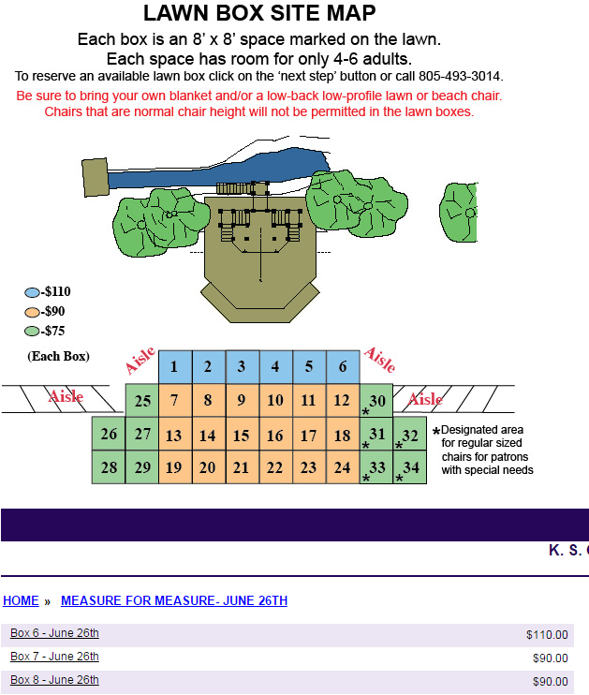
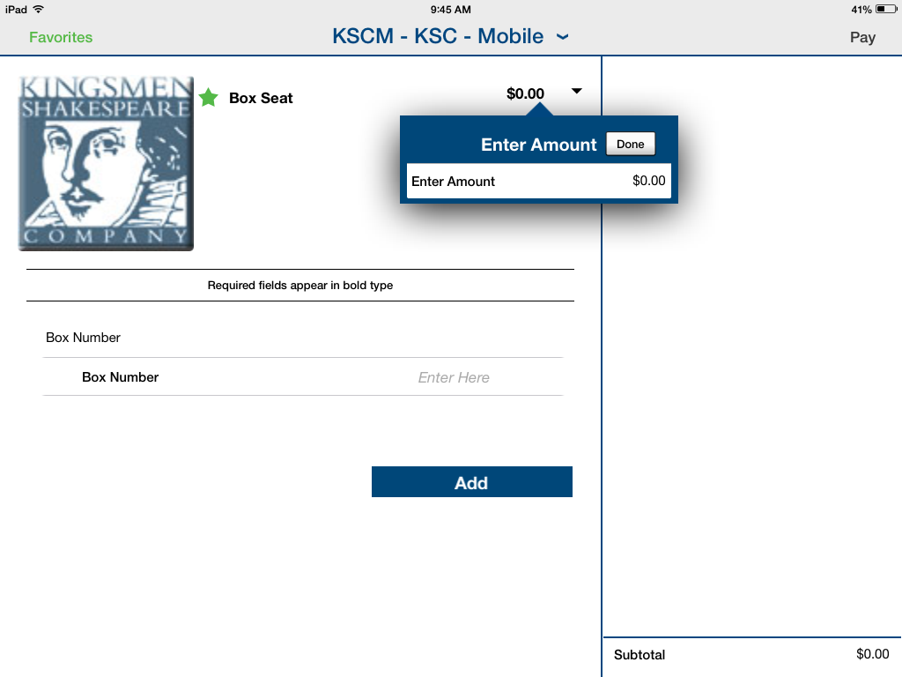
Mobile at Cal Lutheran
Over 50 online stores with many now adding mobile versions
De-centralized management, 60+ users
PCI DSS Requirement 9.9 will become much more difficult
Notes:
Cal Lutheran is just now beginning to convert/create mobile stores, 9 in total. Many of these simplified versions of our online stores, designed for quick payment processing, rather than capturing multiples of customer and product detail.
The screenshot on the left is one of many customers drilldown into to get to purchase the particular box, on the particular day, for the particular play they want. Utilizing the mobile app on the day of the event, the cashier simply enter the available box being purchase and the cost of that box, rather than clicking on multiple pages of information. Both adding the item to the cart and the check out process is faster. After the swipe of a credit card, and a signature with your finger, the only info typed in is the email address of the customer.
Without having a dedicated Director of eCommerce, Cal Lutheran has had to adopt a de-centralized approach to managing its eCommerce. Currently, the Director of Student Accounts administers, trains, and creates reports for the other divisions. Some can do this is on their own, some will always require help. Each division maintains their own iPads and shuttles.
Meeting requirement 9.9 will become more difficult as each division will need to:
- Maintain a list of devices (Inventory)
- Ensuring devices are operating as intended (Inspection)
- Educate retail personnel on their responsibility (Training)
- Document their (Policies and Procedures)

Slide 13
More Resources
EMV Readiness Guide: http://usa.visa.com/download/merchants/visa-merchant-chip-acceptance-readiness-guide.pdf
PTS Approved Devices (Category 1 Mobile): https://www.pcisecuritystandards.org/approved_companies_providers/approved_pin_transaction_security.php

