Slide 1
VA Programing
Jenn Zimmerman
Veterans Coordinator

Slide 2
Todays Agenda
What is a veteran and how does the GI Bill work?
About Cal Lutheran
A little bit about me
How the program started
Processes
End results
Resources

Slide 3
Veteran [vet-er-uh n, ve-truh n]
1. a person who has had long service or experience in an occupation, office, or the like: a veteran of the police force; a veteran of many sports competitions.
2. a person who has served in a military force, especially one who has fought in a war: a Vietnam veteran.

Slide 4
GI Bill 101
Started as the Servicemen’s Readjustment Act of 1944
Changed several times through out the years and expanded to include Voc-Rehab and benefits for dependents and spouses.
Bonus Act, Montgomery GI Bill, Post 9/11

Slide 5
Chapters
Chapter 30 – Montgomery GI Bill
Chapter 31 – Vocational Rehab Chapter 33 - Post 9/11 GI Bill
Chapter 35 – Dependents Education Assistance
1606- GI Bill Selected Reserve
1607 – Reservist Education Assistance Program
Yellow Ribbon Program
The Marine Gunnery Sergeant John David Fry Scholarship (Fry Scholarship)

Slide 6
California Lutheran University
The mission of California Lutheran University is to educate leaders for a global society who are strong in character and judgment, confident in their identity and vocation, and committed to service and justice.
Est. in 1959
Private non profit liberal arts university
2,808 Undergraduate students
1,352 Graduate students
Served 110 GI Bill students this year - 89 currently attending
56 Veterans, 21 Dependents, 5 Spouses, 7 Active Duty

Slide 7
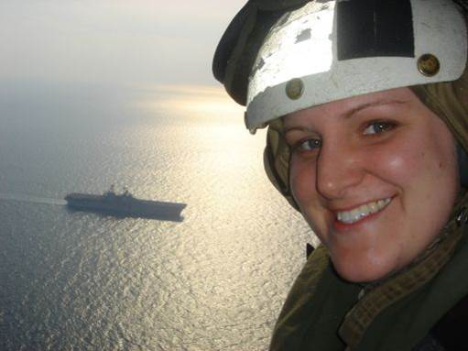
Jenn Zimmerman
Navy veteran
Transfer student
Graduated in 2012

Slide 8
Where we started
Program administered by Registrars Office
Recurring Issues
Incorrect or missing VA-Certification
High Number of debt letters to CLU
Processing by multiple staff members by alphabet
Inconsistent processing, different interpretation of how to process
Frustrations & poor customer service

Slide 9
Cal Lutheran VA Program is born!
First ever Veterans Club
Student lead organization - SVA
Top down leadership support and recognition
Internship to discover best practices for student veterans
Changing the campus climate for veterans
Educating students and staff about unique needs
Establishing new policy and processes

Slide 10
Laying the groundwork
Key points of program
Build a solid foundation
Set goals
Campus cohesiveness
Business Office
Registrars Office
Financial Aid Office
VA Resources
Survey the students
Integrate community resources

Slide 11
Certification Process
Moved the SCO
New online process for students
Moved to a Pre Cert, then cert model
New awarding policies in Financial Aid
New scholarships available

Slide 12
Payment Processing
Exceptions made / not made
Key partners
Road blocks
Different strategies for different chapter benefits
Communication – communication – communication

Slide 13
Snapshot of today
Where we are now
We currently have 110 students, which is on the rise from the previous years.
Changed Yellow Ribbon Program to cover full tuition and fees and unlimited number of students. (Press Release)
Single point of contact on campus
Community Partnerships
Better campus climate for student veterans

Slide 14
The Future Holds…
Working on bringing the VA Vital program to campus
Installing UVIZE, a virtual veteran center
Opening our on campus veteran center in the fall
Long term goals –
Implement early registration for students using GI Bill
Increase enrollment
Strengthen alumni network
Continue to fine tune policy and procedure

Slide 15
End Results
US News Ranking best school for veterans
Articles in local newspapers and military magazines
Students, staff and faculty have a broader understanding of veterans
Increasing enrollment and graduation rates
Customer service improvement
Word of mouth referrals
Happy veterans!

Slide 16
Questions

Slide 17
Resources
The Strategic Student Veteran by David Cass http://www.amazon.com/s/ref=nb_sb_noss?url=search-alias%3Daps&field-keywords=strategic+student+veteran
The UVIZE program virtual veteran center
https://www.uvize.com/
VET NET ALLY
http://web.csulb.edu/divisions/students/veterans_university/awareness.html
The veteran friendly toolkit https://vetfriendlytoolkit.acenet.edu/Pages/default.aspx
SCO Handbook http://www.benefits.va.gov/GIBILL/docs/job_aids/SCO_Handbook.pdf The VA Website
http://www.benefits.va.gov/gibill/
The SCO Hotline for SCO ONLY 1-855-225-1159 Do not give to students
Veteran Success Jam
http://www.acenet.edu/news-room/Pages/Veterans-Jam-2010.aspx
Military Collaborative
http://www.military411.org/
Student Veterans of America
http://www.studentveterans.org/

